Slide 1
Bile duct invasion itself can be the prognosis factor in early HCC
Ye-Rang Jang, Kwang-Woong Lee, Hye-young, Kim, YoungRok Choi,
Suk-Won Suh, Jeong-Moo Lee, Nam-Joon Yi , Kyung-suk Suh
¹Department of Surgery, Seoul National University College of Medicine
Notes:
1.
Thank you Mr. chairperson.
Good afternoon, ladies and gentleman.
Today, I’d like to talk about “Prognosis of the patients with HCC with bile duct invasion”.

Slide 2
INTRODUCTION
Hepatocellular carcinoma
- Aggressive tumor occurs in chronic liver disease and cirrhosis
- Known to progress invasion from vascular to bile duct.
Prognostic factors of HCC
: No globally standardized staging system
- Most variably incorporate features
- The severity of underlying disease (HBV, LC)
- Tumor size (>5cm) and number
- Presence of portal vein thrombosis or invasion
- Extension into adjacent structures
- Presence or absence of metastasis
- Histologic grading
Bile duct invasion?
Notes:
2.
HCC is aggressive tumor that frequently occurs in condition of chronic liver disease and cirrhosis.
Also it is known to progress invasion from vascular to bile duct.
Because of the complicated pathophysiology and treatment, No globally standardized staging and strategy system for HCC is yet established.
Currently Most variably incorporated features to predict the prognosis of HCC are severity of underlying liver disease, Tumor size and number, Presence of protal vein thrombosis or invasion, Extension into adjacent structures, Presence or absence of metastasis, and histologic grading.

Slide 3
INTRODUCTION
HCC with bile duct invasion
Much more RARE than vascular invasion and NOT WELL CHARACTERIZED nor studied.
Previous Reports of HCC with bile duct thrombus
Author | Year | Number of HCC patients with bile duct thrombus (frequency) | Case background | Outcome (overall survival)
Kojiro et al. | 1982 | 24 (9.3%) | Autopsy and surgical cases | Worse than HCC patients without bile duct invasion
Lau et al. | 1997 | 49 (1.9%) | Surgical and non-surgical cases | Similar to HCC patients without clinical jaundice
Satoh et al. | 2000 | 17 (2.5%) | Surgical cases | Similar to HCC patients without bile duct thrombus
Shiomi et al. | 2001 | 17 (12.9%) | Surgical cases | Similar to HCC patients without bile duct thrombus
Yeh et al. | 2004 | 17 (3.0%) | Surgical cases | Worse than HCC patients without bile duct thrombus
Qin et al. | 2004 | 34 (0.8%) | Surgical cases | -
Naoki et al. | 2009 | 15 (5.5%) | Surgical cases | Worse than HCC patients without bile duct thrombus
Zeng et al. | 2015 | 37 (3.6%) | Surgical cases | Worse than HCC patients without bile duct thrombus
→The prognosis of HCC patients with biliary tumor thrombus is till in CONTROVERSY
Notes:
3.
HCC with bile duct invasion, previously called icteric HCC is much more rare than vascular invasion and not well characterized nor studied until recently.
In 2004 Chu-Nan Yeh first studied about HCC with bile duct invasion, in his study Patients with bile duct invasion showed poor survival.
In addition, in 2009, Noake studied HCC with bile duct invasion by grouping into Intrahepatic and extrahepatic invasion, the study showed same conclusion with Yeh’s, further more, the patients with extrahepatic bile duct invasion showed poor progress.

Slide 4
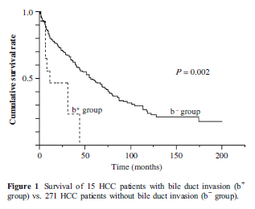
INTRODUCTION
HCC with bile duct invasion
J Gastrointest Surg 2009; 13: 482-497, Naoke Ikenaga, et al.
Medicine 2015; 94(1):e364 Hong Zeng, et al.
HCC with bile duct invasion had an INFILTRATIVE nature
Favorable long-term outcome after CURATIVE(EXTENDED) hepatic
resection could be achieved
Notes:
3.
HCC with bile duct invasion, previously called icteric HCC is much more rare than vascular invasion and not well characterized nor studied until recently.
In 2004 Chu-Nan Yeh first studied about HCC with bile duct invasion, in his study Patients with bile duct invasion showed poor survival.
In addition, in 2009, Noake studied HCC with bile duct invasion by grouping into Intrahepatic and extrahepatic invasion, the study showed same conclusion with Yeh’s, further more, the patients with extrahepatic bile duct invasion showed poor progress.

Slide 5
INTRODUCTION
Purpose
- To PRESENT the CHARACTERISTICS of HCC
with bile duct invasion .
- To COMPARE the PROGNOSIS of HCC with
bile duct invasion with other prognostic
factors .
Notes:
4.
Therefore, the purpose of this study was to present the characteristics of HCC with bile duct invasion
and to compare the prognosis of HCC with bile duct invasion with other prognostic factors

Slide 6
METERIALS and METHODS
Patients
Jan.2009~ Dec. 2011, at SNUH
363 HCC (pathologic proven) patients who underwent surgical resection
13 proved to have bile duct invasion on pathologic findings
Subgrouping by the pathologic T-staging (by AJCC)
(early : T-stage 1,2 / advanced : T-stage 3,4)
Compare the characteristics and prognosis
Recurrence : 260 (71.6%) recurred, 103 (28.4) not recurred
Survival : 71 (19.6%) expired, 292 (80.4%) survived
Follow-up
- Median follow up : 3.5 yrs.
Follow up : 1, 3, 6 months → every 6 months
CT, MRI, USG, Tumor marker, Liver function test
Notes:
5.
Between 2009~2011, 169 patients underwent hepatectomy due to HCC in Seoul national university hospital
Among them, 9 patients were proved to have bile duct invasion on pathologic findings
47 patients underwent hemihepatectomy, 55 sectionectomy, 57 tumorectomy and 10 other operation
Follow up was done from the day of operation to laost OPD f/u
The median follow up was 2.5 years
During the follow up, 99 patients were recurred and 19 patients were expired

Slide 7
RESULTS
Characteristics of the patients with bile duct invasion
Table1 ) Characteristics of patients with bile duct invasion
 | Bile duct invasion
 | Yes (n=13) | No (n=350)
Age (year, mean ± SD) | 57.15±7.07 | 56.39±9.80
Sex (male : female) | 11 : 2 | 288 : 62
Etiology (underlying liver disease) | HBV : 11 (84.6%) None : 2 (15.4%) | HBV : 288 (82.3%), HCV : 12 (3.4%) Others : 14 (3.7%), None : 36 (10.3%)
Preop AFP (ng/mL) | 4328.7±9794 | 9981.4±55587
Preop AFP >200 | 5 (38.5%) | 113 (32.3%)
Preop PIVKA-II (uAU/mL) | 7745.9±13225 | 3721.1±16203
Preop PIVKA-II >400 | 10 (76.9%) | 97 (27.7%)
Preop T-Bil. | 2.20±4.06 | 1.29±2.37
Notes:
7.
This table shows the corrrelation between the recurrence and variables.
The patients with bile duct invasion showed 89% of recurrence
These graphs are univariate analysis of the recurrence.
The graphs indicate that patients with bile duct and vascular invasion had more chance to recur.

Slide 8
RESULTS
Characteristics of the patients with bile duct invasion
Table1 ) Characteristics of patients with bile duct invasion
 | Bile duct invasion
 | Yes (n=13) | No (n=350)
Operation | Ext. hemihepatectomy : 4 (30.8%) Hemihepatectpmy : 7 (53.8%) Segmentectomy : 1 (7.7%) Tumorectomy : 1 (7.7%) | Ext. hemihepatectomy : 11 (3.1%) Hemihepatectomy : 86 (24.6%) Sectionectomy : 68 (19.4%) Segmentectomy : 65 (18.6%) Tumorectomy : 120 (34.3%)
Tumor size (cm) | 6.53±3.83 | 5.15±3.72
Histologic grade (E-S grade) | 2.77±0.59 | 2.42±0.71
Pathologic T-staging (AJCC) | 2.69±0.85 | 1.69±0.78
Microvascular invasion | 11 (84.6%) | 150 (42.9%)
Recur | 13 (100%) | 247 (70.6%)
Expired | 6 (46.2%) | 65 (18.6%)
Notes:
7.
This table shows the corrrelation between the recurrence and variables.
The patients with bile duct invasion showed 89% of recurrence
These graphs are univariate analysis of the recurrence.
The graphs indicate that patients with bile duct and vascular invasion had more chance to recur.

Slide 9
RESULTS
Risk factors for tumor recurrence
Table2 ) Risk factors for tumor recurrence
 | Recurrence (+) (N=260) | Recurrence (-) (N=103) | Univariate P | Multivariate P | Risk ratio (90% CI)
Age | 56.87±10.0 | 56.4±9.7 | 0.713
Sex | 212 : 48 | 87 : 16 | 0.714
Preop AFP (>200) | 88 (33.8%) | 29 (28.2%) | 0.177
Preop PIVKA-II (>400) | 86 (33.1%) | 21 (20.3%) | 0.017
Size (>5cm) | 102 (39.2%) | 28 (27.2%) | 0.002 | 0.061 | 1.804 (0.954-3.413)
T-stage (1&2 : 3&4) | 212 : 48 | 91 : 12 | 0.002 | 0.067 | 2.664 (0.857-8.282)
Bile duct invasion | 11 (4.2%) | 2 (11.7%) | 0.051 | 0.065 | 23.53 (0.00- )
Microvascular invasion | 128 (49.2%) | 34 (33%) | 0.006
Poor E-S grade (gr. 3&4) | 204 (78.5%) | 71 (68.9%) | 0.115
Notes:
7.
This table shows the corrrelation between the recurrence and variables.
The patients with bile duct invasion showed 89% of recurrence
These graphs are univariate analysis of the recurrence.
The graphs indicate that patients with bile duct and vascular invasion had more chance to recur.

Slide 10
RESULTS
Risk factors for Survival
Table3 ) Risk factors for survival
 | Expired (N=71) | Survival (N=292) | Univariate P | Multivariate P | Risk ratio (90% CI)
Age | 55.97±10.47 | 56.55±9.52 | 0.650
Sex | 60 : 11 | 239 : 53 | 0.599
Preop AFP (>200) | 40 (56.3%) | 78 (26.7%) | 0.157 | 0.009 | 2.239 (1.224-4.097)
Preop PIVKA-II (>400) | 37 (52.1%) | 70 (24%) | 0.189
Size (>5cm) | 45 (63.3%) | 85 (29.1%) | 0.042
T-stage (1&2 : 3&4) | 40 : 31 | 263 : 29 | 0.001 | 0.001 | 4.704 (2.428-9.115)
Bile duct invasion | 7 (9.9%) | 6 (2%) | 0.001
Microvascular invasion | 54 (76%) | 108 (37%) | 0.001 | 0.015 | 2.267 (1.170-4.393)
Poor E-S grade (gr. 3&4) | 66 (93%) | 209 (71.6%) | 0.096 | 0.006 | 3.088 (1.296-7.360)
Notes:
7.
This table shows the corrrelation between the recurrence and variables.
The patients with bile duct invasion showed 89% of recurrence
These graphs are univariate analysis of the recurrence.
The graphs indicate that patients with bile duct and vascular invasion had more chance to recur.

Slide 11
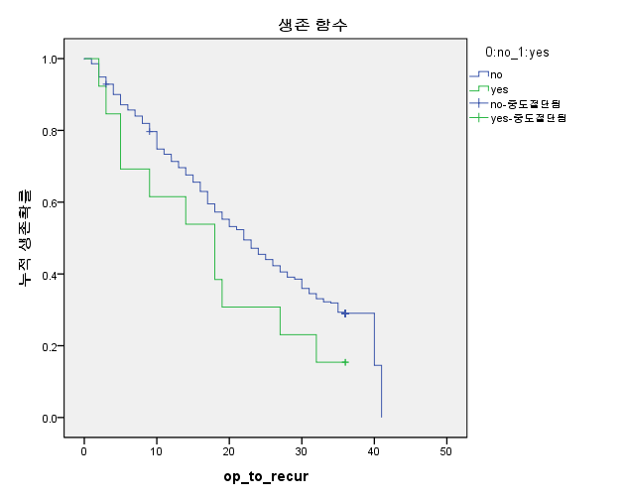
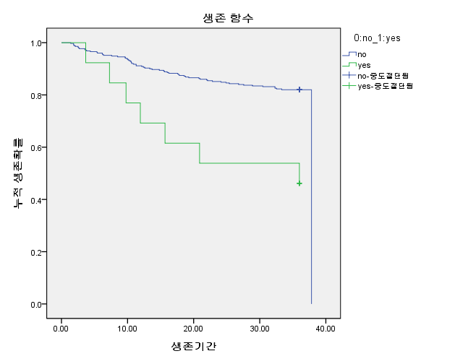
RESULTS
Recurrence and survival curve of BD invasion
[Recurrence]
[Survival]
Without bile duct invasion
With bile duct invasion
95.6%
83.5%
68.7%
71.2%
56.8%
57.3%
34.6%
18.4%
Figure1 ) a) Overall DFS curve of BD invasion, b) Overall Survival curve of BD invasion
Notes:
7.
This table shows the corrrelation between the recurrence and variables.
The patients with bile duct invasion showed 89% of recurrence
These graphs are univariate analysis of the recurrence.
The graphs indicate that patients with bile duct and vascular invasion had more chance to recur.

Slide 12
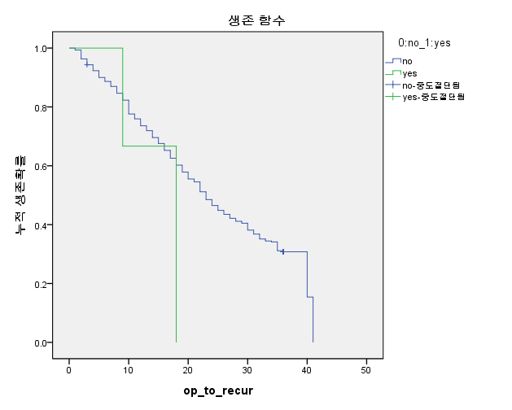
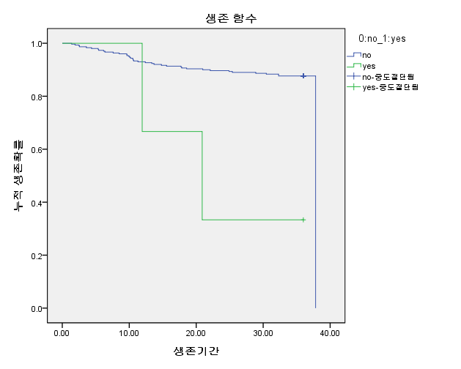
RESULTS
Recurrence and survival curve of BD invasion
(by subgrouping : T1 & T2)
[Recurrence]
[Survival]
Without bile duct invasion
With bile duct invasion
92.7%
86.8%
77.6%
64.5%
63.4%
35.3%
Figure2 ) a) DFS curve of BD invasion for T-stage 1&2 b)Survival curve of BD invasion for T-stsage 1&2
Notes:
7.
This table shows the corrrelation between the recurrence and variables.
The patients with bile duct invasion showed 89% of recurrence
These graphs are univariate analysis of the recurrence.
The graphs indicate that patients with bile duct and vascular invasion had more chance to recur.

Slide 13
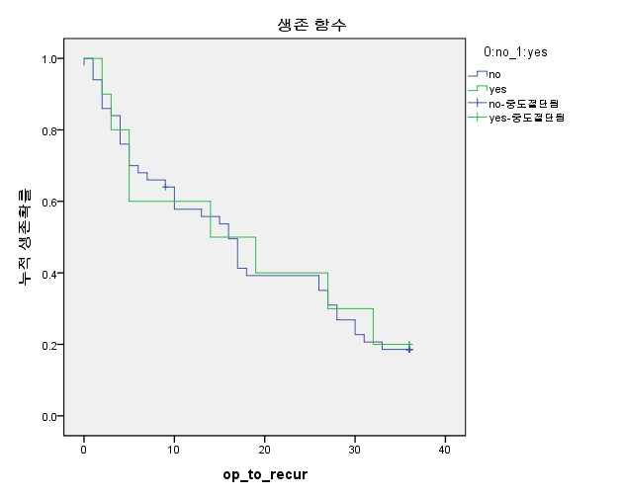
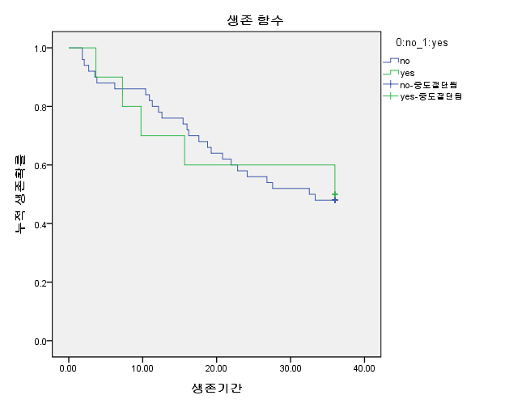
RESULTS
Recurrence and survival curve of BD invasion
(by subgrouping : T3 & T4)
[Recurrence]
[Survival]
Without bile duct invasion
With bile duct invasion
Figure3 ) a) DFS curve of BD invasion for T-stage 3&4 b)Survival curve of BD invasion for T-stage 3&24
Notes:
7.
This table shows the corrrelation between the recurrence and variables.
The patients with bile duct invasion showed 89% of recurrence
These graphs are univariate analysis of the recurrence.
The graphs indicate that patients with bile duct and vascular invasion had more chance to recur.

Slide 14
RESULTS
13 BD invased patients
Table4) 13 Bile duct invased patients
Sex/age | Etiology | Preop T. Bil | Preop BD invasion level | Preop Tx. | Path. T-stage | Microvascular invasion | Path. necrosis | recurrence | survival
M/50 | HBV | 1.2 | Stage 4 | None | 3 | Yes | 0% | Recurred | Survived
M/57 | HBV | 1.1 | Stage 3 | None | 3 | Yes | 3% | Recurred | Survived
M/59 | HBV | 1.0 | None | None | 1 | No | 60% | Recurred | Survived
M/43 | HBV | 15.6 | Stage 3 | None | 3 | Yes | 10% | Recurred | Expired
M/67 | HBV | 1.0 | Stage 2 | None | 1 | No | 80% | Recurred | Expired
M/58 | HBV | 0.4 | Stage 2 | PEIT | 2 | Yes | 20% | Recurred | Expired
F/57 | HBV | 0.6 | Stage 3 | TACE | 3 | Yes | 55% | Recurred | Expired
F/65 | HBV | 0.4 | Stage 2 | TACE | 3 | Yes | 60% | Recurred | Expired
M/55 | HBV | 0.7 | None | None | 3 | Yes | 7% | Recurred | Survived
M/69 | HBV | 1.4 | Stage 4 | TACE | 3 | Yes | 60% | Recurred | Survived
M/51 | None | 1.5 | Stage 4 | TACE/PTBD | 4 | Yes | 0% | Recurred | Survived
M/56 | None | 2.4 | Stage 3 | PTBD | 3 | Yes | 5% | Recurred | Survived
M/56 | HBV | 1.3 | Stage 2 | RFA | 3 | Yes | 60% | Recurred | Expired
Notes:
7.
This table shows the corrrelation between the recurrence and variables.
The patients with bile duct invasion showed 89% of recurrence
These graphs are univariate analysis of the recurrence.
The graphs indicate that patients with bile duct and vascular invasion had more chance to recur.

Slide 15
CONCLUSION
- Bile duct invasion accompanies vascular
invasion in most cases.
In T-stage 1 and 2, by T-staging subgrouping, bile duct invasion CAN BE the independent prognosis factor.
Curative resection can be more important than preoperative treatment or preoperative bile duct invasion level in bile duct invased HCC.
Notes:
11.
In conclusion,
The bile duct invasion acoompanies vascular invasion in most cases
Bile duct invasion itself is not the independent prognosis factor in HCC.
On the other hand, In T-stage 1and2, by T-staging subgrouping, bile duct invasion can be the independent prognosis factor.
Validation study with larger population is needed in the future.
Thank you

