Slide 1
Post-treatment Follow-up Protocol and Management <Trend of HCC in Korea>
Hae Won Lee MD. PhD.
Seoul National University College of Medicine
Notes:
Thank you, Professor Park.
Good afternoon, ladies and gentlemen.
My topic is post-treatment follow-up protocol and management.

Slide 2
Contents
HCC recurrence and risk factors
Adjuvant therapy after treatment
Surveillance for recurrence
Notes:
I will present three subtopics.
The first is HCC recurrence and risk factors.
The Second’s adjuvant therapy after treatment.
And the last is recurrence surveillance during follow-up.

Slide 3
Recurrence
Extrahepatic recurrence
Less common compared to other solid tumors
Lung, abdominal lymph node, bone, adrenal
<Katyal S, et al. Radiology 2000>
Intrahepatic recurrence
Intrahepatic metastasis (IM)
True recurrence from original tumor
Multicentric occurrence (MO)
Multicentric carcinogenesis
De novo HCC
Notes:
HCC is less likely to develop extrahepatic distant metastasis compared to other solid tumors.
The most common site of metastasis is the lung, followed by lymph nodes, bones and the adrenal glands.
On the other hand, intrahepatic recurrence is very common after HCC treatment.
As you know, intrahepatic recurrence can be caused by two different mechanisms.
One is intrahepatic metastasis, which is true recurrence from the original tumor.
It occurs by means of the marginal recurrence or portal dissemination.
The other recurrence pattern is multicentric occurrence.
Multicentric occurrrence is newly developed de novo HCC from underlying carcinogenic liver.

Slide 4
Differentiation between IM and MO
By analysis of genetic backgrounds
Analysis of microsatellite polymorphisms
Comparative genomic hybridization
X chromosome inactivation assays
Integration pattern of hepatitis B virus
DNA fingerprinting using loss of heterozygosity assays
DNA microarray
<Finkelstein SD, et al. Hepatology. 2003>
<Huang et al. Ann Surg Oncol. 2012>
Notes:
There are several methods to differentiate between intrahepatic metastasis and multicentric occurrence.
The definite method is the analysis of genetic backgrounds.
However, these methods are rarely used in clinical practice because they are complex and time consuming.

Slide 5
Differentiation between IM and MO
By histopathologic finding
Modified MO criteria
<Matsuda M, et al. J Hepatobiliary Pancreat Surg. 2001>
The recurrent tumor consists of well-differentiated HCC only
The recurrent tumor has precancerous lesions or well-differentiated HCC around the less differentiated HCC and shows a ‘‘nodule-in-nodule’’ form
All components of the recurrent HCC show higher differentiation than the primary resected tumors.
Recurrent HCC showing either the same or less differentiation than the primary resected tumors was diagnosed as IM.
Notes:
Another method is histopathologic differentiation.
This method was introduced by the Liver Cancer Study Group of Japan in 2001 and a more convenient method.
However, histopathologic method as well as genetic background analysis require the recurrent tumor tissue by biopsy or re-resection.
So, many clinicians usually use a cruder method in practice.

Slide 6
Differentiation between IM and MO
Decision in clinical practice
By recurrence timing
Early recurrence → IM
Late recurrence → MO
Actually, frequently used by clinicians
The crude cut-off
2 years after curative treatment
Not an absolute point
Usually accepted
Notes:
Actually in clinical practice, simply, early recurrence is usually considered as intrahepatic metastasis and late recurrence is considered as multicentric occurrence.
There is no established cut-off time between early and late recurrence.
But 2 years is a generally accepted consensus.

Slide 7
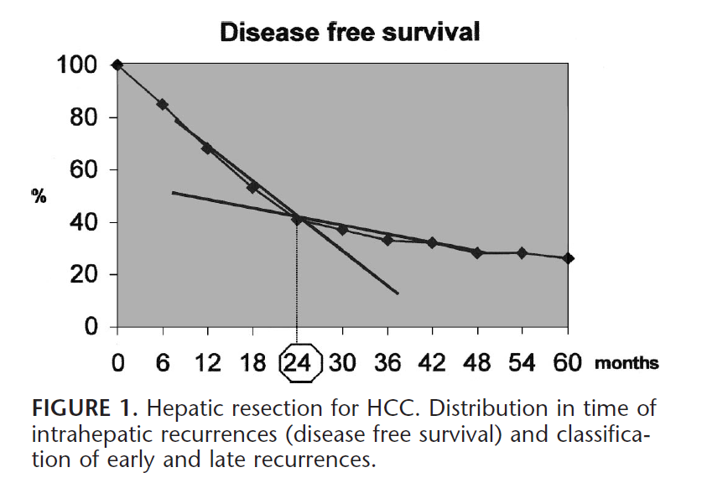
<Portonali N, et al. Ann Surg. 2006>
Notes:
In 2006, Portonali and colleagues suggested the cutoff of two years.
They performed linear regression using disease-free survival curves after HCC resection.
In early period, the slope of the disease-free survival curve is steep and then it’s getting gentle.
So, they suggested twenty four months as the cutoff to separate early and late recurrences, which is the cross point of two linear regression lines.

Slide 8
<Huang et al. Ann Surg Oncol. 2012>
Notes:
Huang and colleagues actually compared primary and recurrent tumors by the histopathologic method.
This is the recurrence of intrahepatic metastasis and this is the recurrence of multicentric occurrence.
As you can see, within 2 years after initial resection, more than ninety percent of intrahepatic metastasis showed up while only 20% of multicentric occurrences developed within 2 years.
Therefore, two years could be acceptable as the crude cut-off point in the clinical setting.

Slide 9
Recurrence Timing & Prognosis
Early recurrence
More frequent and mostly IM
Poor prognosis even after repeat curative treatment
→ Re-resection is not strongly recommended
Late recurrence
Less frequent and mostly MO
More favorable than IM
Relatively good response to repeat curative treatment
→ Re-resection could be considered according to patient’s conditions
Notes:
Differentiation between intrahepatic metastasis and multicentric occurrence is clinically important because not only mechanisms and timing but also prognosis and risk factors are different.
Late recurrence has better prognosis and could be re-resected according to patient’s conditions.
On the other hand, early recurrence, mostly intrahepatic metastasis has poor prognosis even after repeat curative treatment.
So, re-resection is not strongly recommended for early recurrence.

Slide 10
<Huang et al. Ann Surg Oncol. 2012>
Notes:
This is the same study I mentioned before.
Ninety percent of intrahepatic metastasis recurred within one year after repeat hepatic resection.
And two year overall survival was only about twenty percent even after re-resection.

Slide 11
Risk Factors for Recurrence
Tumor-related factors
Number and size of tumors,
Differentiation
Vascular invasion
Preoperative serum AFP and PIVKA-II
: Associated with IM
→ Should pay attention to early recurrence in patients with tumor-related risk factors
Notes:
Risk factors associated with HCC recurrence are also divided to two different categories.
One is tumor-related factors.
The number and size of tumors, tumor differentiation, vascular invasion, and preoperative serum AFP and PIVKA-II levels are included in this category.
And, as you can expect, tumor-related risk factors are associated with intrahepaic metastases.
So, we should pay attention to early recurrence in patients with tumor-related risk factors.

Slide 12
Risk Factors for Recurrence
Underlying disease-related factors
Liver cirrhosis
Activity of hepatitis
Preoperative serum HBV DNA level
: Increase the risk of MO (late recurrence)
→ Should condiser de novo HCC in patients with underlying disease-related risk factors
→ Should try to control the underlying liver condition
Notes:
The other category of risk factors is underlying disease-related factors.
Liver cirrhosis, activity of hepatitis and preoperative serum HBV DNA level are included in this category.
And, these increase the risk of multicentric occurrence.
So, in patients with underlying disease-related risk factors, we should consider de novo HCC and try to control the underlying liver condition

Slide 13
Adjuvant Therapy for HCC Recurrence
Adjuvant therapies for early recurrence
Aim to suppress tumor cell
Systemic chemotherapy
Hepatic artery infusion chemotherapy
TACE / TARE
Adjuvant therapies for late recurrence
Aim to control hepatitis
Interferon
Nucleos(t)ide analogues (NA)
Notes:
I move to the second topic, adjuvant therapy.
As I said before, not only HCC recurrence mechanisms but also risk factors are differentiated to two different types.
So, adjuvant therapies can be categorized as two groups as well.
Adjuvant therapies for early recurrence aim to suppress tumor cell, that is, anti-tumor therapy is needed.
Systemic chemotherapy, arterial infusion chemotherapy and TACE, TARE are included in this group.
On the other hand, adjuvant therapies for late recurrence aim to control hepatitis, that is, anti-viral therapy is needed.
Interferon or nucleoside analogues can be used with this intent.

Slide 14
Anti-tumor Adjuvant Therapy
No available evidence for the effectiveness
Conventional systemic chemotherapy
TACE or TARE
Targeted agents like sorafenib
Effective for advanced HCC
<Llovet JM, et al. N Eng J Med. 2008.>
<Cheng AL, et al. Lancet Oncol. 2009.>
The only promising agents, up to date
Several clinical studies are underway.
Notes:
Unfortunately, conventional systemic chemotherapy, TACE and TARE are not effective to prevent HCC recurrence according to available evidence.
Only targeted agents like sorafenib is promising because some studies showed the effectiveness of sorafenib for advanced HCC.
And, several clinical studies with these agents are underway now.

Slide 15
Efficacy of Sorafenib as Adjuvant Therapy - A Pilot Study-
Wang SN, et al. from Taiwan in 2013
Two-arm, open-label, controlled phase II study
Only high risk HCC enrolled after curative resection
(with poorly differentiation, microvascular invasion and/or microscopic satellites)
Adjuvant therapies
Sorafenib group (n=14): 400mg qd for 4 months from postoperative 14th day
Control group (n=17): no drug
Notes:
According to one pilot study reported from Taiwan in 2013,
When sorafenib was given to high risk patients after resection, it improved the disease-free survival.

Slide 16
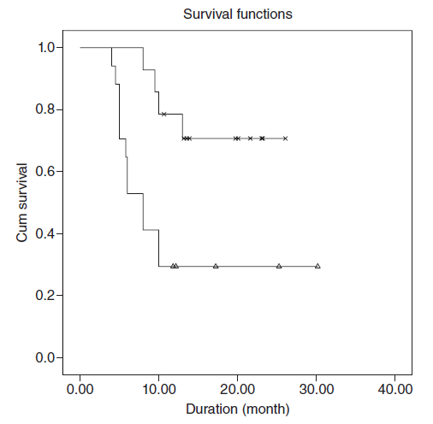
- Time to Recurrence -
Sorafenib : 21.45 months
Control : 13.44 months
P-value = 0.032
<Recurrence-free Survival>
Notes:
Time to recurrence was significantly long in the sorafenib group compared to the control group.

Slide 17
STORM (NCT00692770)
Official title: A Phase III Randomized, Double-blind, Placebo-controlled Study of Sorafenib as Adjuvant Treatment for Hepatocellular Carcinoma After Surgical Resection or Local Ablation
234 centers of 27 countries participated in
Participant recruitment : 15 Aug 2008 ~ 12 Nov 2010
Study completion : Nov 2014
Management
Sorafenib : oorafenib 400mg bid (2 tablets)
Placebo : placebo 2 tablets bid
From randomization up to 4 years or until disease recurrence whichever came first
Notes:
However, one international, multicenter study with large scale has been just completed.
You know, it’s STORM study.
STORM study is a phase three randomized, double-blind, placebo-controlled study of sorafenib as adjuvant treatment for HCC after surgical resection or local ablation.
Two hundred thirty four centers from twenty seven counties participated in this study.
The study was completed in November 2014.
And you can find the results on the website, clinicaltraials.gov.

Slide 18
Participant Flow: Overall Study
 | Sorafenib | Placebo
STARTED | 556 | 558
Participants Received Treatment | 553 | 554
COMPLETED | 82 | 107
NOT COMPLETED | 474 | 451
Protocol Violation | 2 | 7
Withdrawal by Subject | 93 | 35
Adverse Event | 133 | 41
Death | 10 | 5
Lost to Follow-up | 7 | 3
Non-compliant with study medication | 11 | 5
Randomized but not treated | 3 | 4
Progression by clinical judgment | 2 | 3
Physician decision not protocol driven | 2 | 1
Disease progression, recurrence/relapse | 165 | 274
Protocol driven decision point | 3 | 0
Completed all planned assessments | 35 | 65
Radiological and clinical progression | 8 | 8
Notes:
More than five hundred participants were enrolled in each arm.

Slide 19
Primary Outcome: Recurrence-free survival
Event : recurrence, death
 | Sorafenib | Placebo | P-value
Recurrence-free survival (days) | 1,014 ( 839 to 1339 ) | 1,026 ( 841 to 1185 ) | 0.2583
Secondary Outcome: Time to recurrence
Event : recurrence (death censored)
 | Sorafenib | Placebo | P-value
Time to recurrence (days) | 1,172 ( 924 to NA ) | 1,089 ( 923 to 1260 ) | 0.1214
※ Data were expressed as median (95% confidence interval)
Notes:
However, the results are disappointing.
Time to recurrence was a little better in sorafenib group.
But the difference was not significant.
Therefore, up to date, there is no definite evidence of the effectiveness of sorafenib adjuvant therapy.

Slide 20
Inteferon Adjuvant Therapy
Potentially tumoricidal, antiangiogenetic and antiproliferative effects as well as viral suppressive effect
For HCV, evidently effective in some randomized controlled trials and systematic reviews
Not definite effect for HBV
<Shen YC, et al. J Hepatol. 2010>
<Huang TS, et al. J Viral Hepat. 2013>
Notes:
As an anti-viral adjuvant therapy, interferon was tried in many studies because interferon has potentially anti-tumor effect as well as viral suppressive effect.
Some randomized controlled study and systematic review reported that interferon adjuvant therapy was effective for patients with HCV although its effectiveness was not definite for HBV.

Slide 21
Interferon Adjuvant Therapy
Problems
Restricted due to serious side-effects in many cases
Less effect for advanced HCC
No consensus about adjuvant interferon regimens
(e.g. dose, timing, duration of treatment)
Not routinely recommended even for patients with HCV-related HCC
Should be considered only in selected patients
Notes:
However, interferon frequently complicates serious side effects and it is less effective for advanced HCC.
In addition, there is no consensus about adjuvant interferon regimens.
So, interferon adjuvant therapy is not routinely recommended even for HCV patients.

Slide 22
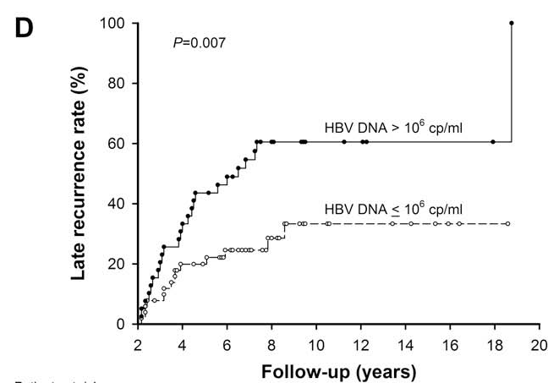
NA Adjuvant Therapy
High HBV viral loads may be associated with late recurrence of HCC.
<Wu JC, et al. J Hepatol. 2009>
Pre- and post-operative antiviral therapies may be potentially crucial in reducing late recurrence.
Notes:
In HBV patients, high HBV viral loads may be associated with late recurrence of HCC.
In many studies, the patients with high HBV DNA level had high recurrence rate during late period.
Thus, pre- and post-operative antiviral therapies may be potentially crucial in reducing late recurrence.

Slide 23
NA Adjuvant Therapy
However, up to date, the results are conflicting.
A large-scale investigation is required to clarify the effects of antiviral therapy with NAs, particularly new agents (ETV or TDF).
Author | Year | No of Pts | Study design | Drug | Conclusion | Weak point
Kuzuya T, et al | 2007 | 49 | Retrospective | LAM | Not effective | Including patients with low HBV level
Chuma M, et al | 2009 | 103 | Retrospective | LAN±ADV ETV | Effective | Short-term (3-year)
Li N, et al | 2010 | 79 | Prospective Non-randomized | LAM±ADV | Not effective | Short-term (2-year)
Urata Y, et al | 2012 | 70 | Retrospective | LAN±ADV ETV | Effective | Not independent
Notes:
However, up to date, the results are conflicting.
Most studies have some weak points in their conclusion.
There is no well-designed comparative study.
A large-scale investigation is required to clarify the effects of antiviral therapy with nucleosides analogues, particularly new agents, entecavir or tenofovir.

Slide 24
NA Adjuvant Therapy
Recommendation at the present situation
ETV or TDF adjuvant therapy in patients with high HBV DNA level (>2,000 IU/mL)
Rationale
Potent agents with low drug resistant & complication rates
Covered by health insurance
Although NAs could not reduce HCC recurrence rate, they could promote postoperative viral clearance, maintain liver function, thereby significantly enhance tolerance to subsequent curative therapies for HCC recurrence.
Notes:
Nonetheless, I recommend entecavir or tenofovir adjuvant therapy in patients with high HBV DNA level more than two thousand IU/mL.
Because those agents have low resistance rate and low complication rate and can be covered by health insurance.
And the most important thing is this.
Although nucleosides analogues could not reduce HCC recurrence rate, they could promote postoperative viral clearance, maintain liver function, thereby significantly enhance tolerance to subsequent curative therapies for HCC recurrence.

Slide 25
Surveillance for Recurrence
Surveillance protocol
How long interval ?
What modalities ?
→ Not established
Notes:
The last topic is the surveillance after treatment.
There are two questions about this.
How long interval is proper?
What modalities are needed?
Of cause, there is no answer, no consensus
It is very different according to countries, centers and clinicians.

Slide 26
Surveillance Interval
6 months
Recommend screening interval for general population with HCC risk factors
Not for recurrence but for de novo HCC development
Surveillance interval for HCC recurrence
Should be shorter than 6 months at least in the early period when IM are frequent
Notes:
As you know, six months is the screening interval recommended for general population with HCC risk factors.
It’s not for recurrence but for de novo HCC.
Thus, recurrence surveillance interval should be shorter than 6 months at least in the early period when intrahepatic metastasis frequently develops.

Slide 27
Surveillance Interval
Up to 2 years after curative treatment
More frequent recurrence, IM ≫ MO
Aim to early detect IM to obtain the best prognosis by early interventions
3-4 months recommended according to patient’s risk factors
After post-treatment 2 years
Less frequent recurrence, IM ≪ MO
Could be extended to 6 months
Notes:
Within 2 years after treatment, recurrence is frequent and intrahepatic metastases are predominant.
Surveillance should aim to early detect intrahepatic metastasis.
So, I recommend three to four month interval.
And it should be adjusted according to patients’ risk factors.
However, after 2 year, recurrence rate decreases and multicentric occurrences are predominant.
HCC recurrence risk may be similar to general screening situations.
So, surveillance interval could be extended to 6 months.

Slide 28
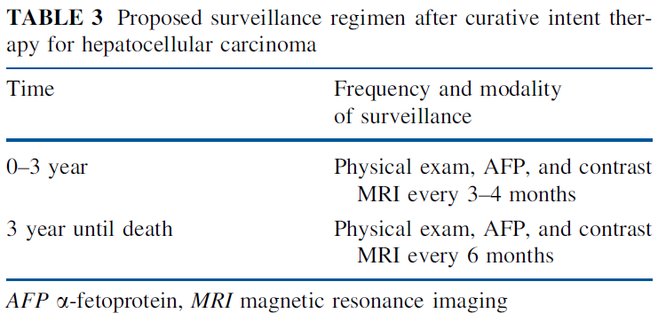
Surveillance Modalities
<Hatzaras I, et al. Ann Surg Oncol. 2013.>
Imaging studies + tumor markers
Generally accepted standard
Add the laboratory test on liver function and viral status for the check of underlying liver condition
Notes:
This is one of surveillance recommendations suggested by Hatzaras and colleagues.
They follow-up at the interval of 3 to 4 months up to three years after treatment.
After then they do at the interval of 6 months.
They use AFP and MRI as surveillance modalities.
Imaging studies and tumor markers are generally accepted standard of surveillance.
And, liver function test and viral quantification can be added to check underlying liver condition.

Slide 29
Surveillance Imaging
Dynamic studies strongly recommended
Dynamic contrast-enhanced CT or MRI, or MRI with liver specific contrast agents
Conventional USG not suitable
Chest CT, PET, bone scan
Not routinely recommended
Could be considered in cases with suspicious conditions
Notes:
I think during recurrence surveillance, non-contrast imaging like sonography is not suitable.
Dynamic contra-enhanced CT or MRI or MRI with liver specific contrast agents is strongly recommended.
Chest CT, PET or bone scan is not routinely recommended but could be performed to investigate extrahepatic recurrence in cases with suspicious conditions.

Slide 30
Gd-EOB-DTPA MRI
MRI with liver specific contrast agents
Highly sensitive to subcentimeter HCC
Problems
Many false positive
Health insurance coverage
Not established effect of Gd-EOB-DTPA MRI on patient’s survival
Can be recommended once or twice per year as a complement to CT under the coverage of health insurance.
Notes:
Gd-EOB-DTPA, that is, Primovist MRI is highly sensitive to subcentimeter HCC.
Using Primovist MRI, early detection of small HCC could be possible.
However, false positive rate is high and health insurance coverage is limited.
Most of all, it is not clear whether the early detection of small HCC by Primovist MRI could improve the patient’s survival or not.
So, I don’t recommend the routine use of MRI.
But, MRI can be used once or twice per year as a complement to CT within the coverage of health insurance.

Slide 31
Tumor Markers
AFP
A well-known, traditional tumor marker
AFP is associated with tumor differentiation and prognosis
PIVKA-II (DCP)
A recently used tumor marker
Reported to be associated microvascular invasion by some studies
Tumor marker follow-up
Recommended in all cases including cases with normal level before treatment for surveillance on de novo HCC as well as true recurrence
AFP ± PIVKA-II
Notes:
As you know, the tumor markers of HCC are AFP and PIVKA.
Some clinicians use only AFP.
Some clinicians use PIVKA as well.
Although further studies are needed to clarify the efficacy of PIVKA, I usually check PIVKA as a complement to AFP.
Generally, tumor marker follow-up has an advantage only when the tumor marker increased preoperatively.
However, I recommend tumor marker follow-up in all HCC cases including cases with normal level before treatment.
Because unlikely to other solid tumors, we should monitor de novo HCC as well as true recurrence.

Slide 32
My Surveillance Protocol (for patients with intermediate risk)
Time after treatment | Interval | Modalities
 |  | Imaging | Lab
Up to 2 year | 3 months | CT (MRI: 1-2/year) | CBC, LFT, PT AFP, PIVKA-II, (HBV DNA in HBV patients)
2 to 5 year | 4 months | CT (MRI: /1-2 years) | CBC, LFT, PT AFP, PIVKA-II, (HBV DNA in HBV patients)
After 5 years | 6 months | USG | CBC, LFT, PT AFP, PIVKA-II, (HBV DNA in HBV patients)
Notes:
This is my actual surveillance protocol.
I like frequent follow-up.
My surveillance interval is 3 months up to 2 years, 4 months to 5 years and after then 6 months.
But, It’s just mine, not recommendation.

Slide 33
Summary I
Within 2 years after curative HCC treatment, recurrence is more frequent and intrahepatic recurrence is mostly IM, which is associated with tumor-related risk factors.
After 2 years from HCC treatment, recurrence is less frequent and intrahepatic recurrence is usually caused by MO, which is associated with liver disease-related risk factors.
Aggressive treatments with curative intent could be considered for late recurrence, which shows relatively good prognosis.
Notes:
In summary,
Within 2 years after curative HCC treatment, recurrence is more frequent and intrahepatic recurrence is mostly IM, which is associated with tumor-related risk factors.
After 2 years from HCC treatment, recurrence is less frequent and intrahepatic recurrence is usually caused by MO, which is associated with liver disease-related risk factors.
Aggressive treatments with curative intent could be considered for late recurrence, which shows relatively good prognosis.

Slide 34
Summary II
Although targeted agents are promising as an adjuvant therapies, there is no definite evidence revealed up to date.
Antiviral adjuvant therapy with ETV or TDF is recommended after HCC treatment in patient with high HBV DNA level.
Although there is no established recurrence surveillance protocol, the surveillance test should include dynamic imaging and tumor markers and should be performed at the intervals of 3-4 months at least up to 2 years after treatment.
Notes:
Although targeted agents are promising as an adjuvant therapies after HCC treatment, there is no definite evidence revealed up to date.
Antiviral adjuvant therapy with ETV or TDF is recommended after HCC treatment in patient with high HBV DNA level.
Although there is no established recurrence surveillance protocol, the surveillance test should include dynamic imaging and tumor markers and should be performed at intervals of 3-4 months at least up to 2 years after treatment.

Slide 35
Thank you for your attention

