Slide 1
LOXL2 is required for EMT and migration in pancreas cancer
Yun Sun Lee,MS.,
Joon Seong Park,MD.,PhD., Dong Sup Yoon,MD., PhD.
Pancreas-biliary Cancer Clinic, Department of Surgery, Gangnam Severance Hospital, Yonsei University College of Medicine, Seoul. Korea
Notes:
Good after noon everyone. My name is YunSun Lee. From yonsei university college of medicine. Today, I’ll talk about the role of LOXL2 in Pancreas cancer Emt and migration.

Slide 2
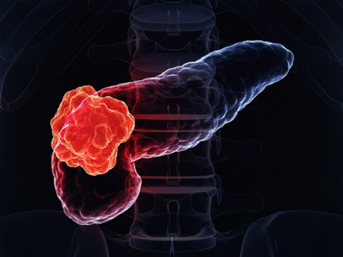
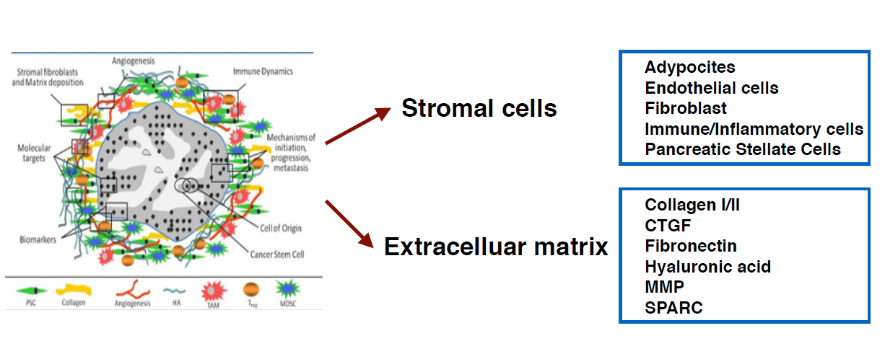
Introduction
Pancreatic adenocarcinoma
- Has one of the highest mortality rates of any malignancy
(Median survival 6~9 months, 5y survival rate ~5% )
- Complex, heterogenous and genetically unstable disease
- Dense and desmoplastic stroma
*Role of ECM
Support tumor growth and promotes metastasis
Physical barrier to drug delivery
http://www.sec.gov
Notes:
It is known that The median survival is only 6 to 9 months and 5 year survival rate is only about 5% , Pancreatic adenocarcinoma or pancreas cancer has the highest mortality rates of any malignancy.
They show complex, heterogenous and genetically unstable features.
Among them, we focused on the presence of a dense desmoplastic reaction that consist largely of fibroblasts, pancreatic stellate cells, and extracellular matrix proteins.
Especially, ECM has important role to support tumor growth and metastasis promotion and construct the physical barrier to drug delivery.

Slide 3
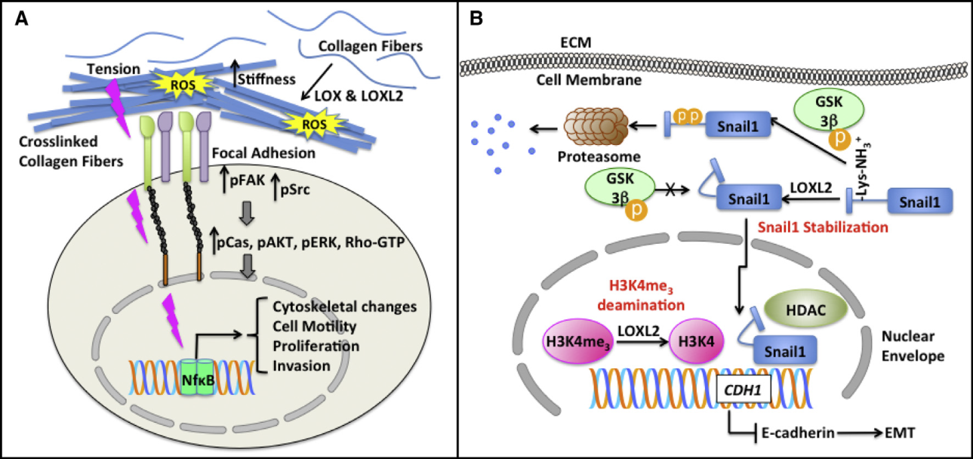
Introduction
Lysyl Oxidase-Like 2 (LOXL2)
- Extracellular enzymes responsible for crosslink formation in fibrillar collagen and elastin
- Able to regulate the EMT markers
Cell biology 2010

Slide 4
Material and Method
Patients : 84 patients received radical resection for pancreas cancer from 2002 to 2012 at Gangnam Severance Hospital
Post-adjuvant chemotherapy regimen
(8 weeks after surgery, 6 Cycle of gemcitabine 1000mg/BSA)
Cell lines : Miapaca2, Panc-1, AsPc1, BxPc3
Methods
- IHC staining
- siRNA transfection
- Cell cytotoxicity (WST method)
- RT-PCR & qPCR
- Gel electrophoresis and Western blot
-Transendothelial Migration assay and Invasion assay

Slide 5
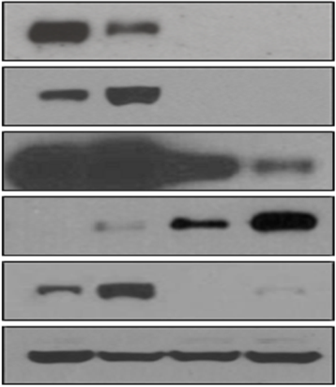
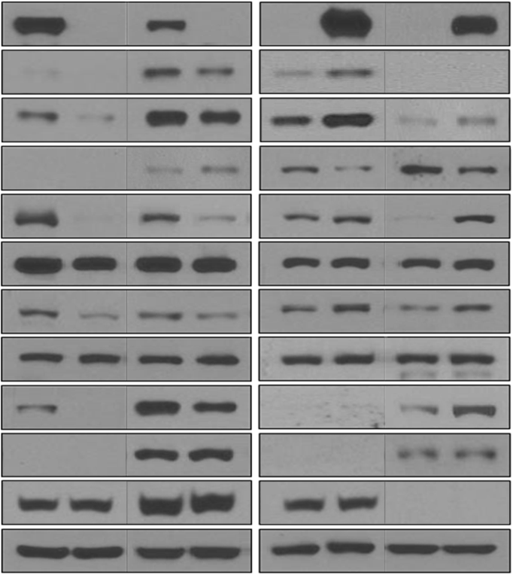
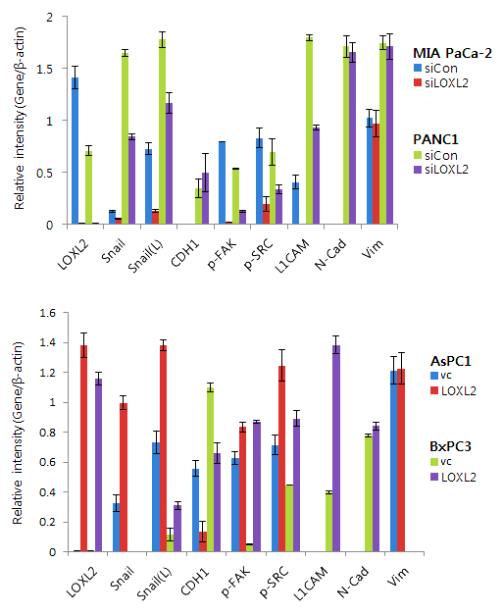
LOXL2 expression in pancreas cancer and influence on EMT markers
MIA PaCa-2
PANC1
MIA PaCa-2 PANC1 AsPC1 BxPC3
AsPC1
BxPC3
siCon siLOXL2 siCon siLOXL2
vc LOXL2 vc LOXL2
LOXL2
Snail
Snail
(Exp.30m)
CDH1
L1CAM
β-actin
LOXL2
Snail
Snail
CDH1
P-FAK
FAK
P-SRC
SRC
L1CAM
N-Cadherin
Vimentin
β-actin
(L.E)

Slide 6
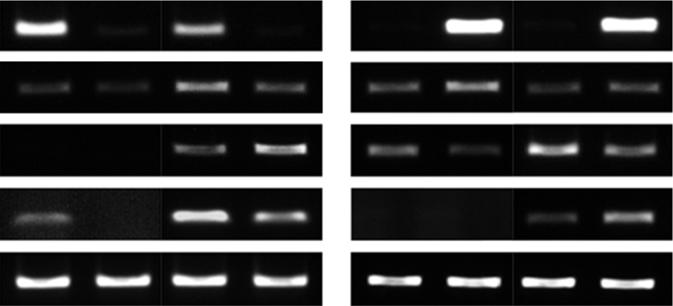
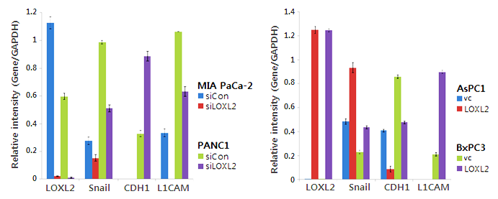
LOXL2 expression in pancreas cancer and influence on EMT markers
MIA PaCa-2 PANC1 AsPC1 BxPC3
siCon siLOXL2 siCon siLOXL2 vc LOXL2 vc LOXL2
LOXL2
Snail
CDH1
L1CAM
GAPDH

Slide 7
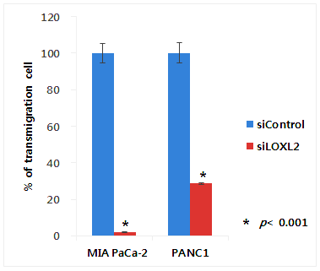
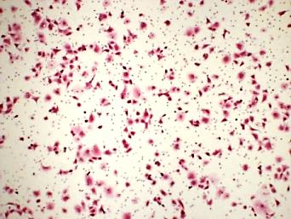
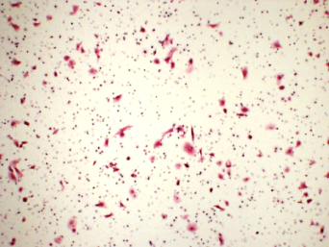
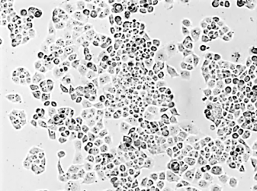
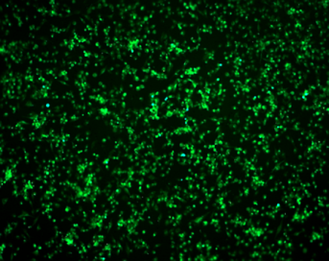
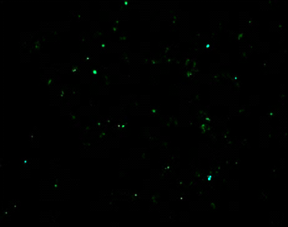
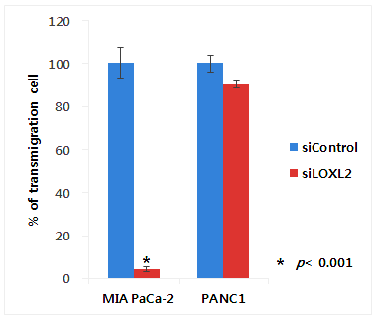
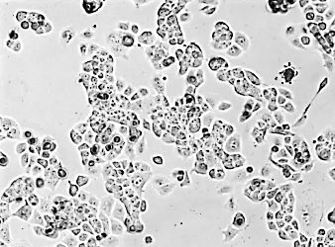
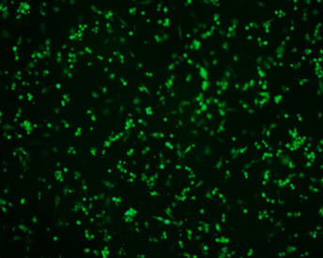
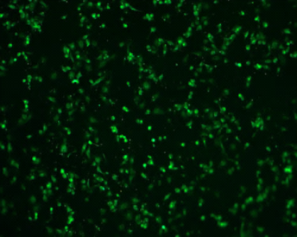
Knockdown of LOXL2 induce the morphological change and inhibit the invasiveness of pancreas cancer
MIA PaCa-2
PANC1
siControl siLOXL2
MIA PaCa-2
PANC1
siControl
siLOXL2
siControl siLOXL2
siControl
siLOXL2
MIA PaCa-2
PANC1

Slide 8
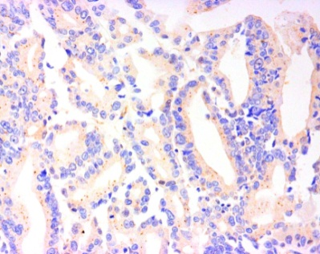
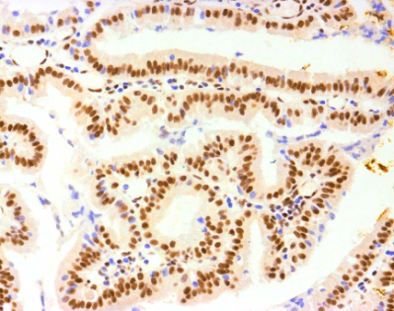
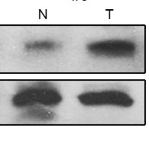
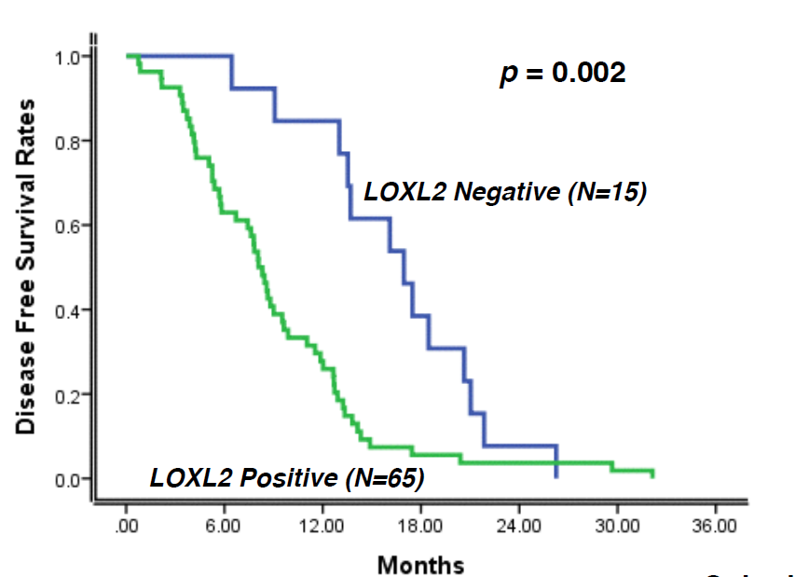
Highly expressed LOXL2 observed in pancreas cancer patients and has correlation with recurrence and DFS rates
LOXL2 antibody
Normal
Cancer
Pancreas Tissue
N T
LOXL2
LOXL2
RT-PCR
WB
β-actin
β-actin

Slide 9
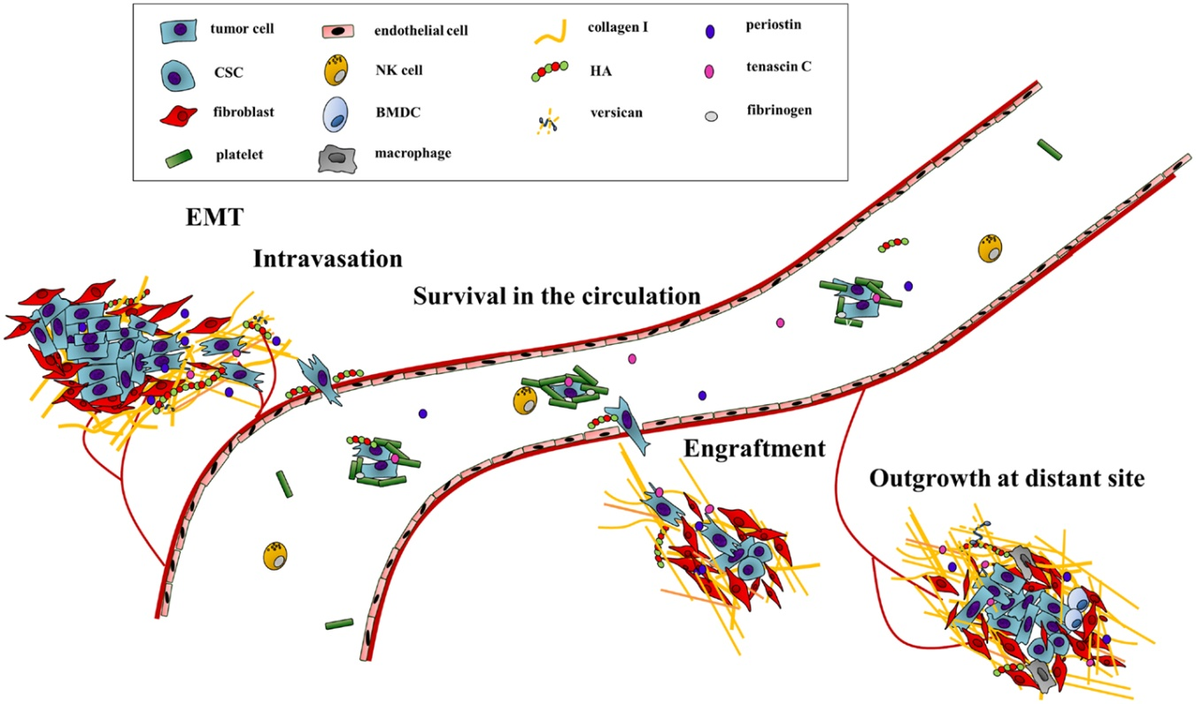
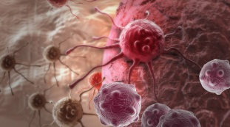
Conclusion
Pancreas Cancer
LOXL2
LOXL2 overexpression induce EMT
Desmoplastic microenvironment is a hallmark feature in pancreas cancer
The stromal EMT contribute aggressive progression by fostering tumor growth and metastatic spread also enhance the chemo-resistance
Through the ECM modulation, LOXL2 can be the independent marker for metastatic disease and potentially be a valuable target for improvement of patient outcome and survival
Metastasis & invasiveness
Poor prognosis

Slide 10
Acknowledgement
-YunSun Lee
-JoonSeong Park
-DongSup Yoon
-SeungMyung Dong
-JooHee Jung
Thank you.
Notes:
This is acknowledgement and thank you for listening.

