Slide 1
How to reduce the hospitalization in Laparoscopic Cholecystectomy: Personal experience and limitations in practice
Kyung Sik Kim
Department of Hepatobiliary Pancreatic Surgery, Severance Hospital, Department
of Surgery and Medical Education, Yonsei University, College of Medicine, Korea
Notes:
Good Afternoon, Members, Guests and Chairpersons.
Thank you for kind introduction and giving me a chance to present.

Slide 2
Table of contents
Introduction
Influencing factors on postoperative hospital stay
Usefulness of critical pathway
Patient satisfaction with critical pathway
Conclusion
Notes:
I will give a talk as follows.

Slide 3
Introduction
Advantages of laparoscopic cholecystectomy
Less postoperative pain
Shorter operation time
Lower rate of postoperative complications
Shorter hospital stay
Clinical pathway in laparoscopic cholecystectomy
High success rates (Topal et al. Surg Endosc 2007;21:1142-6)
Day-surgery vs. overnight surgery
No statistical differences (Vaughan et al. The Cochrane Library 2013)
All trials at high risk of bias
Notes:
Main advantages of laparoscopic cholecystectomy compared to open have been known to include less postoperative pain, shorter operation time, lower rate of postoperative complications and shorter hospital stay.
Today’s topic will focus on maximizing this benefit of shorter hospital stay in laparoscopic cholecystectomy.
In an attempt to reduce hospital stay, critical pathway have been implemented with promising outcomes.
Greater than 90% success rates of outpatient laparoscopic cholecystectomy with implementation of critical pathway have been reported.
And a recent Cochrane review comparing postoperative outcomes between day surgery and overnight surgery have shown no significant difference. However, it was also noted that high risk of bias present in all trials and further investigation is called for before final conclusion.

Slide 4
Introduction
Factors associated with delayed hospital stay
Advanced age, delayed diet resumption, greater need for oral analgesia
Tsang et al. Asian J Surg 2007;30:23-8
ASA score, LC difficulty
Morimoto et al. Asian J Endos Surg 2015;8:289-95
Intraoperative complications
Cheng et al. Surg Endosc 2008;22:1283-9
Aim
Share personal experiences in how to reduce hospitalization
Notes:
For a successful critical pathway development, further understanding of factors associated with delayed hospital stay is essential.
There are only a few publications analyzing factors associated with delayed hospital stay in LC.
Some of the factors found to be associated with delayed hospital stay have been advanced age, delayed diet resumption of greater than 8 hours, greater than 2 tablets of oral analgesia. Also ASA score and LC difficulty, as well as intraoperative complications, were included in associated factors of delayed hospital stay.
These finding should be incorporated into development of critical pathway for a successful implementation.
Here, I will present my personal experience in how to reduce hospitalization.

Slide 5
Influencing factors on postoperative hospital stay
Retrospective multicenter analysis
August 1, 2012 and August 31, 2012
336 consecutive patients underwent LC for benign gallbladder disease at 8 different hospitals
Severance Hospital, Gangnam Severance Hospital, Wonju Severance Christian Hospital, Inchon & Daejeon St. Mary Hospital, National Health Insurance Serivce Ilsan Hospital, Seoul Nanitional University Bundang Hospital, and Guro Hospital
Notes:
Before going into specific details on reducing hospitalization, you should first understand factors influencing postoperative hospital stay.
Therefore, I would first like to share our results on this topic.
This was a retrospective multicenter analysis involving 336 consecutive patients during a one month period

Slide 6
Results
Multivariate logistic regression | p | Odds ratio | 95% CI
Operation time (min) | <0.001 | 1.030 | 1.005-1.045
Emergency operation | <0.001 | 6.104 | 2.293-16.250
Age (years) | 0.014 | 1.025 | 1.005-1.045
Smoking | 0.022 | 2.341 | 1.129-4.853
 | POD ≤ 2days (n=225) | POD > 2days (n=111) | p
Operation time, min (range) | 45 (14-190) | 77 (16-371) | <0.001
Perioperative transfusion | 1 (0.5%) | 6 (5.6%) | 0.006
Emergency operation | 9 (4.0%) | 23 (20.7%) | <0.001
Operation history | 36 (16.0%) | 20 (18.0%) | 0.782
Acute inflammation | 24 (10.7%) | 47 (42.3%) | <0.001
Gallbladder stone | 61 (27.1%) | 31 (28.2%) | 0.837
Surgical site infection | 2 (0.9%) | 5 (4.6%) | 0.041
 |  | POD ≤ 2days (N=225) | POD > 2days (n=111) | p
Age ≥65 years |  | 45 (20.0%) | 36 (32.4%) | 0.012
Male gender |  | 85 (37.8%) | 56 (50.5%) | 0.036
BMI (kg/m²) |  | 25.3 ± 15.2 | 24.2 ± 3.2 | 0.618
DM |  | 22 (10.0%) | 22 (20.2%) | 0.011
Albumin <3.0g/dL |  | 4 (1.8%) | 8 (7.3%) | 0.024
Smoking |  | 25 (11.2%) | 25 (22.5%) | 0.010
ASA score | 1 | 122 (54.2%) | 40 (36.0%) | 0.003
 | 2 | 87 (38.7%) | 63 (56.8%)
 | 3 | 16 (7.1%) | 7 (6.3%)
 | 4 | 0 (0.0%) | 1 (0.9%)
*Influencing factors on postoperative hospital stay length: Perioperative factors
*Influencing factors on postoperative hospital stay length: Patient factors
Chong et al. Korean J Hepatobiliary Pancreat Surg 2016;20:12-6
Notes:
336 patients were divided into two groups by median POD of 2 days. 225 patients were discharged within POD 2 and grouped into early discharge group. Remaining 111 patients were discharged after 2 days and they belonged to late discharge group.
Analysis of Perioperative factors have shown that there were significant differences in operation time, perioperative transfusion, emergency operation, acute inflammation and surgical site infection. Patient factor analysis have shown significant difference in age, with more patients over 65 years belonging to late discharge group. Also, gender, presence of DM, albumin level below 3, smoking, ASA score were among the factors with significant differences.
Multivariate logistic regression analysis of all significant factors in univariate analysis yielded 4 independent influencing factors, which included operation time, emergency operation, age and smoking. While emergency operation had highest odds ratio, causality should be carefully interpreted. Patients undergoing emergency operation were older and presented with acute cholecystitis much frequently.

Slide 7
Influencing factors on postoperative hospital stay
Conclusion
Older patients with longer operation time are likely to be in late discharge group
Although not determined to be independent factors, preoperative albumin level and strict perioperative sugar control needs further investigation as to influence on hospital stay
Limitations
Bias inherent to retrospective nature of the design
Short follow-up period
Lack of discharge protocol among the participating hospitals
Lack of discharge protocol
Notes:
This study concluded that older patients with longer operation time are likely to be in late discharge group.
Although not a independent predictive factors, low preoperative albumin level and presence of diabetes were found to be significantly higher in late discharge group. Further investigation as to influence on hospital stay needs to be done.
This study has a merit of multicenter study including all laparoscopic cholecystectomy without open conversion.
With broad inclusion criteria, a more accurate assessment of influencing factors for hospital study was expected. However limitations include bias inherent to retrospective nature of the design, short follow-up period and lack of discharge criteria among the participating hospitals.
Although lack of discharge criteria among participating hospitals could not be quantified, this may have also played a key role in late discharge group. It was noted from the data that there were patients staying in the hospital for up to 14days even though there were no evidences any related complications. Importance of implementation of discharge protocol in reducing hospital stay can be inferred from this study.

Slide 8
Usefulness of critical pathway
Optimal management of discharge protocol
Implementation of critical pathway (June, 2010)
Inter-departmental networking is essential
Surgeons
Anesthesiologists
Residents
Nurses
Admissions
Quality improvement
Notes:
One of the ways to optimal management of discharge protocol may be use of critical pathway.
We have implemented critical pathway in our hospital since June of 2010.
Inter-departmental networking and cooperation is essential in successful implementation.
The process not only requires surgeons, but also the anesthesiologists, residents, nurses, admission, and quality improvement department have their own well-defined responsibilities.

Slide 9
Usefulness of critical pathway
Inclusion criteria | Exclusion criteria
16≤age≤70 | Acute cholecystitis, GB empyema
GB stone, GB polyp | CBD stone
Visit via OPD | Visit via ER
Agree with CP | Co-operation case
 | Cardiovascular disease
 | Pulmonary disease
 | Previous history affecting laparoscopic surgery
 | Open conversion
 | OP complication; biliary tract injury
 | Drain insertion
 | Post op hemodynamic unstability
Chong et al. J Minim Invasive Surg 2016 Accepted
Notes:
After consulting and discussing within our inter-departmental network along with review of previous publications, we have devised inclusion and exclusion criteria for critical pathway.
Inclusion criteria included ages ranging from 16 to 70 years old. Preoperative diagnosis of GB stone and GB polyp were included. Patients had to plan operation via visit to outpatient department and agree with critical pathway.
Diagnosis of acute cholecystitis and GB empyema were excluded as well as presence of CBD stones.
Other exclusion criteria included visit via ER, co-operation case, and underlying medical and surgical history affecting laparoscopic surgery.
Even if the patients were enrolled into CP, if open conversion or intraoperative complications, such as biliary tract injury, occurred they were removed from CP. Insertion of drain and postoperative hemodynamic instability were also reasons for removal from CP.

Slide 10
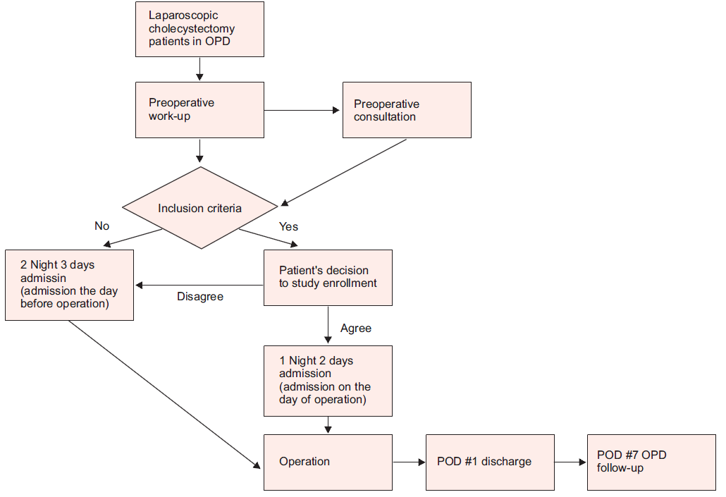
Usefulness of critical pathway
Chong et al. J Minim Invasive Surg 2016 Accepted
Notes:
This is the flow chart of our critical pathway protocol of laparoscopic cholecystectomy.
When the patient first arrives in OPD for laparoscopic cholecystectomy, this is the time critical pathway practice starts. Patient should be informed of such pathway and possibility of inclusion. After which, patient goes through preoperative work-up and other operability related consultations. If the results are within inclusion criteria, patient is given a choice to be enrolled into critical pathway.
If agreed, patient is admitted on the day of the surgery and discharged the next day if the exclusion criteria does not occur.
Based on these protocol, we have analyzed usefulness of critical pathway.

Slide 11
Usefulness of critical pathway
Retrospective review
From June 2010 to July 2011
57 patients in CP group vs. 91 patients in non-CP group
Primary outcome
Difference in length of hospital stay
Difference in medical costs
Notes:
The study was based on retrospective review of medical records from June 2010 to July 2011.
57 patients in CP group and 91 patients in non-CP group were analyzed.
The study was designed to look at differences in length of hospital stay and medical costs.

Slide 12
Usefulness of critical pathway
Reduced hospitalization
Reduced medical costs
Chong et al. J Minim Invasive Surg 2016 Accepted
Notes:
Results have shown that number of hospital days had significant difference. CP group was 1 day and Non-CP group was 2.51 days.
Patients in CP group followed the protocol 100% and were discharged as planned with only one day of hospitalization.
However, patients in non-CP group showed deviations from the planned discharge protocol. Although all patients in non-CP group were also possible candidates for CP group, number of hospitalization was lengthened by 0.51 days from planned 2 days.
In terms of medical costs, all categories analyzed showed reduction in CP group.
Reduced hospitalization and reduced medical costs are main benefits found from this study. These benefits could also lead to better usage of hospital resources while patients save unnecessary medical bills.

Slide 13
Patient satisfaction with critical pathway
Critical factor in successful implementation
Which factor influences patient satisfaction with critical pathway???
Notes:
Now we have seen the benefits of critical pathway, let’s move to discuss how the critical pathway can be successfully implemented.
Patient satisfaction is a critical factor in successful implementation.
If the patient is not satisfied with the CP protocol, the patient would just deviate from the protocol.
Our previous study have shown 100% completion of CP protocol. However, the data may have been biased by exclusion of dropouts from the CP protocol for intraoperative or postoperative findings of drain insertion or postoperative pain.
We have further evaluated this with more larger data, while trying to find the factor related to patient satisfaction in critical pathway.

Slide 14
Patient satisfaction with critical pathway
Retrospective review
From January 2011 to September 2015
253 patients enrolled into critical pathway
Survey based
Five-point Likert response set
Ranging from 1(never) to 5(very often)
Notes:
The study was based on retrospective review of medical records and survey results from January 2011 to September 2015.
253 patients were enrolled into critical pathway.
In order to evaluate what is the most important factor leading to patient satisfaction, we have devised a survey and analyzed the results.
A self-completed, anonymous surveys were filled out by all patients undergoing critical pathway during the study period.
A five-point Likert response set, ranging from 1(never) to 5 (very often) was utilized.

Slide 15
Patient satisfaction with critical pathway
Notes:
This is the sample of survey filled out by all patients. It was composed of total 20 categories with 24 responses for evaluation.
These surveys were taken at the time of discharge.

Slide 16
Patient satisfaction with critical pathway
Exploratory factor analysis
Principle component analysis for extraction
Kaiser-Meyer-Olkin index: 0.859
Barlett’s test of sphericity: p<0.001
Factor 1: Satisfaction with explanation regarding the operation
Cronbach’s α: 0.939
Factor 2: Physical well-being and overall satisfaction in regards to operation
Cronbach’s α : 0.877
Factor 3: Overall satisfaction with CP
Cronbach’s α : 0.815
Notes:
Exploratory factor analysis with principle component analysis for extraction method was used to reduce the 24 responses.
KMO index and Barlett’s test of spericity all satisfied suitability of the analysis.
Three factors were finally obtained.
Factor one was satisfaction with explanation regarding the operation
Factor two was physical well-being and overall satisfaction in regards to operation and final factor was overall satisfaction with critical pathway.
All factors show high Cronbach’s alpha reliability coefficients

Slide 17
Patient satisfaction with critical pathway
Multiple regression analysis | β | t | p
Factor 1 | 0.410 | 6.060 | <0.001
Factor 2 | 0.008 | 0.119 | 0.906
Factor 3 (dependent variable)
Factor 1: Satisfaction with explanation regarding the operation
Overall satisfaction of CP: 4.25/5.00 (85%)
Notes:
Results of multiple regression analysis have shown that satisfaction with explanation regarding the operation influences the overall satisfaction with CP the most.
Overall satisfaction of CP scored 85%.

Slide 18
Patient satisfaction with critical pathway
Drop-out from CP: 24 (9.5%) patients
Open drain
Postoperative pain
Postoperative nausea/vomiting
Postoperative fever
Reported compliance rate with CP: 66 – 75%
Muller et al. Langenbecks Arch Surg 2009;394:31-39
Soria et al. Am Surg 2005;71:40-4
Notes:
Other analysis of the data have also revealed that patients dropped out from the initial enrollment of CP accounted for 9.5%. Still over 90% complied with out CP protocol.
The most common reasons for drop-out included open drain, postoperative pain, postoperative nausea/vomiting, postoperative fever.
This result is very good compared to past publications showing compliance rate of only 66 to 75%.
High compliance rate with CP in our study may have resulted from close communication and cooperation among surgeons, residents, nurses in treating patients with satisfactory explanations on what to expect.

Slide 19
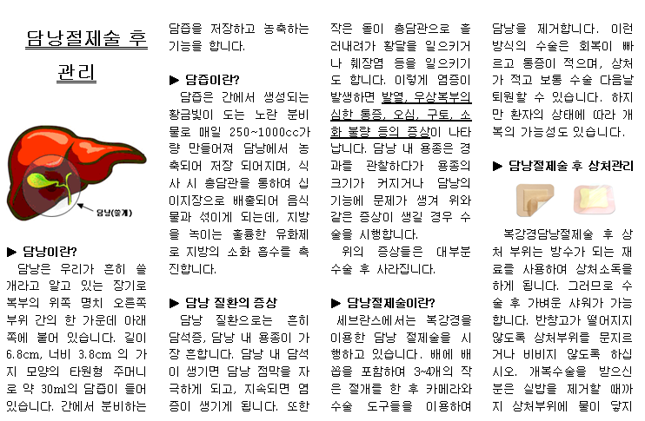
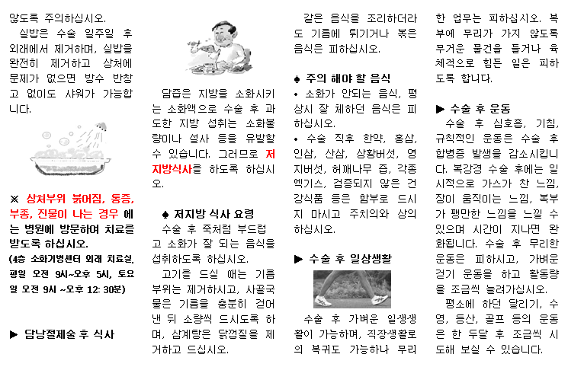
Patient satisfaction with critical pathway
Satisfaction with explanation regarding the operation
Notes:
One of the tools we used in explanation to patients was a pamphlet describing the postoperative care. With this and thorough explanation of what to expect after the operation, patients would be more likely to comply with the CP protocol.
On a final note from this result, in order for CP protocol to be successfully implemented, great attention should be paid in explanation of the detailed preoperative and postoperative course to patients. This would lead to more compliance from patients with CP.

Slide 20
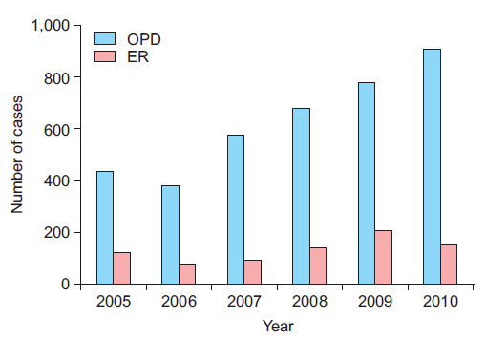
Conclusion
Chong et al. J Minim Invasive Surg 2016 Accepted
Notes:
Now the conclusion.
Our hospital data from 2005 to 2010 showed consistent increase in cases of laparoscopic cholecystectomy. Percentages of OPD based elective LC was taking greater percentage. In order to reduce unnecessary hospitalization days and increase available bed capacity, we have started using critical pathway.

Slide 21
Conclusion
Reducing hospitalization in laparoscopic cholecystectomy
Increased available hospital resources
Greater patient satisfaction
Reduced medical costs
Lesson learned
Detailed explanation regarding the operation is the key to compliance
Future
More multicenter studies with follow-up survey are needed
Notes:
Reducing hospitalization in LC create many benefits. These benefits include increase available hospital resources, greater patient satisfaction, and reduced medical cost. These can be achieved with implementation of critical pathway
Lesson learned in regards to successful implementation of CP was detailed explanation.
Current critical pathway we have implemented is a rather conservative one. With more broadening of inclusion criteria shortening of hospital stay may be possible. More multicenter studies with follow-up survey should be performed to fine-tune our critical pathway.

Slide 22
“Consensus protocols and comprehensive patient and health professional education can overcome multiple barriers by managing expectations and providing a uniform plan and timeline for care.” (Calland et al. Annals of surgery 2001;233:704-15)
Notes:
I would like to close with following quote.
Thank you.

