Slide 1
Effects of Splanchnic Vasoactive Agents on Hepatic Functional Recovery and Regeneration in Porcine 70% Partial Hepatectomy Model
Dong-Sik Kim, Jae Hyun Han, Yoon Young Choi,
Sung Won Jung, Young Dong Yu, Joo-Young Kim*
Division of HBP Surgery and Liver Transplantation, Department of Surgery, Korea University College of Medicine, Seoul, Korea
Department of Pathology, Korea University College of Medicine, Seoul, Korea*
This study was supported by Basic Research Program through the National Research Foundation of Korea (NRF) funded by the Ministry of Education, Science and Technology (2014R1A1A1A05006371).
The authors have no conflicts of interest to declare.

Slide 2
Introduction
Posthepatectomy Hepatic Failure (PHHF)
Small-for-Size Syndrome (SFSS)
Excessive portal flow and pressure to sinusoidal endothelium
Effective measure for prevention or treatment unavailable
In transplantation setting - splenic artery ligation/embolization, splenectomy, portocaval shunt…variable success rates
Notes:
Posthepatectomy hepatic failure and small-for-size syndrome are both clinically important issues caused by small functioning liver volume after resection or transplantation leading to significant morbidity and potentially life-threatening conditions.
Recently, many studies suggested that both conditions share same pathophysiologic condition of excessive portal flow and pressure to sinusoidal endothelium of remnant liver parenchyma.
Unfortunately, there is no effective measure for prevention or treatment available until now other than avoiding surgery.

Slide 3
Splanchnic Vasoactive Agents
Somatostatin and its analogues such as octreotide, lanreotide
Vasopressin and its analogue such as terlipressin
Can induce splanchnic vaso-constriction with minimal influence on systemic circulation
Subsequent decrease in portal flow/pressure
Potential for prevention/treatment of PHHF/SFSS
Notes:
Splanchnic vasoactive agents such as somatostatin or vasopressin and their analogues such as octreotide or terlipressin can induce splanchnic vasoconstriction with minimal influence on systemic circulation.
Splanchnic vaso-constriction subsequently decrease portal flow and pressure, which may decrease sinusoidal endothelial injury in the setting of PHHF or SFSS.
Therefore, those agents seem to have potential for prevention or treatment of PHHF or SFSS.

Slide 4
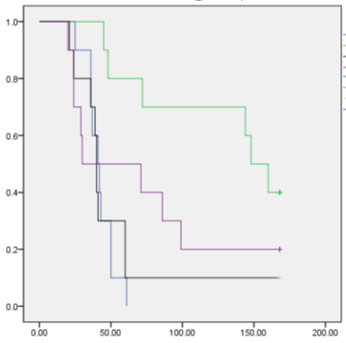
Effects of Propranolol, Somatostatin and Terlipressin on Recovery from Posthepatectomy Hepatic Failure after 90% Partital Hepatectomy in Rats
Woongbae Ji., Dong-Sik Kim et al. 2012, 64th Annual Congress of KSS
Cumulative Survival
Portal pressure, mmHg
*
Terlipressin (p<0.01)
*
*
*
*
*
*
*
*
*
Propranolol (p=0.189)
Somatostatin (p=0.817))
Control
Post-op time(hr)
Notes:
Our team reported initial experiments using 90% rat hepatectomy model.
IN this study, those medications could effectively decrease portal pressure and significant survival improvement was shown by terlipressin.
However, it was difficult to draw a conclusive results in small animal model using medications with hemodynamic effects.
Especially, somatostatin could not be administered enough to exert its effect because of its short half-life.
Moreover, in order to proceed with clinical trial in the future, study using large animal seemed to be mandatory.

Slide 5
Aim
to determine the effects of splanchnic vasoactive agents such as terlipressin and octreotide
on recovery of hepatic function and regeneration
using porcine 70% hepatectomy model
for evaluation of potential for clinical use in prevention and treatment of PHLF and SFSS.
Notes:
for evaluation of potential for clinical use in prevention and treatment of PHLF and SFSS.

Slide 6
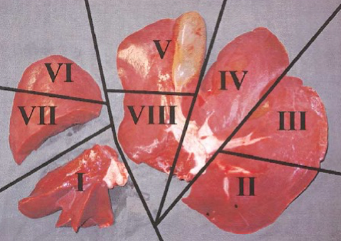
Methods
Female domestic white pigs weighing 30~35kg (Optipharm, Osong, Korea)
70% hepatectomy was performed under general anesthesia
Terlipressin (0.5 mg t.i.d. SC), Octreotide (0.2 mg t.i.d. SC) starting immediately after completion of hepatectomy
animals were terminated on POD 7.
Notes:
Female domestic white pigs weighing 30~35kg underwent 70% hepatectomy under general anesthesia.
Control group had hepatectomy without any medication.
Terlipressin and Octreotide group received respective medication, first dose starting immediately after completion of hepatectomy.
Portal pressure was measured at preop, 30 min, 1hr, 6hr, and 7days after surgery.
Blood samples were drawn at prep, 1hr, 6hr, and 7days postop.
Liver tissue was obtained for histologic analysis at prep, 6hr, and 7 days after surgery.

Slide 7
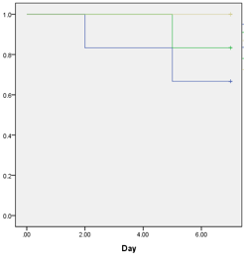
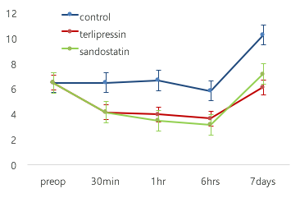
Results
Portal Pressure
Survival
Octreotide
Terlipressin
p=0.0093
p=0.0338
Control
Notes:
Both terlipressin and octreotide decreased portal pressure significantly compared to control group.
The effects of medication started immediately after injection.
2 pigs in control group and 1 pig in terlipressin group expired before 7 day postop, but there was no statistical significance in survival.

Slide 8
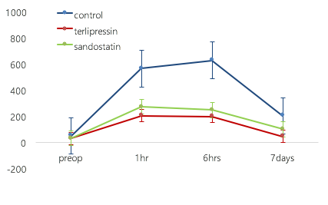
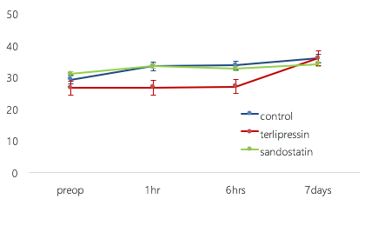
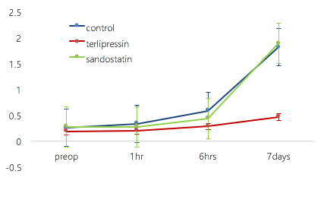
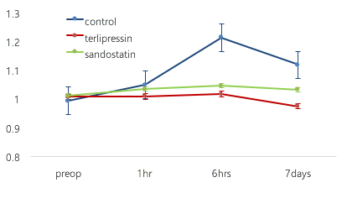
Results
AST
ALT
p=0.0211
Total Bilirubin
INR
p=0.0504
p=0.083
Notes:
In the control group, AST, total bilirubin, and INR were increased after hepatectomy and lasted until the time of termination.
In contrast, both treatment group showed much less elevation in AST level, although statistical significance was observed only in terlipressin group.
Elevation in bilirubin level was also negligible in terlipressin group with statistical significance.
There was also a significant difference in the level of INR between control and terlipressin group.

Slide 9
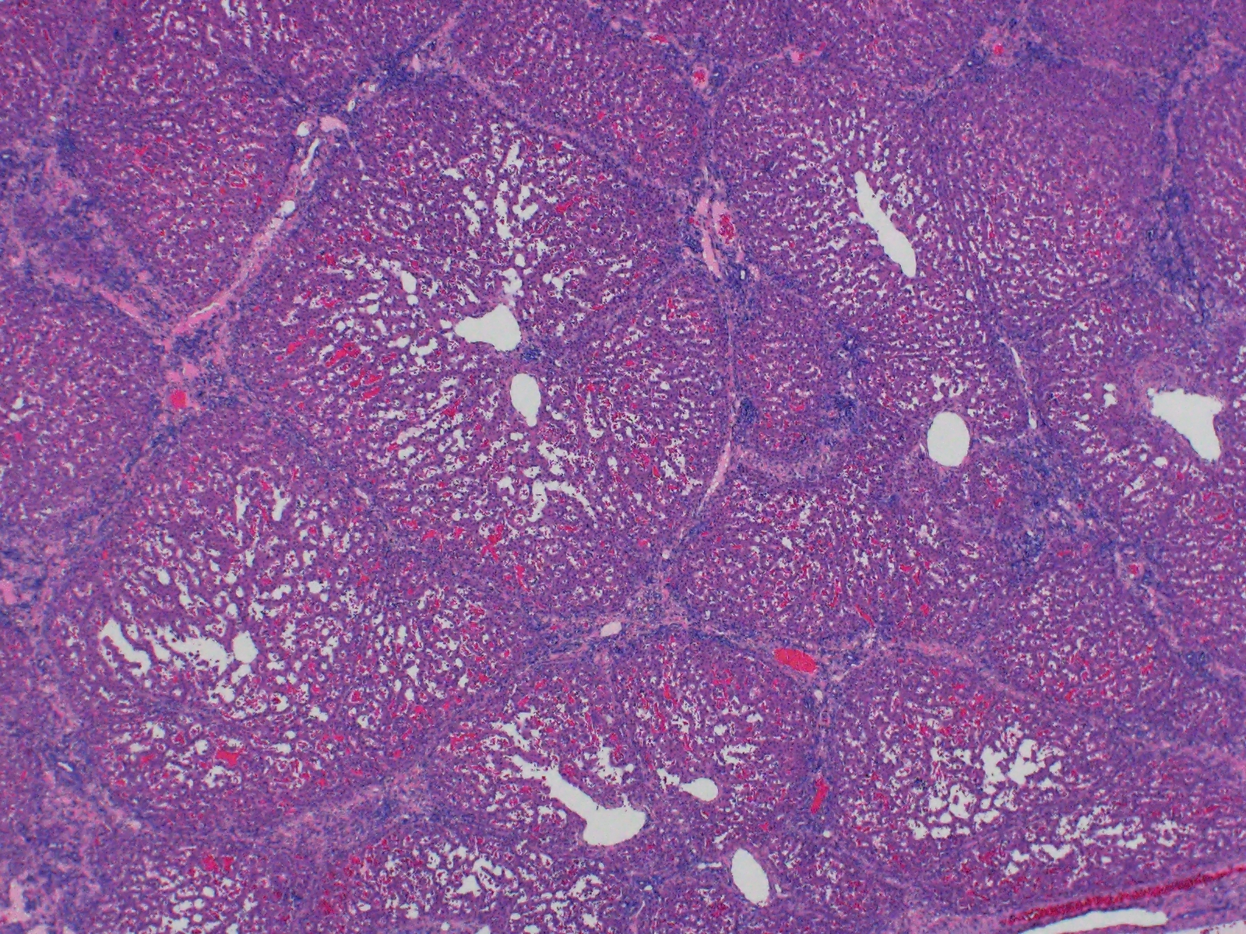
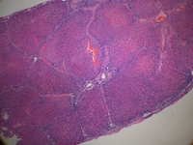
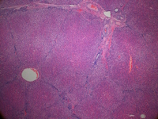
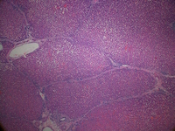
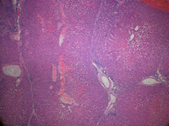
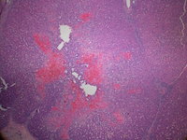
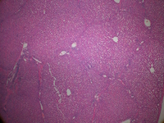
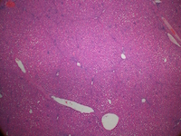
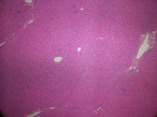
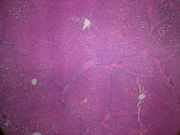
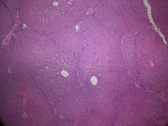
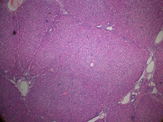
Histologic Changes
Preop
6hr
7 days
Sham
Control
Terlipressin
Octreotide
H & E, x40
Notes:
This slide shows representative H & E staining of each group on different time point.
Control group at 6hrs shows areas of confluent necrosis, which is more aggravated on post 7 days.
In contrast, both terlipressin and octreotide group showed no significant histologic evidence of injury.

Slide 10
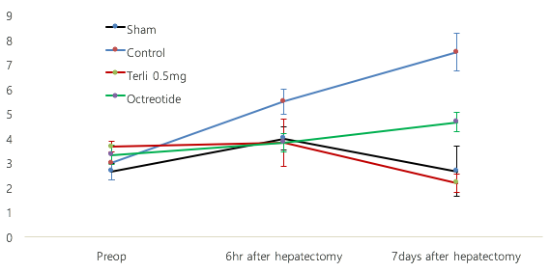
Histologic Changes
p=0.056
p=0.121
p=0.002
Notes:
Pathologist performed scoring of histologic changes related to liver injury, with blinding of group information.
Both terlipressin and octreotide group showed significantly low score in liver injury.

Slide 11
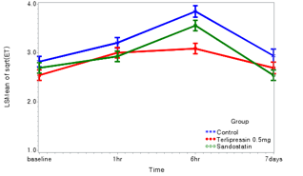
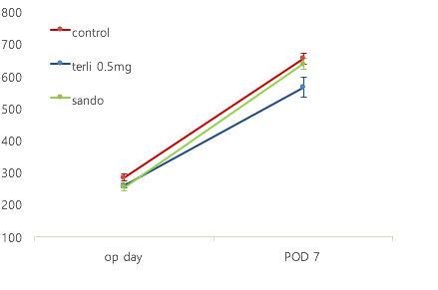
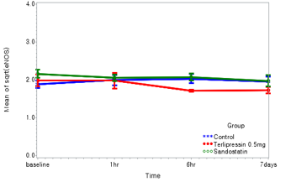
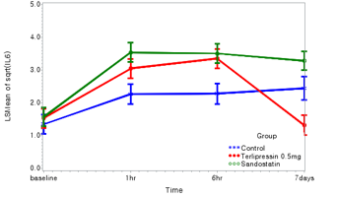
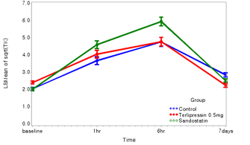
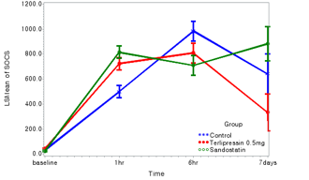
Results
⊿ Liver Weight
ET-1
❋
p=0.001
p=0.032
eNOS
IL-6
Thymidine Kinase
SOCS
❋
p=0.085
p=0.0061
❋
❋
❋
p=0.0021
p=0.0462
Notes:
To measure the extent of liver regeneration, liver weight was measured.
Interestingly, Terlipressin group showed significantly less regeneration compared to control or octreotide group.
We also checked various cytokines and markers of liver injury and liver regeneration for supportive data.
ET-1 is a marker of endothelial injury, which was significantly decreased in terlipressin group at 6hrs after hepatectomy.
IL-6 is considered as a initiation signal for liver regeneration, which was significantly decreased at post day 7. Similar trend was observed in thymidine kinase, which is a surrogate maker of liver regeneration.

Slide 12
Summary
Terlipressin & Octreotide effectively decreased portal pressure after 70% hepatectomy in swine model
Both agents could reduce parenchymal injury caused by massive hepatectomy
Terlipressin showed better biochemical laboratory responses, in spite of significantly lower rate of liver regeneration
Those agents, especially terlipressin may play an important role in prevention and treatment of PHHF and SFSS maintaining a balance between liver regeneration and functional recovery
limitation
70% hepatectomy was not enough to induce a clinically compatible liver failure model
dose and dosing schedule was not optimal due to limitations in animal study
Notes:
Considering hepatocytes in mitosis and regeneration is not functioning as hepatocyte any more, it seems making sense.

Slide 13
Conclusion
Splanchnic vasoactive agents could effectively decrease portal pressure and prevent liver injury after massive hepatectomy
Clincial trial seems feasible and desperately required

Slide 14
Thank you for Attention !
– D.S. Kim
This study was supported by Basic Research Program through the National Research Foundation of Korea (NRF) funded by the Ministry of Education, Science and Technology (2014R1A1A1A05006371).
The authors have no conflicts of interest to declare.

