Slide 1
3D PRINTING OF MOUSE PRIMARY HEPATOCYTES FOR GENERATING 3D HEPATIC STRUCTURE
Sungho Jang¹, KyoJin Kang¹, Jaemin Jeong¹, Hyeryeon Jeon¹, Su A Park², WanDoo Kim ², HeungMo Yang³, SungJu Kim³, Dongwook Han⁴, SeungBerm Lee⁵, Dongho Choi¹
¹Department of Surgery, Hanyang University College of Medicine, Seoul, Korea,
²Department of Nature-Inspired Nanoconvergence Systems, Korea Institute of Machinery and Materials, Daejeon,
³Department of Surgery, Sungkunkwan University College of Medicine, Seoul, South Korea,
⁴Department of Biomedical Science, Graduate School of Biomedical Science Engineering, Kunkuk University, Seoul, Korea
Notes:
Let me introduce about 3D printing of mouse primary hepatocytes for generating 3D hepatic structure.

Slide 2
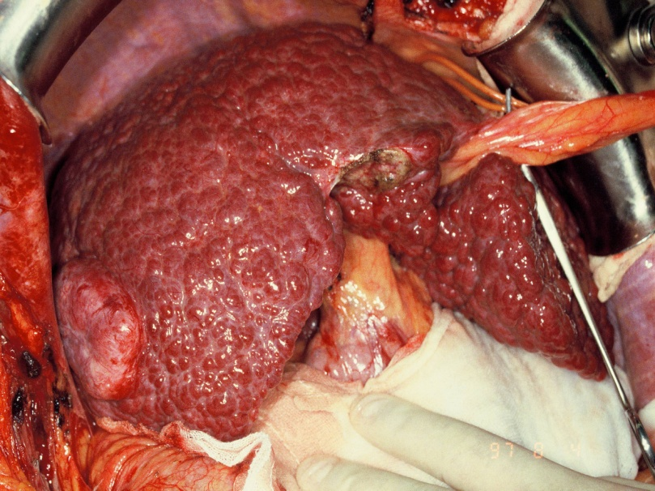
Introduction
Need liver transplantation…
Notes:
There are so many patients who have end stage liver disease in the world.
Doctors treat the patients by numerous medications but most of the patients needs liver transplantation for their life.
But, It is limited by donor organ shortage and donor pool. And there are another problems of surgical complications.
So, We suggest making the liver and use it.
The first step of that idea is generating 3D hepatic structure and we made that through 3D bioprinting device.

Slide 3
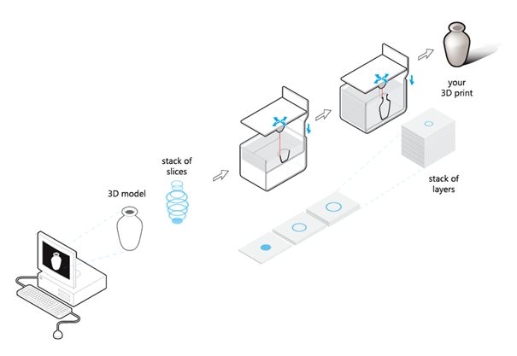
3-Dimensional printing
Notes:
What is 3D printing?
We drew the 3D model, and the computer programming made a stack of slices.
And then the 3D printer builded up a stack of layers, then we could get the 3D things.

Slide 4
3-Dimensional Bio-printing
Bio-structure
Bio ink + Cells
Notes:
Here, I’ll introduce 3D bio printing procedure.
I used isolated primary hepatocytes as a building materials and I got the 3D hepatic structure.

Slide 5
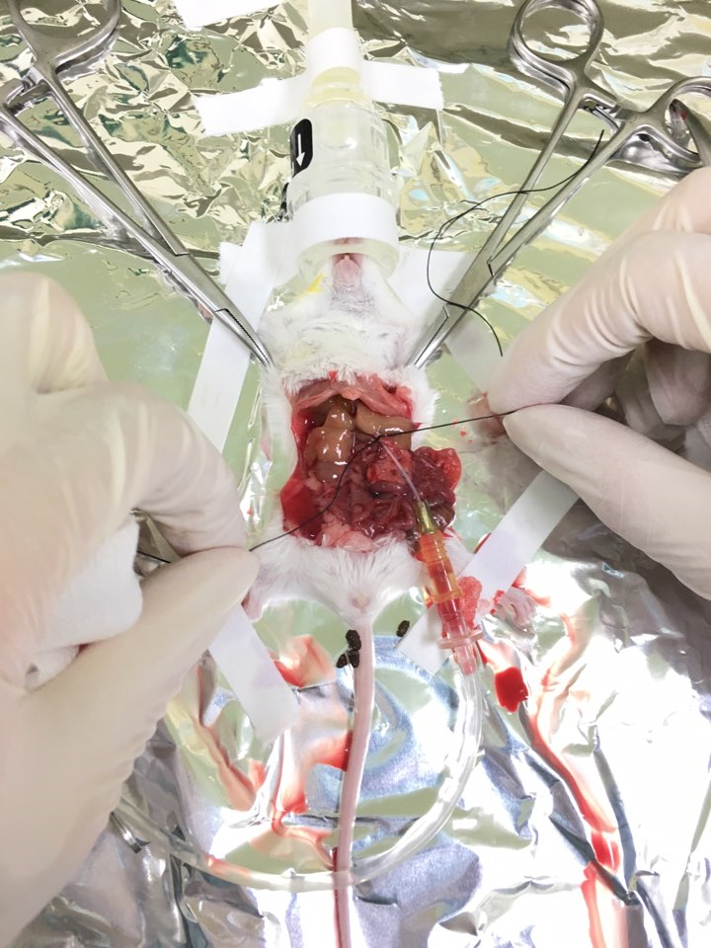
Materials & Methods
Portal vein
A, B solution
Two step collagenase perfusion
Total cells = 7.2 x 10⁷ cells → 4 x 10⁷ cells were selected.
Notes:
We took mouse primary hepatocytes using collagenase perfusion steps.
This method efficiently isolated primary hepatocytes, finally we got 4*10^7(40 multiplication 7 square) sorted hepatocytes from 4 mice.
A:
B: Collagenase

Slide 6
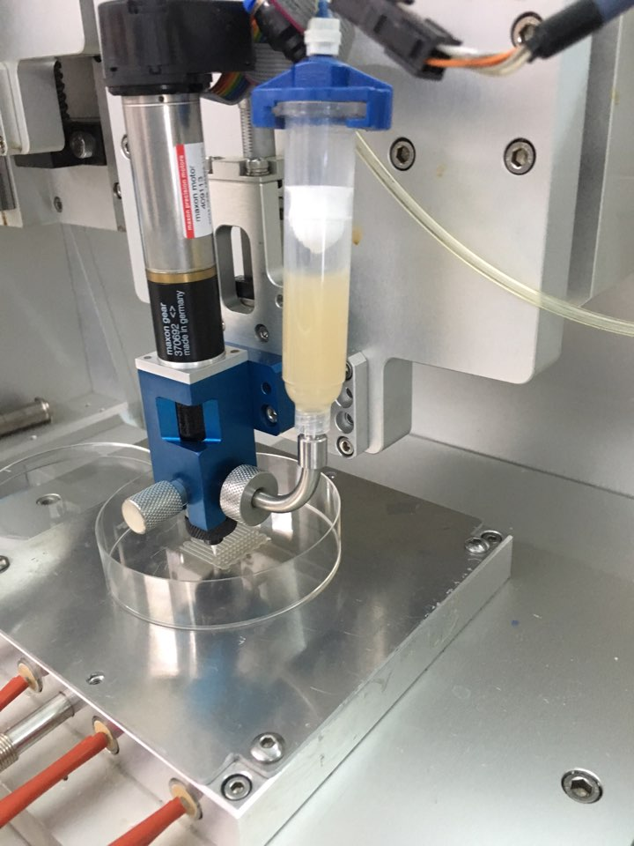
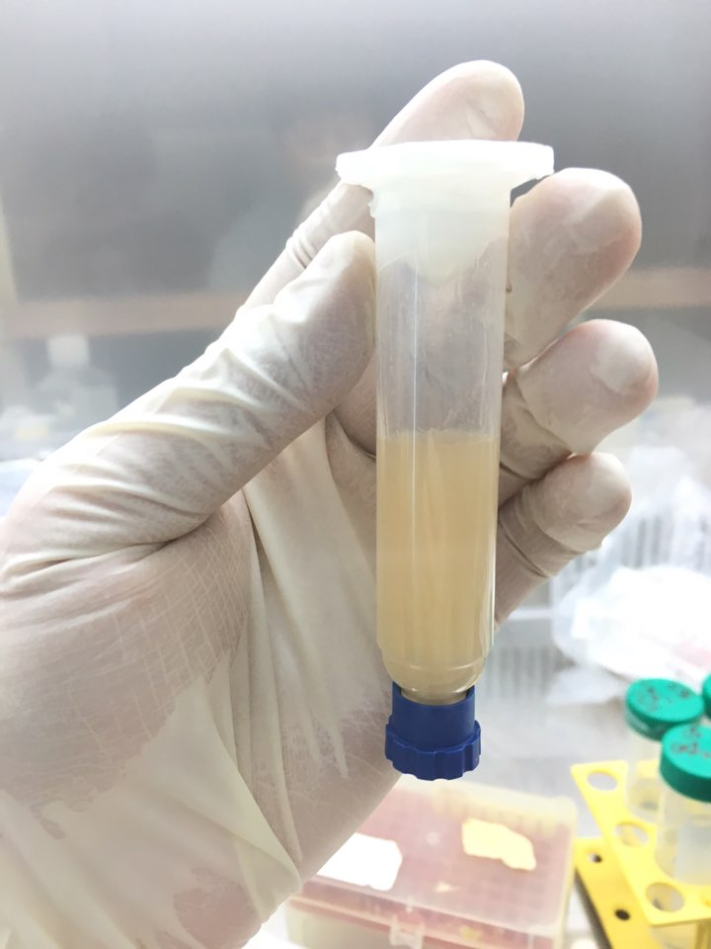
3-Dimensional Bio-printing
Alginate 3% with 1% CaCl₂ + Cells
Notes:
Sorted hepatocytes were mixed with 3% alginate and printed using 3D bioprinting technique.

Slide 8
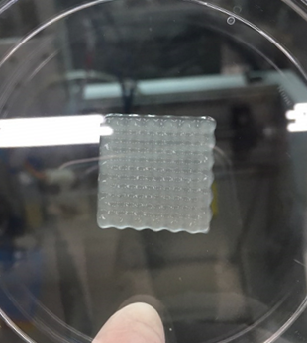
3-Dimensional Bio-printing
25mm
25mm
Notes:
Through the 3D bioprinter, we got the scaffold that made by hepatocytes and alginate structure.

Slide 9
Compare morphology of primary hepatocytes cultured in 2D system and 3D bio-printing
Day 1
Day 3
Day 7
Day 14
A
B
C
D
2D Hepatocyte
E
F
G
H
3D Hepatocyte
Notes:
We compared morphology of primary hepatocytes cultured in 2D system and 3D bio-printing.
The hepatocytes were survived more than 3weeks in 3D culture with cumulative characteristics.
On the other hand, the hepatocytes were fade away only within 3days in 2D system.

Slide 10
Expression levels of hepatic gene
in the 3D alginate scaffold
*MEF : mouse embryonic fibroblast
Notes:
And we used immuno-staining and qRT-PCR with alb, HNF4a genes for confirming functional hepatocytes.
You can see a growing hepatic gene expression levels in a 3D alginate scaffold.

Slide 11
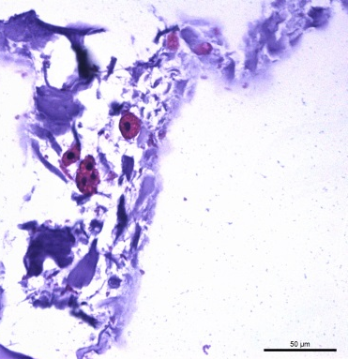
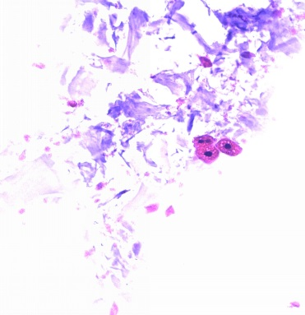
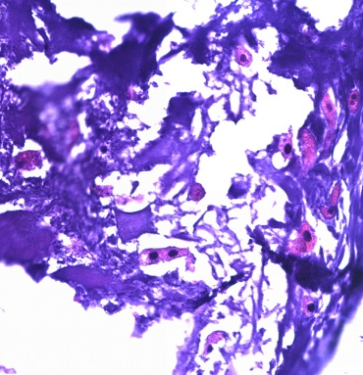
Immunostaining of hepatic genes cultured by 3D bio-printing
H&E
Alb
DAPI
Merge
Day 3
Day 7
Day 14

Slide 12
Conclusion
In a 2D system, hepatocyte could not survive over a week.
In a 3D bioprinting system, hepatocyte could survive over 3weeks.
3D bio-printing with primary hepatocytes have possibility about long-term culture of primary hepatocyte.
It can be applied to make 3D hepatic structure and transplantable liver graft.
Notes:
So finally, we got some conclusions from this experiment.

