Slide 1
Biliary & Pancreas Symposium 1:
Updates in Best Practices of Laparoscopic Cholecystectomy
Strategies to Attenuate Postcholecystectomy Syndrome (PCS)
: the Role of Medication
In Woong Han, M.D.
Departments of Surgery,
Dongguk University College of Medicine

Slide 2
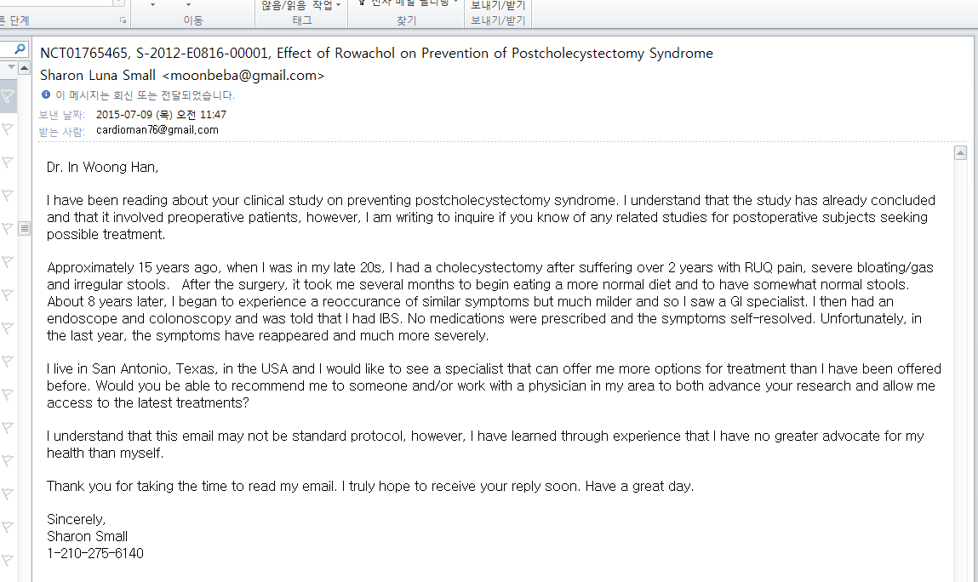
Mail from outlander who has been troubled with PCS
Approximately 15 years ago, when I was in my late 20s, I had a cholecystectomy after suffering over 2 years with RUQ pain, severe bloating/ gas and irregular stools.
the symptoms have reappeared and much more severely
I live in San Antonio, Texas, in the USA

Slide 3
Postcholecystectomy Syndrome (PCS)
Definition : No consensus for definition of PCS
heterogeneous group of diseases
usually manifested by abdominal symptoms following GB removal
Although used widely in the medical literature, but inaccurate
Encompasses a large number of biliary and non-biliary disorders
Onset: within a few weeks -months to years later after surgery
Symptoms: nonspecific and vary with the underlying etiology
most often include RUQ or epigastric pain after meals
Jaundice
dyspeptic symptoms
Constipation
Diarrhea
Filip M et al, J Gastrointestin Liver Dis. 2009

Slide 4
Diagnostic W/U for PCS
Causes of Postcholecystectomy Syndrome
Biliary Causes | Non-biliary Causes
 | Pancreatic Causes | Other GI Disorders | Extra-intestinal Disorders
(Micro)lithiasis | Pancreatitis | GERD | Psychiatric disorders
Biliary stricture/ Injury | Pancreatic pseudocyst | Esophageal motor disorders | Coronary artery disease
Cystic duct remnant | Malignancy |  | Intercostal neuritis
SOD | Pancreas divisum | Peptic ulcer disease | Wound neuroma
Stenosing papillitis |  | Intra-abdominal adhesions | Neurologic disorders
Malignancy |  |  | Unexplained pain syndromes
Choledochocele |  | Malignancy
GB duplication |  | IBD
GB remnant |  | Hepatitis
Biliary ascariasis |  | D-G RD
Bile leak |  | Diverticulitis
Quallich LG et al, Gastrointest Endosc , 2002; Cheon YK et al, Gastrointest Endosc , 2009;
Topazian M et al, Am J Gastroenterol , 2005; Walsh RM et al, Surg Endosc , 2002

Slide 5
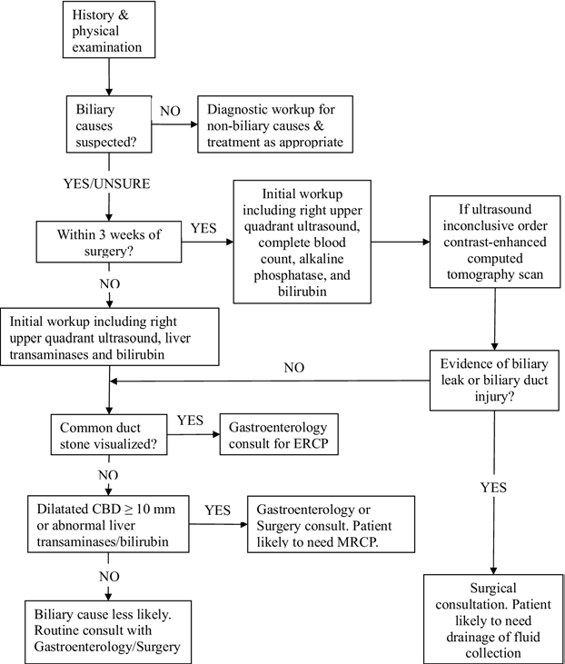
Diagnostic W/U for PCS
JM. Schofer et al, J Emerg Med. 2010
Fig 1. W/U for biliary causes of PCS

Slide 6
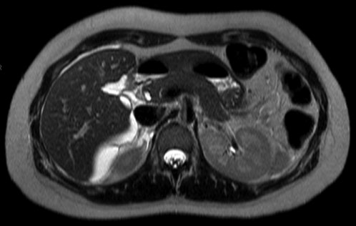
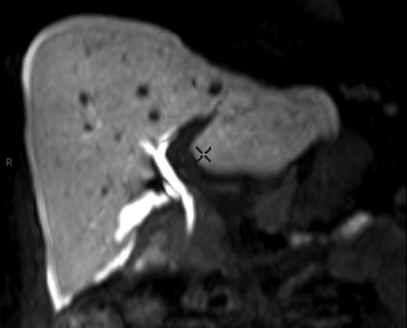
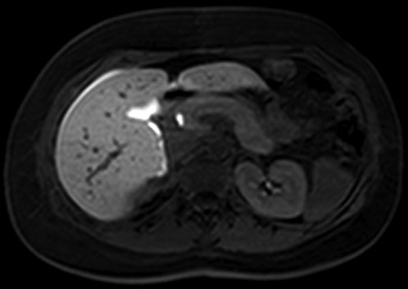
Bile leak
Figure 1. A 31-year-old female patient presenting with right upper abdominal pain 1 week after laparoscopic cholecystectomy. MR demonstrating the presence of a bile leak
R Giroetti et al, The British Journal of Radiology, 2010

Slide 7
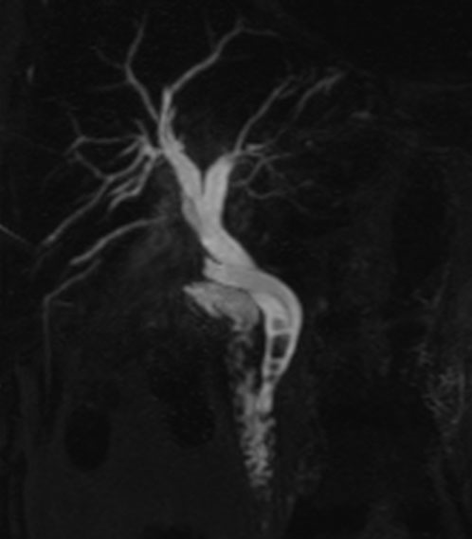
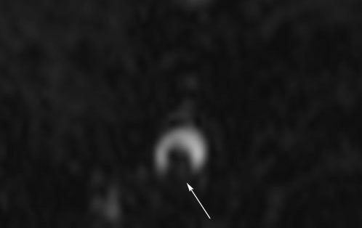
Choledocholithiasis
Figure 2. A 60-year-old female patient presenting with colic pain in the abdominal right upper quadrant 3 weeks after
laparoscopic cholecystectomy
R Giroetti et al, The British Journal of Radiology, 2010

Slide 8
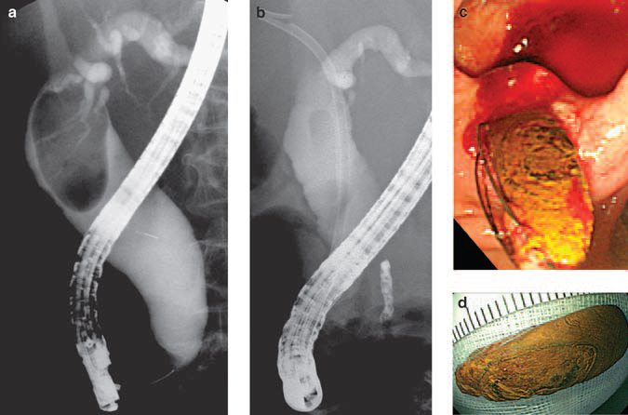
Retained CBD stone Medical treatment
Ursodeoxycholic acid (UDCA; Ursa):
hydrophilic dihydroxy bile acid
could dissolve gallstones
A terpene preparation (Rowachol):
enhance the solubility of cholesterol, calcium carbonate, calcium phosphate
it a potent choleretic agent
JM Han et al, Am J Gastroenterol 2009
Parameter | Initial ERCP | F/U ERCP | P
CBD stone size (mm)
Transverse diameter | 21.6± 6.2 | 12.2±4.9 | < 0.01
Longitudinal diameter | 29.5±14.3 | 20.1±1.2 | < 0.01
CBD diameter (mm) | 23.2 ± 6.1 | 19.5±3.8 | < 0.01
Table 1 . Changes in CBD stone size and CBD diameter
after biliary stent placement and medication with
UDCA and a terpene preparation in elderly patients
Fig. 1. 10-F plastic stent with UDCA and a terpene preparation for 6 months, cholangiogram showed a significant decrease in the size of the stone

Slide 9
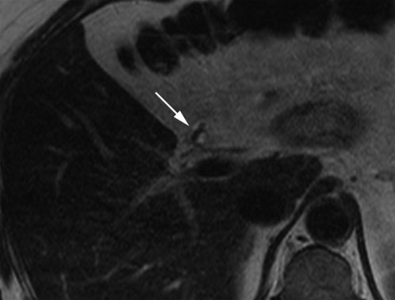
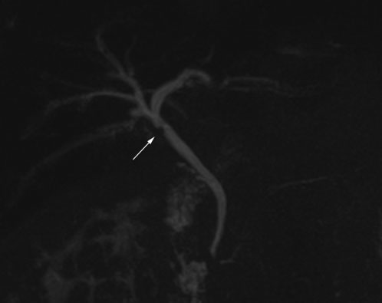
Surgical Clip
Figure 5. A 52-year-old male patient who underwent laparoscopic cholecystectomy 5 years previously. cholangitis caused by a surgical clip inadvertently positioned at the common bile duct just below the hepatic confluence
R Giroetti et al, The British Journal of Radiology, 2010

Slide 10
Sphincter of Oddi Dysfunction (SOD)
R Giroetti et al, The British Journal of Radiology, 2010
Type | Clinical criteria | Prevalence of abnormal SOM (%) | Treatment of choice
I | Typical biliary-like pain LFT elevated by two-fold Dilated CBD (≥ 12 mm) on ERCP Delayed drainage of contrast medium in duodenum on ERCP (≥ 45 min) | 65-86 | Sphincterotomy
II | Typical biliary-like pain One or more (but not all) additional criteria | 50 | Sphincterotomy who altered SOM
III | Typical biliary-like pain only | 28 | Medication
SOM, sphincter of Oddi manometry; CBD, common bile duct; ERCP, endoscopic retrograde cholangiopancreatography.

Slide 11
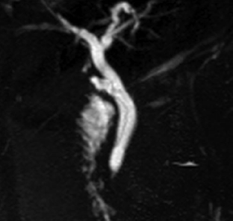
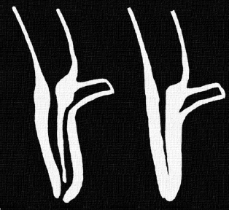
Sphincter of Oddi Dysfunction (SOD)
Figure 11. A case of recurrent biliary-like pain in a 39-year-old male patient who underwent laparoscopic cholecystectomy 5 years previously. irregular contraction of the sphincter, causing a small amount of bile to remain in the lumen.
R Giroetti et al, The British Journal of Radiology, 2010

Slide 12
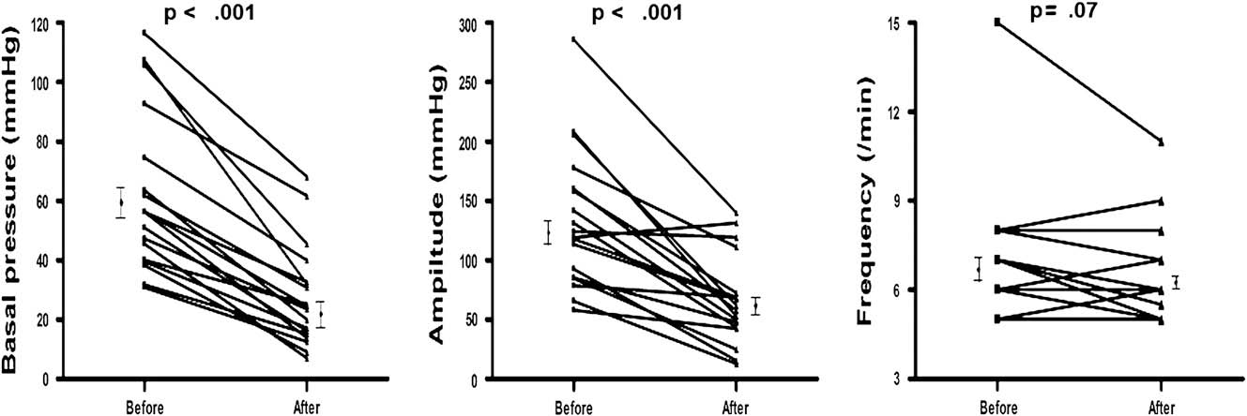
Sphincter of Oddi Dysfunction (SOD) Medical treatment
Cheon et al, Gastrointest Endosc 2009
Vardenafil: a PDE-5 inhibitor
inhibited sphincter of Oddi motility in patients with suspected SOD
reduced basal sphincter pressure
Figure 1. Individual values of basal pressure, amplitude, and frequency of the SO in patients with suspected SOD (n = 20) before and 20 minutes after administration of 10 mg vardenafil

Slide 13
Symptomatic Evaluation
RUQ or Epigastric pain: Key feature
Other symptom?
Fatigue
Nausea/vomiting
Dyspnea
Insomnia
Appetite loss
Constipation
Diarrhea
Financial problems

Slide 14
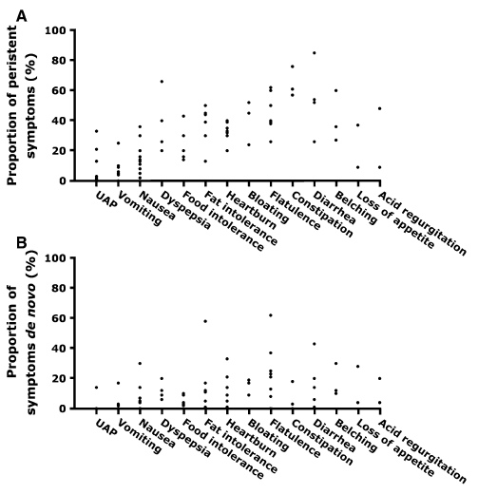
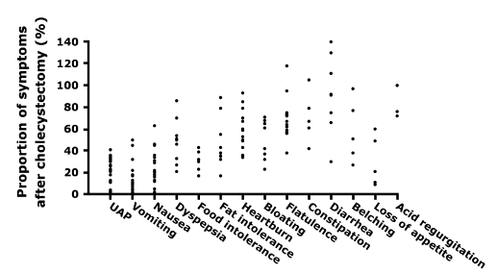
Postcholecystectomy symptoms systematic review
M.P. Lamberts et al, Surg Endosc. 2013
38 studies who underwent
cholecystectomy (1968– 2011)
Fig. 2 Proportion of symptoms after cholecystectomy reported in the studies.
Fig. 3 Persistent (a) and de novo (b) symptom proportions reported in 11 studies.

Slide 15
QoL & GI symptoms after cholecystectomy
Wanjura V et al, World J Surg. 2016
Table 4 Individual GIQLI items, study group compared to control group
GIQLI item | *Study group (N = 451) | *Control group (N = 390) | p value
Bowel frequency | 2.98 | 3.18 | 0.01
Restricted eating | 3.12 | 3.34 | 0.006
Heartburn | 3.26 | 3.46 | 0.003
Belching | 3.04 | 3.25 | 0.002
Uncontrolled stools | 3.69 | 3.83 | <0.001
Nausea | 3.37 | 3.56 | <0.001
Flatus | 2.32 | 2.57 | <0.001
Abdominal pain | 3.18 | 3.42 | <0.001
Regurgitation | 3.47 | 3.69 | <0.001
Bloating | 2.43 | 2.74 | <0.001
Bowel urgency | 2.84 | 3.22 | <0.001
Diarrhea | 2.97 | 3.40 | <0.001
*Study group, patients after cholecystectomy; Control group, normal healthy people

Slide 16
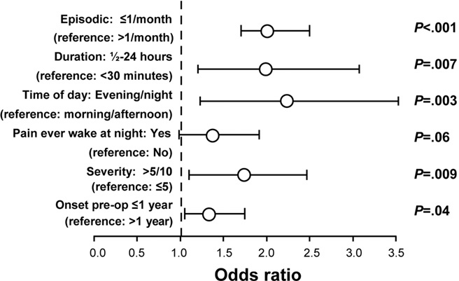
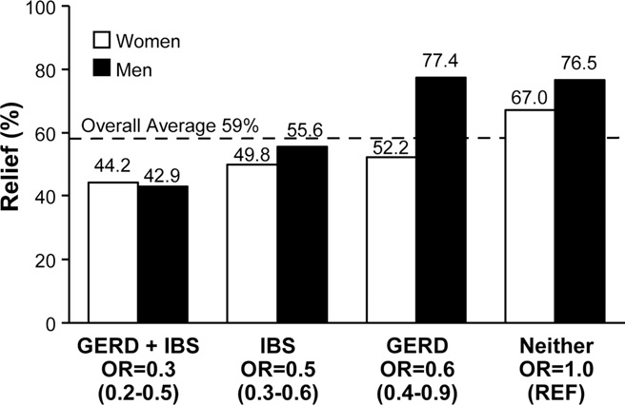
Postcholecystectomy pain incidence
Johnson L et al, Clin Gastroenterol Hepatol. 2011
A total of 1008 patients who underwent elective cholecystectomy
RUQ pain after elective cholecystectomy: 41%
Figure 2. Improving the odds of pain relief after cholecystectomy
Figure 3. IBS or GERD reduce the odds of relief of UAP at 3 and 12months (P < 001).

Slide 17
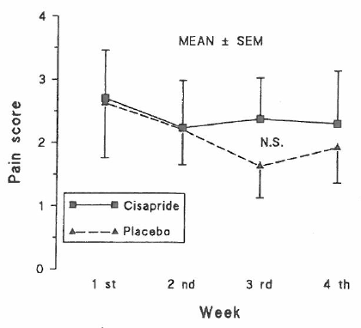
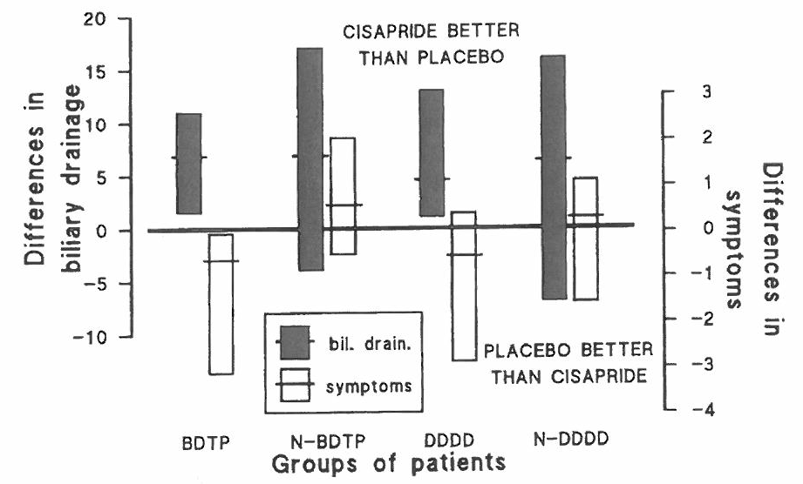
Postcholecystectomy pain Medical Treatment- Cisapride
Farup PG et al, Scand J Gastroenterol. 1991
Fig. 1. Mean daily pain score
after 4 weeks of treatment
Fig. 2. The differences in symptoms and biliary
drainage after 4 weeks of treatment
Cisapride: promote biliary drainage but unfavorable symptomatic effect

Slide 18
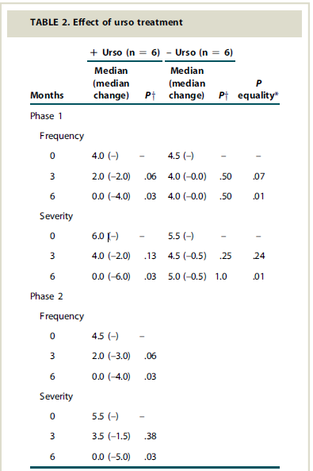
Postcholecystectomy pain Medical Treatment- UDCA
Okoro et al, Gastrointest Endosc. 2008
Microlithiasis:
Cause for acute pancreatitis
in patients with intact GB
a potential cause of
postcholecystectomy pain
Postcholecystectomy pain:
improved or resolved
after UDCA treatment
(oral 300 mg twice each day
for about 6 months)

Slide 19
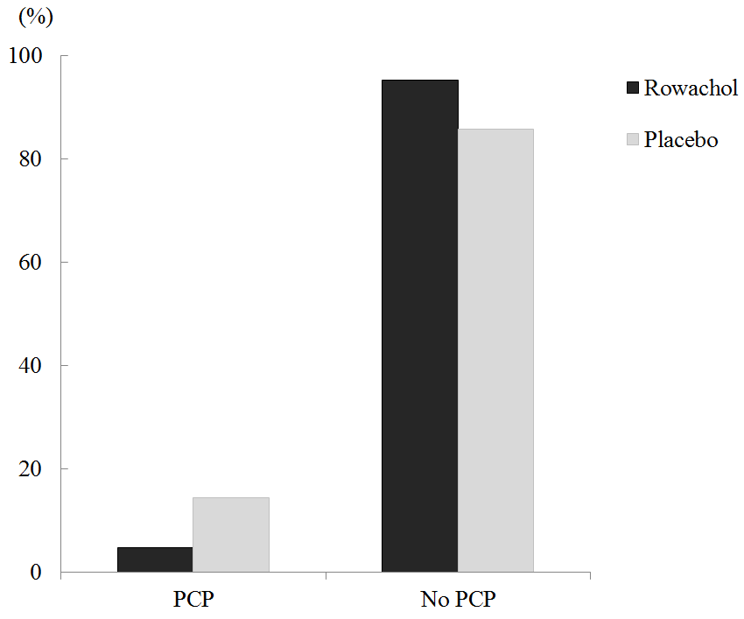
Effects of Rowachol on Prevention of Postcholecystectomy Pain after LC: Prospective multicenter Randomized controlled trial
IW Han et al, HPB in press, 2016
P= 0.076
FIGURE 2. Incidence of Abdominal pain 3 months postoperatively
Rowachol might be beneficial for prevention of PCP after laparoscopic cholecystectomy
14.3%
4.7%
Table 6. Multivariate Analysis for Postcholecystectomy Pain
at 3 Months Postoperatively
 | Hazard Ratio | 95 % Confidence Intervals | P
Higher difficulty score in LC (≥ 3) | 5.78 | 1.36- 24.40 | 0.02
Pathology (acute cholecystitis) | 2.03 | 0.42- 9.78 | 0.38
Absence of postoperative Rowachol treatment | 2.54 | 1.10- 10.39 | < 0.05

Slide 20
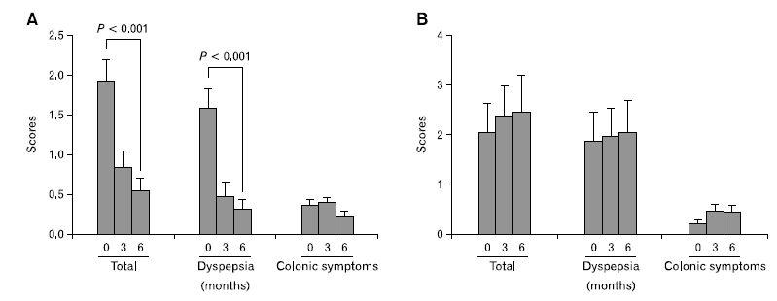
Dyspeptic or Colonic Symptoms
GH Kim et al, J Neurogastroenterol Motil. 2014
Preoperative Dyspeptic symptoms: indigestion, nausea, vomiting, food intolerance, heart burn, acid regurgitation, and loss of appetite
→ improved after cholecystectomy
Preoperative Colonic symptoms: diarrhea, and constipation
→ still persisted after cholecystectomy
Fig 1. Changes of symptom scores, total, dyspeptic or colonic symptoms, before surgery and at 3 and 6 months after surgery in patients without/ with gastritis

Slide 21
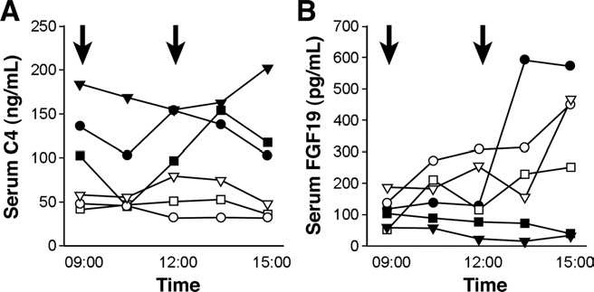
Postcholecystectomy diarrhea
5-20% after cholecystectomy
3-6 watery bowel movements daily
Mechanism: not well known
Increasing bile acid in colon
→ Water shift in colon and increase transit time
Mostly recovered 2-3 months after cholecystectomy
Fig 3. Changes during the day in serum values of (A) C4 and (B) FGF19. patients undergone cholecystectomy (open symbols) and not (solid symbols). The arrows show where breakfast and lunch were eaten after taking the 9:00 and 12:00 samples
Serum FGF19: correlated gut transit time
Fort JM et al, Gastroenterology. 1996; Niranjan B et al, Trop Gastroenterol. 2000;
Sauter GH et al, Am J Gastroenterol. 2002; Walters JR et al, Clin Gastroenterol Hepatol. 2009

Slide 22
Postcholecystectomy diarrhea Risk factor
Fisher M et al, ANZ J Surg. 2008
Table 2. Multivariate logistic regression model associated with postcholecystectomy diarrhea
 | OR | 95% CI | P
Age (<50 vs. ≥50 years) | 3.6 | 1.08–12.31 | 0.037
Sex (men vs. women) | 2.8 | 0.76–10.27 | 0.121
Postoperative food intolerance (yes vs. no) | 3.2 | 1.03–10.60 | 0.044
BMI (preoperative) (>30 vs. ≤ 30 kg/cm2) | 2.6 | 0.79–8.26 | 0.118
PCD was independently associated with younger age, especially <50, and postoperative food intolerance

Slide 23
Postcholecystectomy diarrhea Medical Treatment- Systematic Review
Wilcox C et al, Aliment Pharmacol Ther. 2014
Table 2. Medical Treatment for chronic bile acid- induced diarrhea
Treatment | Advantages | Disadvantages
Colestyramine | Evidence- established and effective | poorly tolerated due to unpalatability and side effects ∇ bioavailability of co-administered agents/ fat-soluble vitamins
Colestipol | effective alternative not tolerate colestyramine | Same as Colestyramine
Colesevelam | Available in tablet form improved tolerability Good bioavailability of co-administered agents | Not licensed for BAD No large-scale studies to date Large size, relatively expensive
Conventional anti-diarrheals | Better tolerated than BAS Good bioavailability of co-administered agents Available in tablet form, Relatively inexpensive | Not licensed for BAD No large-scale studies to date
Aluminium hydroxide | Better tolerated than BAS, Available tablet Good bioavailability of co-administered agents | Not licensed for BAD No large-scale studies to date
Dietary intervention | No need for drug treatment Direct effect on fecal bile acid excretion rate | No large-scale studies to date Poor compliance due poor taste Requires formal dietetic assessment
Bile acid sequestrants (BAS)

Slide 24
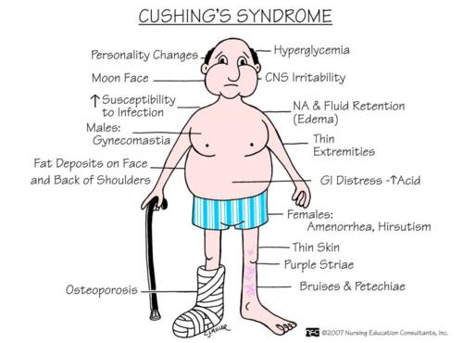
Syndrome?
A set of medical signs and symptoms
Correlated with each other and, often, with a specific disease
Derives from the Greek σύνδρομον, meaning "concurrence"
Multiple Concurrent symptoms!!!
Cushing syndrome
a collection of signs and symptoms due to prolonged exposure to cortisol
high blood pressure, abdominal obesity, thin arms and legs, reddish stretch marks, a round red face, a fat lump between the shoulders, weak muscles, weak bones, acne, and fragile skin that heals poorly

Slide 25
PCS: Symptom Clusters after LC - Prospective multicenter Study-
IW Han et al, KAHBPA 2015
Factor analysis by Varimax rotation and K-mean methods

Slide 26
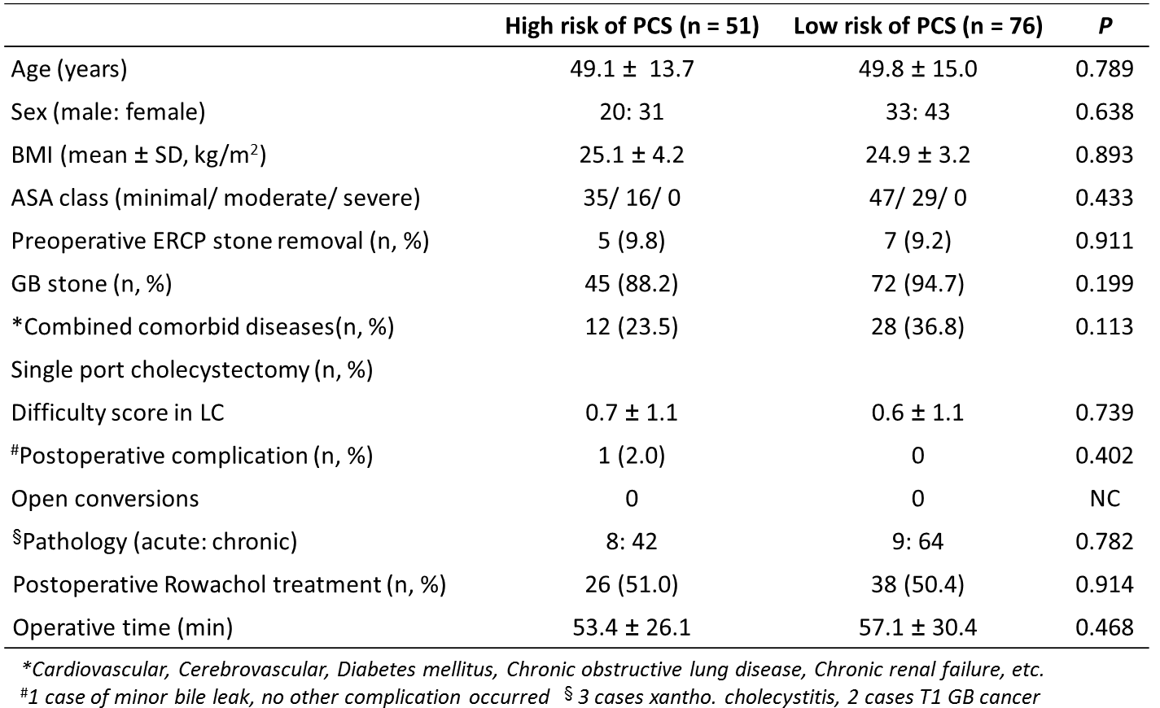
PCS: RUQ pain and Diarrhea Risk factor and Medical Prophylaxis
IW Han et al, KAHBPA 2015
→ Strategy will be needed for treating both RUQ pain and diarrhea after LC

Slide 27
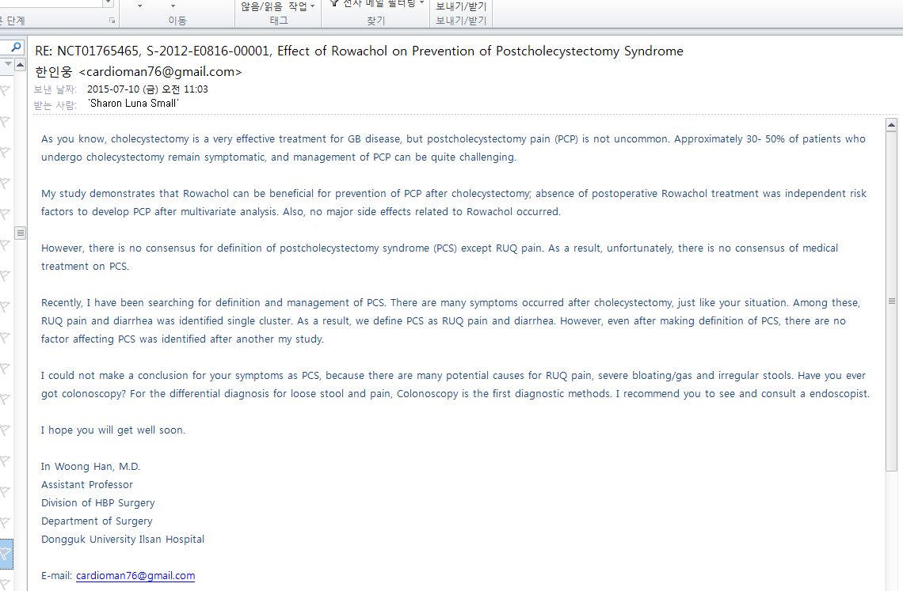
Mail from outlander who has been troubled with PCS
However, there is no consensus for definition of postcholecystectomy syndrome (PCS) except RUQ pain. As a result, unfortunately, there is no consensus of medical treatment on PCS.

Slide 28
Prospective Multicenter Observational Analysis for Post-cholecystectomy Complication and Development of Predictive Model in Korea
Ongoing trial by KAHBPS and NECA, 2016
Nationwide study in patients with cholecystectomy
Korean version of ACS NSQIP
The Symptomatic evaluation using validated questionnaire
Complication evaluation
Predictive model for complication after cholecystectomy
Dozens of the end-points: symptoms cluster, risk factors, and medical treatment for PCS

Slide 29
Take Home Message
Symptoms of PCS: various
RUQ pain, diarrhea, etc
Ongoing prospective study for Complications after cholecystectomy- Korean NSQIP by KAHBPS
Management of PCS: according to each diagnosis
Medical Treatment of PCS:
Choleretic drug might be beneficial for pains
Bile acid sequestrants are useful to diarrhea
More study will be needed for multiple symptoms

