Slide 1
A clinical trial to evaluate the pharmacokinetic characteristics of hepatitis B immunoglobulin used for prevention of hepatitis B recurrence after liver transplanation
The 44th Congress of the Korean Association of HBP Surgery
Gun Hyung Na¹, Seunghoon Han², Sung Ho Choi¹, Tae Ho Hong¹, Young Kyoung You¹, Dong Goo Kim¹
¹ Department of Surgery, Seoul St. Mary’s Hospital, College of Medicine, The Catholic University of Korea, Seoul, Korea
² Department of Pharmacology, Seoul St. Mary’s Hospital, College of Medicine, The Catholic University of Korea, Seoul, Korea
Notes:
Thank you, chairman.
I am Gunhyung Na from The catholic university of Korea.
Today, My topic is the pharmacokinetic characteristics of hepatitis B immunoglobulin after LDLT.

Slide 2
Introduction
The HBV recurrence rate after LT is greater than 80% without any prophylaxis, and HBV reinfection may lead to rapid disease progression and early graft loss.
Prevention of HBV recurrence after LT is essential in HBV-related patients.
The combination of long-term hepatitis B immunoglobulin (HBIG) and nucleos(t)ide analogues is currently the standard treatment and has effectively reduced HBV recurrence rates.
However, there are few studies about the pharmacokinetic characteristics of HBIG.
Notes:
Because the HBV recurrence rate after LT is greater than 80% without any prophylaxis, and HBV reinfection may lead to rapid disease progression and early graft loss.
Prevention of HBV recurrence after LT is essential in HBV-related patients.
The combination of long-term hepatitis B immunoglobulin (HBIG) and nucleos(t)ide analogues is currently the standard treatment and has effectively reduced HBV recurrence rates.
However, there are few studies about the pharmacokinetic characteristics of HBIG.

Slide 3
Objective
Predictive model & viral factors influencing HBIG concentration
Accurate measurement methods
(CMIA, ELISA, RIA, ECLIA)
Clinical factors influencing HBIG concentraion
Prediction of proper maintenance dose
Notes:
The objective of This study
First, making a predictive model to predict the concentration of HBIG based on objective datas. And we evaluate viral factors, such as HBV DNA, HBsAG, HBeAg, to influence the concentration of HBIG.
Second, we evaluated which method is the most accurate according to the our prediction model among several measurement methods.
Third, we evaluated clinical factors influencing HBIG concentration
Last, we evaluated the proper maintenance dose of HBIG

Slide 4
Study Design
Screening
N = 20
Characteristics | Data
Age | 53.6 ± 9.48
Sex (male), n (%) | 18 | 90.0%
Type of LT (LDLT), n (%) | 19 | 95.0%
BMI | 24.7 ± 3.04
Child score | 9.0 ± 3.48
MELD score | 15.9 ± 8.12
HCC, n (%) | 10 | 50.0%
Pre-transplant HBeAg (+), n (%) | 5 | 25.0%
Pre-transplant HBV DNA (+), n (%) | 14 | 70.0%
Pre-transplant HBV mutant (+), n (%) | 4 | 28.6%
Enroll
N = 20
ITT group
N = 20
Reason for exclusion | Number
Expired (MI, varix bleeding) | 2
PP group
N = 18
Notes:
Twenty patients were enrolled. And Two patients died, Myocardial infarction and varix bleeding. 18 patients have completed this study.
This table showed patients characteristics. Mean age was 53.6, Mean meld score 15.9, All patients were pre transplant HBsAg positive, 5 patients

Slide 5
Study Design
Hepatitis B immunoglobulin schedule
Sampling: 1) before and 2) 30 min after administration
Total sampling number: 12
Schedule | Dose
LT (an-hepatic phase) | 10000 IU
~ POD 7 days | 10000 IU daily
~ POD 4 weeks | 10000 IU weekly
~ POD 6 months | 10000 IU monthly
Visit 1 | Visit 2 | Visit 3 | Visit 4 | Visit 5 | Visit 6 | Visit 7
Pre-LT | LT | 1 day | 1 week | 4 week | 12 weeks | 24 weeks
Notes:
All patients were given 10,000 units of HBIG intravenously during the anhepatic phase, which was followed daily for 7 days and then every month for 6 months after LDLT.
Blood sampling was performed before and 30minutes after administration of HBIG, Total sampling number was 12.

Slide 6
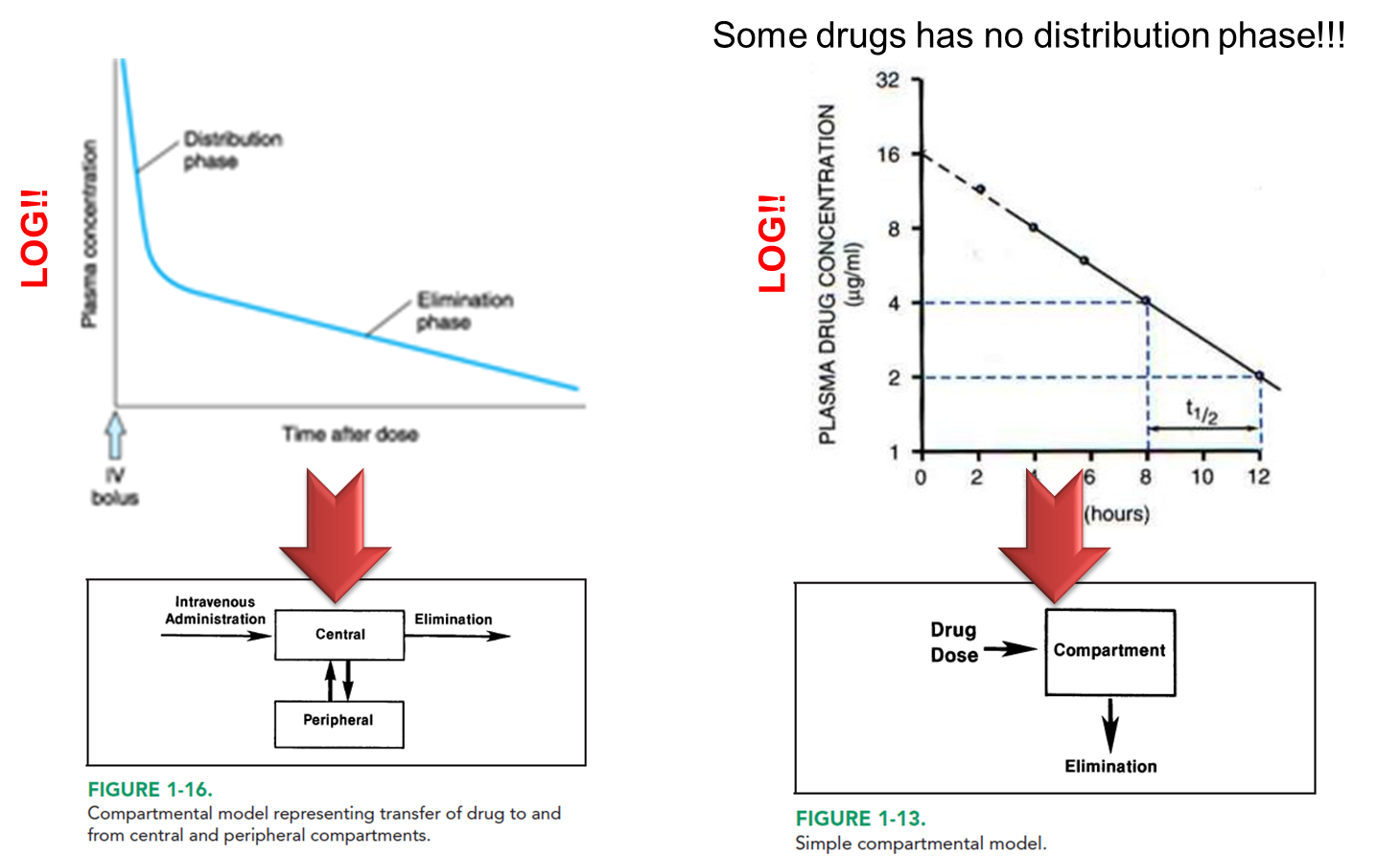
1. Predictive model
1 – compartment model
Basic assumption for Ig PK
Large molecule - NO significant extravascular distribution
1-compartment model - Volume of dist. ≒ plasma volume - Linear conc. Decrease ☞ Trough-peak sampling scheme
Non-linear Mixed-effects Modeling
Plausible explanation to the data using mathematical structure (= model)
Notes:
Because antibody is large molecule, and no significant extravascular distribution, it assumed one-compartment model. And we used non-linear mixed effects modeling.

Slide 7
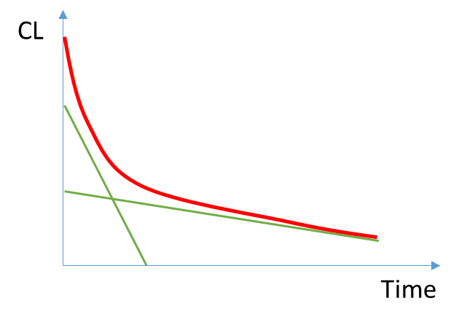
1. Predictive model
Viral factors influencing HBIG concentration
DNA titer, HBeAg, HBsAg were tested as potential covariates
Time-varying Clearance
peak-trough gap ↑ - immediate post-transplant period (in comparison to the later period)
 | OFV | ΔOFV
Base model | 2713.120 | -
HBV DNA | 2662.614 | -50.506
HBeAg | 2712.846 | -0.274
HBsAg | 2732.479 | 19.359
Notes:
HBV DNA, HBsAg, HBeAg were tested as potential covariates, and only HBV DNA influence the concentration of HBIG. HBV DNA was reflected in the predictive model.

Slide 8
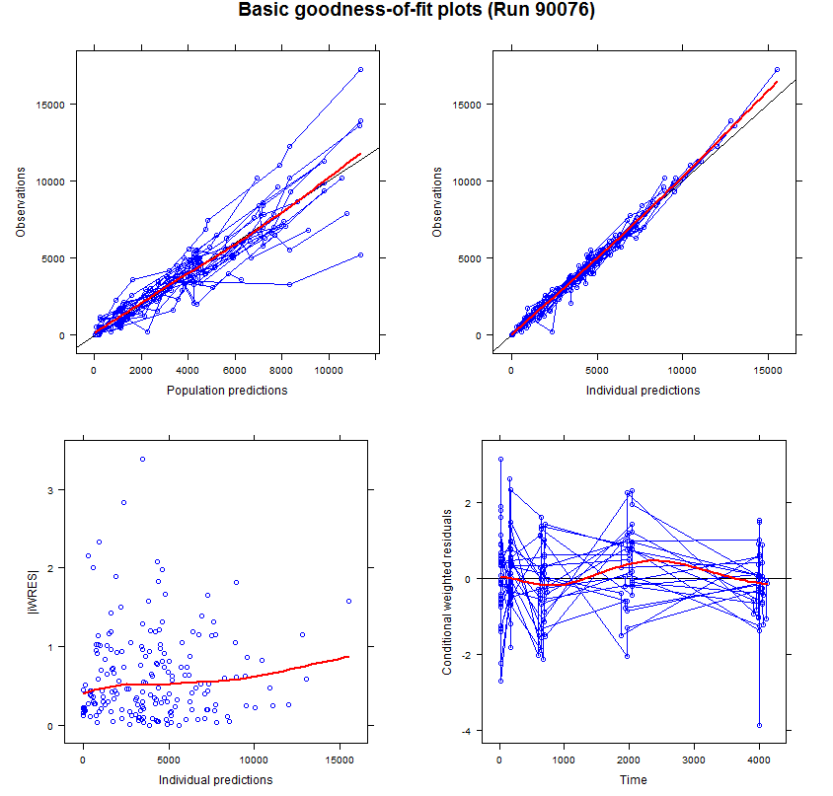
1. Predictive model
Notes:
We investigated whether the predictibe model reflects the objective data.
In this graph, our predictive model is well reflected.

Slide 9
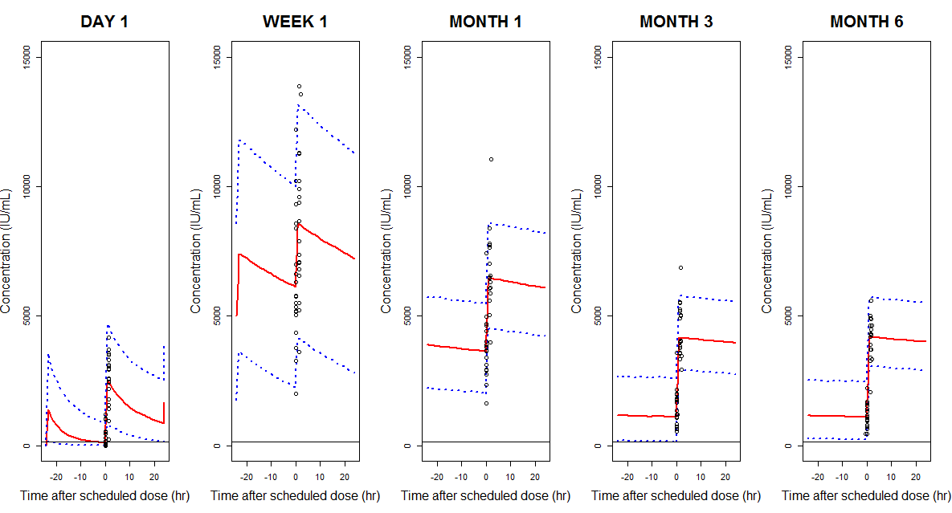
1. Predictive model
Notes:
The red solid line is the median data of predictive model, and blue dotted line is the 90% data of predictive model.
Black circle dot is the objective data.
Predictive model is well reflected.

Slide 10
2. Accurate measurement methods
Notes:
The residual error of CMIA method was the lowest.
CMIA method is the most accurate according to the our prediction model, however further evaluation is needed.

Slide 11
3. Clinical factors influencing HBIG concentration
 |  |  | Pre-1week HBsAb |  |  |  | Pre-24weeks HBsAb
 |  |  | Number | Mean | SD | P-value | Number | Mean | SD | P-value
Recipient Age |  | <60 | 13 | 9679.38 | 3707.28 | 0.515 | 13 | 2558.15 | 2215.31 | 0.317
 |  | >=60 | 7 | 8552.57 | 3421.81 |  | 5 | 1501.90 | 626.09
Sex |  | Male | 18 | 8870.44 | 3249.52 | 0.121 | 16 | 2131.19 | 2016.71 | 0.427
 |  | Female | 2 | 13016.00 | 5523.92 |  | 2 | 3333.25 | 954.95
BMI |  | <25 | 12 | 9662.50 | 4376.89 | 0.576 | 10 | 2581.75 | 2541.01 | 0.457
 |  | >=25 | 8 | 8718.75 | 1925.52 |  | 8 | 1868.50 | 766.80
Child score |  | <10 | 11 | 10952.36 | 3566.41 | 0.016 | 10 | 2837.30 | 2439.91 | 0.170
 |  | >=10 | 9 | 7247.11 | 2392.87 |  | 8 | 1549.06 | 710.49
MELD score |  | <15 | 11 | 10969.27 | 3545.64 | 0.015 | 10 | 2890.05 | 2414.92 | 0.131
 |  | >=15 | 9 | 7226.44 | 2395.25 |  | 8 | 1483.13 | 676.52
HCC |  | non-HCC | 10 | 8894.80 | 2720.51 | 0.637 | 10 | 2354.10 | 2527.22 | 0.835
 |  | HCC | 10 | 9675.20 | 4362.74 |  | 8 | 2153.06 | 987.53
Pre-LT | Total bilirubin | 3.0 미만 | 10 | 11357.80 | 3481.87 | 0.005 | 9 | 2978.67 | 2544.10 | 0.123
 |  | 3.0 이상 | 10 | 7212.20 | 2258.71 |  | 9 | 1550.83 | 664.62
 | ALT | 50 미만 | 14 | 9411.29 | 4238.11 | 0.816 | 13 | 2505.00 | 2238.80 | 0.415
 |  | 50 이상 | 6 | 8990.33 | 1158.63 |  | 5 | 1640.10 | 640.25
 | Creatinine | 1.0 미만 | 14 | 10298.57 | 3696.56 | 0.049 | 13 | 2601.65 | 2198.86 | 0.248
 |  | 1.0 이상 | 6 | 6920.00 | 1753.60 |  | 5 | 1388.80 | 537.54
 | Albumin | 3.0 미만 | 10 | 6765.60 | 2257.59 | <0.001 | 9 | 1725.78 | 776.34 | 0.252
 |  | 3.0 이상 | 10 | 11804.40 | 2751.55 |  | 9 | 2803.72 | 2608.57
Notes:
Pre-transplant patients characteristics including Child score, MELD score, bilirubin influence HBIG concentration immediately after transplantation, but not in maintenance period

Slide 12
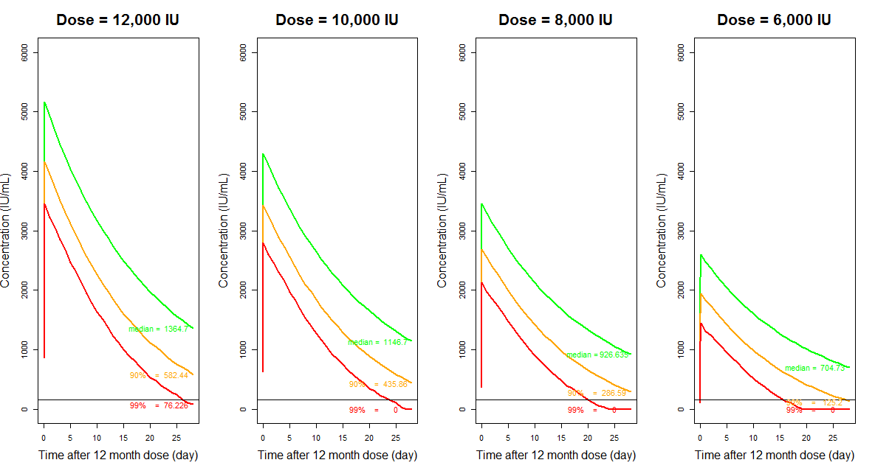
4. Prediction of proper maintenance dose
For 99% attainment
Dose = Target level * 160
For 90% attainment
Dose = Target level * 20
For 50% attainment
Dose = Target level * 9
Notes:
In our protocol, 6 months After LT, the patients were given 4,000 units of HBIG (low dose) intravenously every month.
Our target concentration of HBIG is 300 IU/ml
We predicted proper maintenance dose using our predictive model.
According to the predictive model, For 90% attainment, 6000 unit of HBIG was needed to maintain target concentration.
When formulated, maintenance dose = Target level * 20

Slide 13
Conclusions
Pre-transplant HBV DNA is the most influencing factor to HBIG concentration.
Pre-transplant liver function influence HBIG concentration immediately after transplantation, but not in maintenance period.
CMIA method is the most accurate according to the our prediction model, however further evaluation is needed.
For 90% attainment, maintenance dose = Target level * 20
Notes:
In conclusion,

Slide 14
Thank you for your attention.
Trial Registration clinicaltrials.gov Identifier: NCT02125071
Funding/Support: The study was sponsored by Green Cross Corporation
Role of the Funders/Sponsor: The sponsors were involved in the design and conduct of the study and collection and management of the data. Both Seoul St. Mary's Hospital for Clinical Research and the sponsors had access to the full trial database for analysis. The sponsors had the right to comment on the manuscript, but final decisions on content rested with the academic authors.

