Slide 1
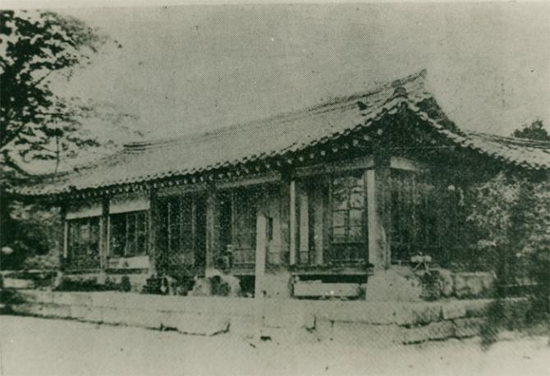
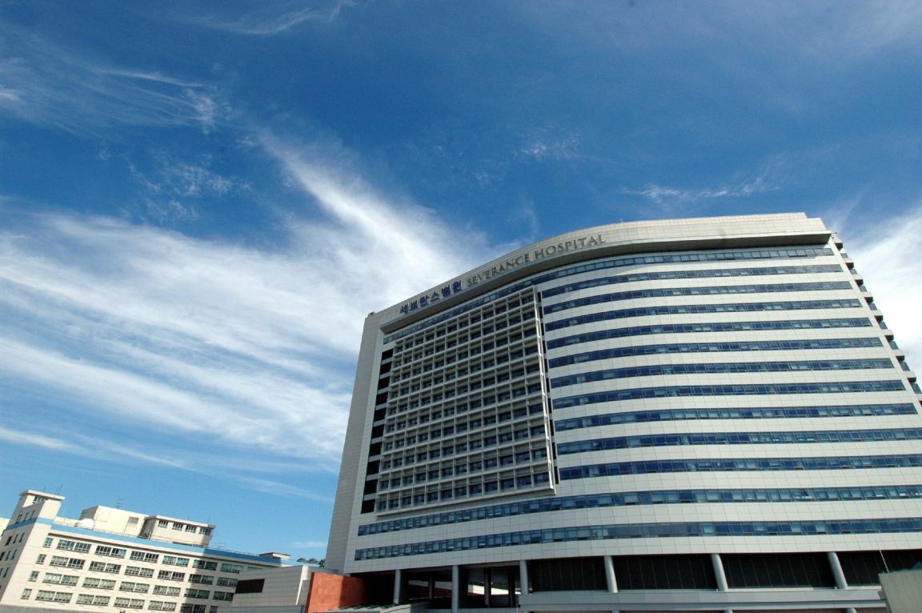
Evaluation of Safe Resection Guideline
for Preventing Post-hepatectomy Liver Failure
after Right Hepatectomy for Hepatocellular Carcinoma
Seok Jeong Yang*, Dai Hoon Han, Gi Hong Choi,
Jin Sub Choi
Division of Hepatopancreaticobiliary Surgery, Department of Surgery, Severance Hospital, Yonsei University College of Medicine,
Yonsei University Health System, Seoul, Korea
Notes:
Thanks chairman and Good afternoon everyone, Today, My topic is selecting practical predictors for postheptectomy liver failure.

Slide 2
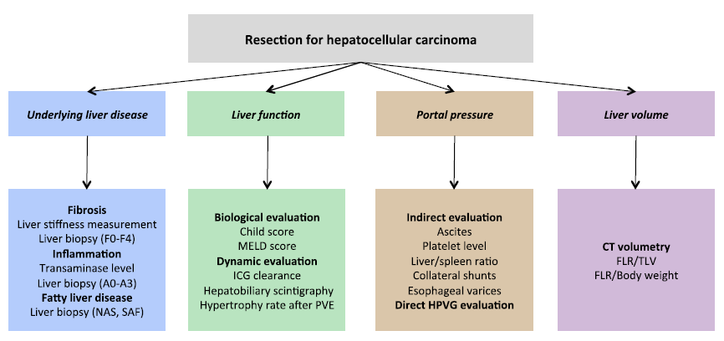
Considerations for liver resection
1.
3.
2.
4.
Notes:
When we plan to liver resection for HCC, we should consider underlying liver fibrosis, liver function, portal pressure and remnant liver volume. Although there is different preference, surgeons usually use liver stiffness measurement(LSM), ICG clearance, platelet count and CT volumetry to assess each subject. So, I gonna review these parameters shortly, then let me introduce my study.

Slide 3
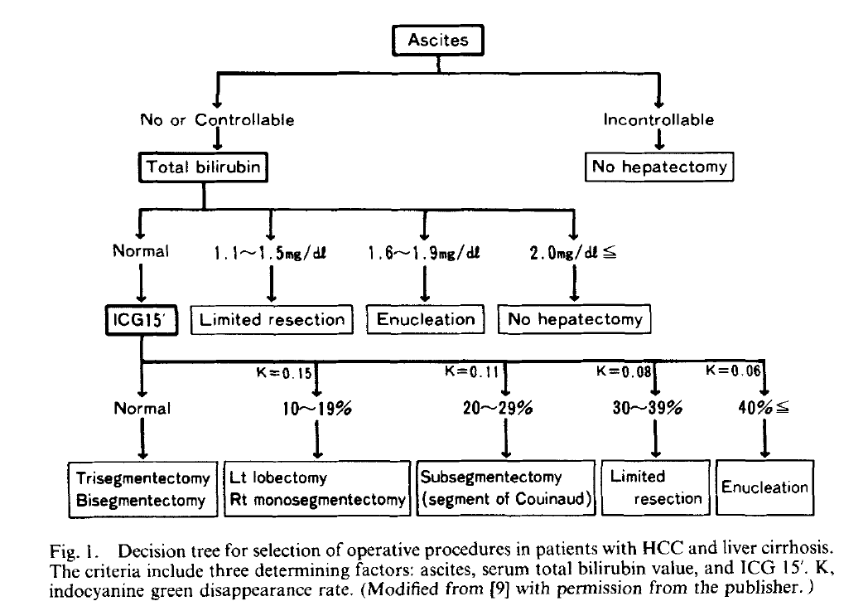
Guide 1. ICG clearance
Notes:
One of the most popular guideline for heptectomy is Makuuchi’s decision tree based on bilirubin level and ICG clearance. But, as we know, suggested bilirubin level is too tight and ICG clearance can be affected by many factors. So We need to update this 23 years old guidleline to keep pace with recent advancement of medicine.

Slide 4
Guide 2. Platelet count (150,000)
Notes:
Next parameter is Platelet count. At 2011, Dr. Maithel reported multicenter study, the result is peroperative PLT count 150,000 per microL is cut-off value for the probability of major complications, liver failure and 60 day mortality. But, this value seemed to be too high to abandone any hepatectomy.

Slide 5
Guide 3. Liver Stiffness Measurement
Annals of Surgery Volume 257, Number 5, May 2013
Notes:
Liver stiffness measurement by fibroscan is relatively recent item. Many researchers revealed that the Fibroscan score can reflect accurate pathologic liver fibrosis degree and portal HTN.
In Korea, Professor Kim and collegues reported Fibroscan score 25 is critical level related to severe postoperative hepatic insufficiency. At 2013, Dr. Wong also mentioned fibroscan score 12 is the single prognostic factor for major complication in the multivariate ananlysis. But, These studies used different definition of posthepatectomy liver failure and contained various extent of hepatectomy, So that’s why the cut-off value is quite difference from the study to study.

Slide 6
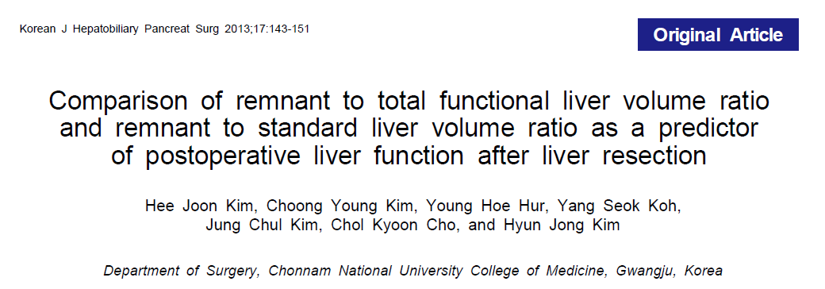
Guide 4. Remnant liver volume
Notes:
The last parameter is remnant liver volume. In general, we know remannt liver volume should be more than at least 20% of total liver volume in non-disease liver. And Recent studies are saying that remnant liver volume to body weight ratio 0.5 or to standard liver volume ratio 30% , which reported by Dr kim from Chonnam national university, are more accurate than to total liver volume to predict liver failure. But for diseased liver, I think we don’t have enough evidence to decide safe remannt liver volume.

Slide 7
Evaluation of Safe Guideline
to Prevent Postoperative Liver Failure
after Major Hepatectomy
ICG clearance
Platelet count
Liver stiffness measurement
Remnant liver volume
- According to Extent of Hepatectomy
Notes:
So, We tried to evaluate appropriate cut-off levels of these four parameters according to extent of hepatectomy to prevent posthepatectomy liver failure(PHLF)

Slide 8
Evaluation of Safe Guideline to Prevent Posthepatectomy Liver Failure - For Right Hepatectomy -
Material and Method
From January 2007 to December 2013
Right hepatectomy for Hepatocellular Carcinoma
Preoperative work-up by Fibroscan® and ICG R15
Check residual volume with Voxel ®
Posthepatectomy Liver Failure(PHLF) by criteria of International Study Group of Liver Surgery(ISGLS)
Notes:
As a first step, we designed retrospective study from January 2007 to December 2013, confined to right hepatectomy for HCC, the PHLF was defined as international study group of liver surgery(ISGLS) criteria.

Slide 9
Patient Selection
2007.3~2013.12
Liver resections for HCC
N =835
Exclusion
633 cases other than Right hepatectomy
Right hepatectomy
N = 202
Exclusion
1) 106 cases absence of Fibroscan®, ICG R15, CT volumetry
2) 5 cases invalid data for PHLF
N = 90
Notes:
During study period, 202 patients were underwent right hepatectomy for HCC. Among them we only included 90 cases who had all four parameters and enough data to estimate PHLF.

Slide 10
Grading of Posthepatectomy Liver Failure by ISGLS
Clinical Relevant PHLF
Notes:
ISGLS categorized PHLF as grade A, B, C. Grade A is just when there are abnormal INR or bilirubin level at POD 5 without any clinical implication. So We divided study group to No PHLF or grade A and Grade B or C group, then we named grade B or C as clinical relevant PHLF.

Slide 11
Demographics (1)
Table 1. Preoperative characteristics of the study population
Variables | N=90
Age (years) | 55.6 (28-81)
Sex (Male/Female, %) | 78(86.7%) / 12 (13.3%)
BMI (kg/m²) | 23.3 ± 3.1
Background liver disease (%)
HBV | 77 (86.5%)
HCV | 4 (4.5%)
Alcoholic LC | 1 (1.1%)
Others | 7 (7.8%)
Hypertension / DM (%) | 20 (22.2%) / 15 (16.7%)
Hemoglobin (g/dL) | 14.2(11-17)
Platelet count (10⁹/L) | 175 (71-334)
Albumin (g/dL) | 4.3 (3.3-5.6)
AST (IU/L) | 35.7 (17-111)
ALT (IU/L) | 37.3 (8-172)
Total bilirubin (mg/dL) | 0.7 (0.2-1.4)
Prothrombin time (%) | 95.8 (80-100)
Alpha-feto protein (ng/mL) | 24.4 (1.5-83000)
PIVKA-II* (mAU/mL) | 67 (0-17817)
ICG R15 (%) | 9.2 (3.2-24.8)
Liver stiffness in fibroscan (kPa) | 12.4 (4.0-48.0)
RLV/TFLV†(%) | 39.3 (17.1-75.7)
RLV/Bwt ‡ | 0.69 (0.28-1.38)
Child-Pugh score (%) | A (100%)
MELD§ score | 6.8 (6-11)
* Prothrombin induced by vitamin K absence-II, † Remnant liver volume to total functional liver volume ratio, ‡ Remnant liver volume to body weight ratio, § Model for End-stage Liver Disease
Notes:
The Demographics of this study is here. The median value of PLT is 175, biliruin level was 0.7, ICG R15 was 9.2, Fibroscan score was 12.3, Remannt liver volume to total liver volume ratio was 39.3 and Remnant liver volume to Body weight ratio was 0.69. But as you see, there were wide ranges of each parameters.

Slide 12
Demographics (2)
Table 2. Perioperative characteristics of the study population
Variables | N=90
Tumor size (cm) | 4.4 (1-11)
Fibrosis stage (%)
1 / 2 | 1 (1.1%) / 19 (21.1%)
3 / 4 | 23 (25.6%) / 42(46.7%)
Operative time (min) | 269.4 (136-753)
Blood loss (ml) | 594.3 (50-2200)
Hospital stay (days) | 14.5 (7-69)
Postoperative complications¶ (%) | 45 (49.9%)
I | 12 (13.3%)
II | 18 (20.0%)
III | 11 (12.2%)
IV | 1 (1.1%)
V | 3 (3.3%)
Posthepatectomy Liver Failure(PHLF)** (%) | 24 (26.6%)
Grade A | 9 (10.0%)
Grade B | 11 (12.2%)
Grade C | 4 (4.4%)
Postoperative mortality (%) | 3 (3.3%)
Death within 1 year after surgery (%) | 10 (11.1%)
¶ Postoperaive complications are stratified according to Clavien-Dindo classification, ** Posthepatectomy liver failure(PHLF) is defined as suggestion by International Study Group of Liver Surgery(ISGLS)
Notes:
About 72% patients had more than fibrosis or cirrhosis by pathologic report. 26.6% patient had PHLF, among them Grade B was 12.2%, Grade C was 4.4%. The in hospital mortality was 3.3% and about 10% of total patients died by HCC or liver disease progression within1 year after surgery.

Slide 13
Clinical factors for Posthepatectomy Liver Failure(PHLF) after Right hepatectomy
Table 3. Comparisons of clinicopathologic variables between the groups with or without Clinical Relevant PHLF(CR PHLF)†† after right hepatectomy
Clinicopathologic variables | CR PHLF (n=15) | No CR PHLF (n=75) | P-value
Age (years) | 55 (43-72) | 56 (28-81) | 0.452
Sex (Male/Female) | 14 (93.3%) / 1 (6.7%) | 64 (85.3%) / 11 (14.7%) | 0.682
BMI (kg/m²) | 23.6 (19.6-28.3) | 22.8 (17.6-35.4) | 0.383
Background liver disease |  |  | 0.357
HBV | 13 (86.7%) | 64 (86.5%)
HCV | 2 (13.3%) | 2 (2.7%)
others | 0 (0%) | 9(10.8%)
Platelet count (10⁹/L) | 121.0 (71-201) | 168.5 (72-334) | 0.000
Albumin (g/dl) | 4.3 (3.4-5.6) | 4.4 (3.3-5.0) | 0.302
AST (IU/L) | 34.0 (23-111) | 31.0 (17-102) | 0.063
ALT (IU/L) | 36.0 (12-172) | 30.5 (11-96) | 0.159
Total bilirubin (mg/dL) | 0.8 (0.4-1.2) | 0.7 (0.3-1.4) | 0.030
Prothrombin time (%) | 98 (80-100) | 98 (80-100) | 0.069
ICG R15 (%) | 9.1 (5.3-24.8) | 7.9 (3.2-20.5) | 0.149
Liver stiffness by Fibroscan® (kPa) | 12.1 (6.4-35.3) | 9.9 (4.0-48.0) | 0.025
MELD score | 7 (6-9) | 7 (6-11) | 0.298
RLV/TFLV (%) | 31.8 (18.1-43.7) | 38.9 (17.1-75.7) | 0.001
RLV/Bwt | 0.51 (0.28-0.74) | 0.69 (0.35-1.37) | 0.000
Tumor size (cm) | 3.3 (1.7-9.6) | 4.0 (1.0-11.0) | 0.168
Fibrosis stage 4 (%) | 12 (80.0%) | 30 (42.9%) | 0.002
Operative time (min) | 249 (175-343) | 250 (136-753) | 0.471
Blood loss (ml) | 500 (50-2200) | 425 (50-2000) | 0.115
Postoperative mortality (%) | 2 (13.3%) | 1 (1.3%) | 0.071
Death within 1 year after surgery (%) | 5 (33.3%) | 5 (6.7%) | 0.010
†† Clinical Relevant Posthepatectomy Liver Failure(CR PHLF) means grade B and C PHLF by ISGLS definition
Notes:
When we compared the clinical relevant PHLF group to No CR PHLF group. Platelet count, total bilirubin level, Fibroscan score and remnant liver volume showed statistical significan difference. But ICG clearance did not.

Slide 14
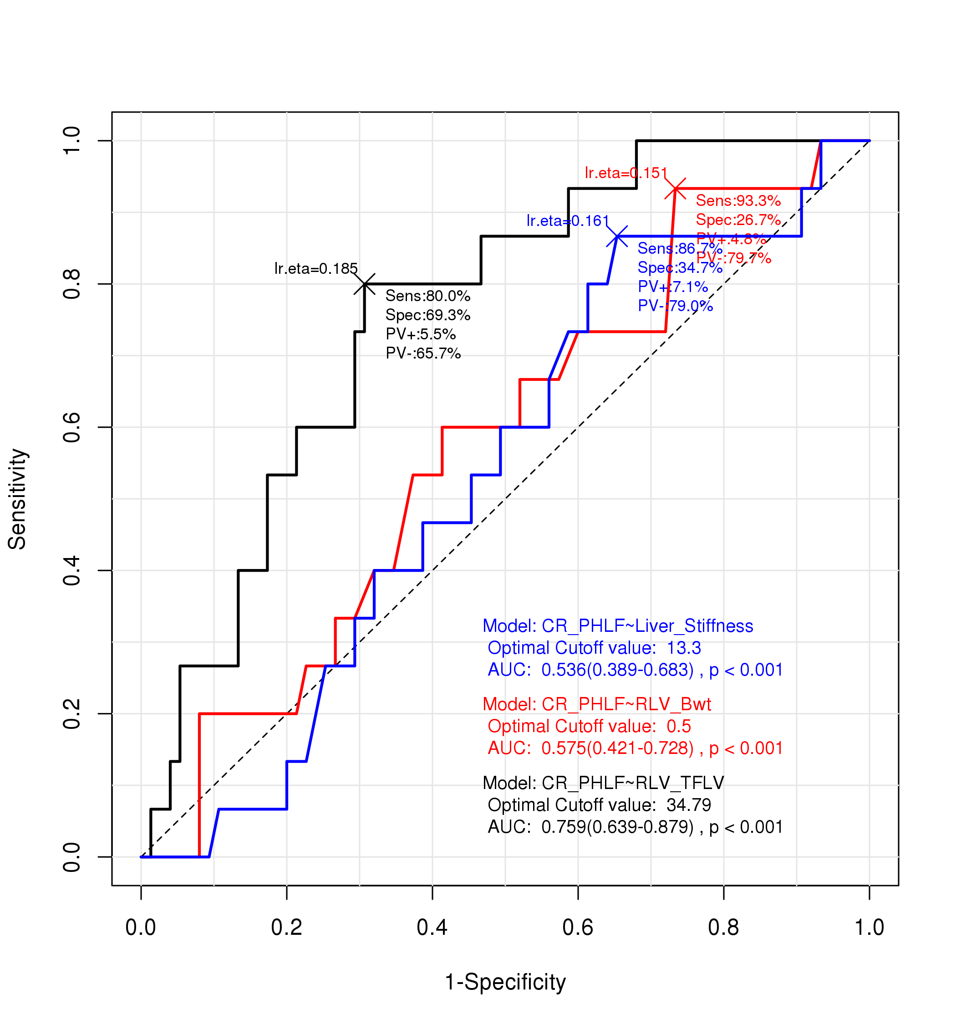
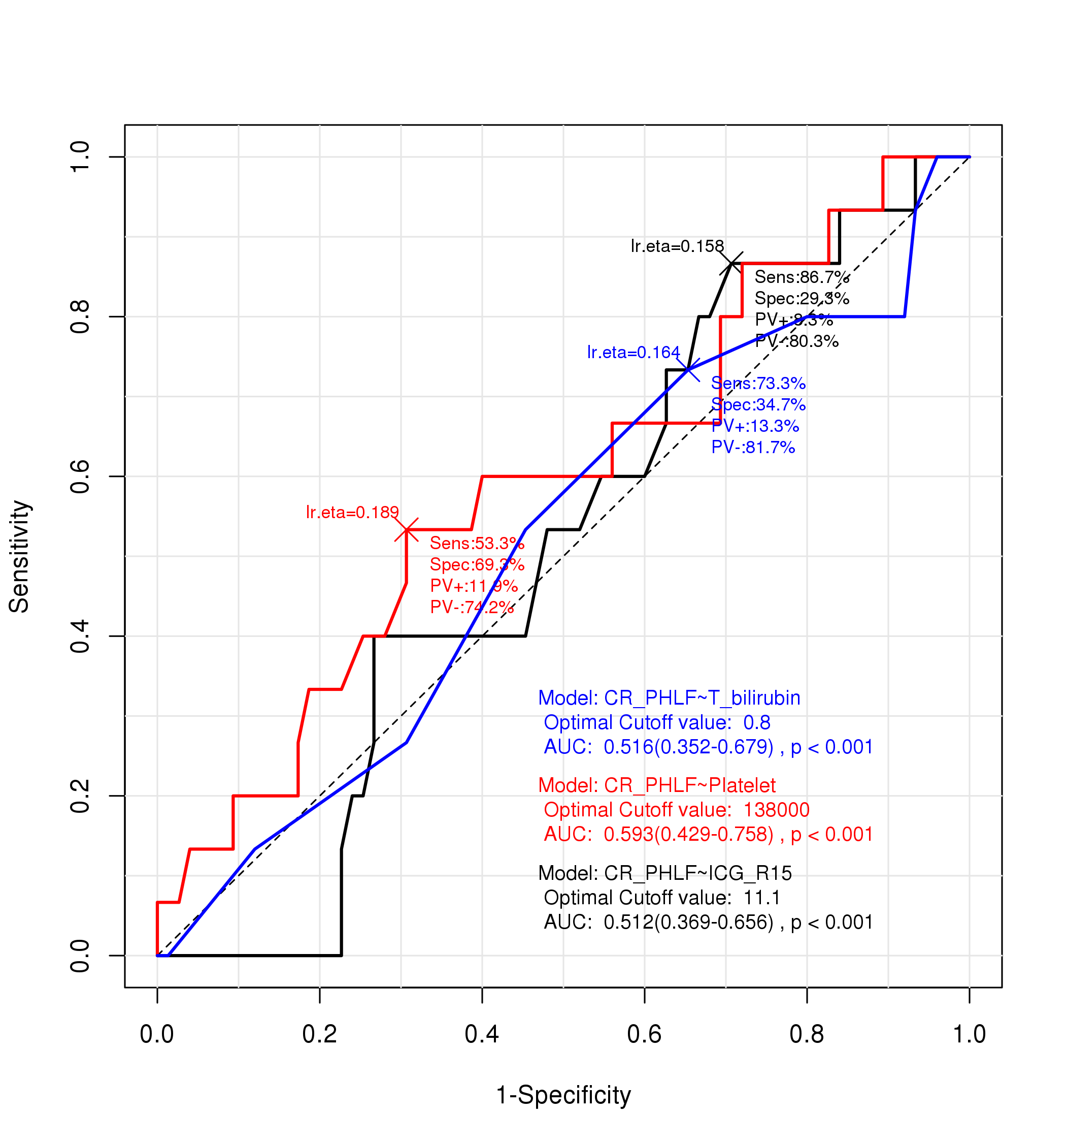
ROC curves and Cut-off values for Clinical relevant PHLF after Right hepatectomy (1)
Comparison of ROC curves | AUC | 95% CI | Cut- off value
RLV/TFLV (%) | 0.759 | 0.639-0.879 | 34.79
RLV/Bwt | 0.575 | 0.421-0.728 | 0.5
Platelet count(10⁹/L) | 0.593 | 0.429-0.758 | 138
Total Bilirubin | 0.516 | 0.352-0.679 | 0.8
Liver_Stiffness | 0.536 | 0.389-0.683 | 13.3
ICG R15 | 0.512 | 0.369-0.656 | 11.1
Notes:
To determine cut-off levels of each items, We drawed ROC curves. As you see, RLV to TFLV has widest area under curve and the cut-off value was about 35%. And PLT count showed the second wide area under curve and the cuf-off is 138.

Slide 15
Validation of new criteria for expectation of Clinical Relevant PHLF after Right hepatectomy (1)
Table 4. Logistic regression analysis of risk factors for clinical relevant posthepatectomy liver failure after right hepatectomy
Clinicopathologic factors | Univariable (P-value) | Multivariable (P-value) | Exp(B) (95% CI)
Platelet count (10⁹/L) < 138 | 0.000 | 0.002 | 14.812 (2.771-79.181)
Total bilirubin (mg/dL) > 0.8 | 0.079 | 0.835 | 0.748 (0.159-3.505)
ICG R15 (%) > 11.1 | 0.914 | 0.230 | 3.104 (0.488-19.730)
Liver stiffness in fibroscan (kPa) > 11 | 0.038 | 0.557 | 0.555 (0.078-3.965)
Liver stiffness in fibroscan (kPa) > 13.3 | 0.161 | 0.354 | 0.381 (0.049-2.930)
RLV/TFLV (%) < 34.79 | 0.001 | 0.012 | 9.302 (1.644-52.652)
RLV/Bwt < 0.5 | 0.025 | 0.344 | 2.220 (0.425-11.584)
Notes:
Among those criteria, the Platelet count 138 and RLV to TFLV ratio 34.79 % are only proven risk factor by multivariable analysis. And we can expect CRPHLF prevalence with those two parameter.

Slide 16
Validation of new criteria for expectation of Clinical Relevant PHLF after Right hepatectomy (2)
Table 5. Perioperative and postoperative course according to Platelet count (Cut-off value = 138, ×10⁹/L)
Variables | Platelet ≥ 138 (n=59) | Platelet < 138 (n=31) | P-value
Operative time (min) | 259 (136-753) | 249 (140-565) | 0.619
Blood loss (ml) | 450 (50-2000) | 500 (50-2200) | 0.331
PHLF (%) | 10 (16.9%) | 14 (45.2%) | 0.006
CR PHLF (%) | 3 (5.1%) | 12 (38.7%) | 0.000
Clinical relevant complication ‡(%) | 6 (10.3%) | 9 (29.0%) | 0.025
Hospital stay (days) | 12 (7-26) | 15 (8-69) | 0.005
Postoperative mortality (%) | 1 (1.7%) | 2 (6.5%) | 0.272
Death within 1 year after surgery | 4(6.8%) | 6 (19.4%) | 0.087
‡ postoperative complications which are more than grade III by Clavien-Dindo classification
Table 6. Perioperative and postoperative course according to RLV/TFLV (Cut-off value = 34.79)
Variables | RLV/TFLV ≥ 34.79 (n=54) | RLV-Bwt ratio < 34.79 (n=36) | P-value
Operative time (min) | 263 (140-565) | 237 (136-753) | 0.759
Blood loss (ml) | 425 (50-2050) | 550 (50-2200) | 0.240
PHLF (%) | 7 (13.0%) | 17 (47.2%) | 0.000
CR PHLF (%) | 3 (5.6%) | 12 (33.3%) | 0.001
Clinical relevant complication ‡(%) | 7 (13.2%) | 8 (22.2%) | 0.387
Hospital stay (days) | 12 (7-44) | 13 (8-69) | 0.107
Postoperative mortality (%) | 0 (0.0%) | 3 (8.3%) | 0.061
Death within 1 year after surgery | 5(9.3%) | 5 (13.9%) | 0.513
Notes:
Those two parameters are the discriminating factor for PHLF, CR-PHLF, more than Grade III complication prevalences.

Slide 17
Evaluation of Safe Guideline to Prevent Posthepatectomy Liver Failure in Hepatocelluar Carinoma Patients - For Rt. Hepatectomy -
Conclusions
1. Platelet count, total bilirubin, liver stiffness measurement, residual liver volume to body weight ratio or total functional liver volume are significantly related to posthepatectomy liver failure after right hepatectomy
2. Platelet count <138 ×10⁹/L and RLV/TFLV (%) < 34.79 are most effective predictors for clinical relevant posthepatectomy liver failure
Limitations
Retrospective study, selection bias
Further investigation is needed to subgroup analysis and multicenter study.
Notes:
Conclusions ~~,
But A strong selection bias is a crucial handicap of this retrospective study. I mean the enrolled patients seemed to be appropriate subjects or inevitable cases for right hepatectomy eventhough they had abnormal level of each parameters.
And, The concept of grade B PHLF of ISGLS is too broad, sometimes we can accept the grade B PHLF, So, Grade C subgroup analysis is necessory but the cases of grade C was just 4.. So, We need multicenter study.

Slide 18
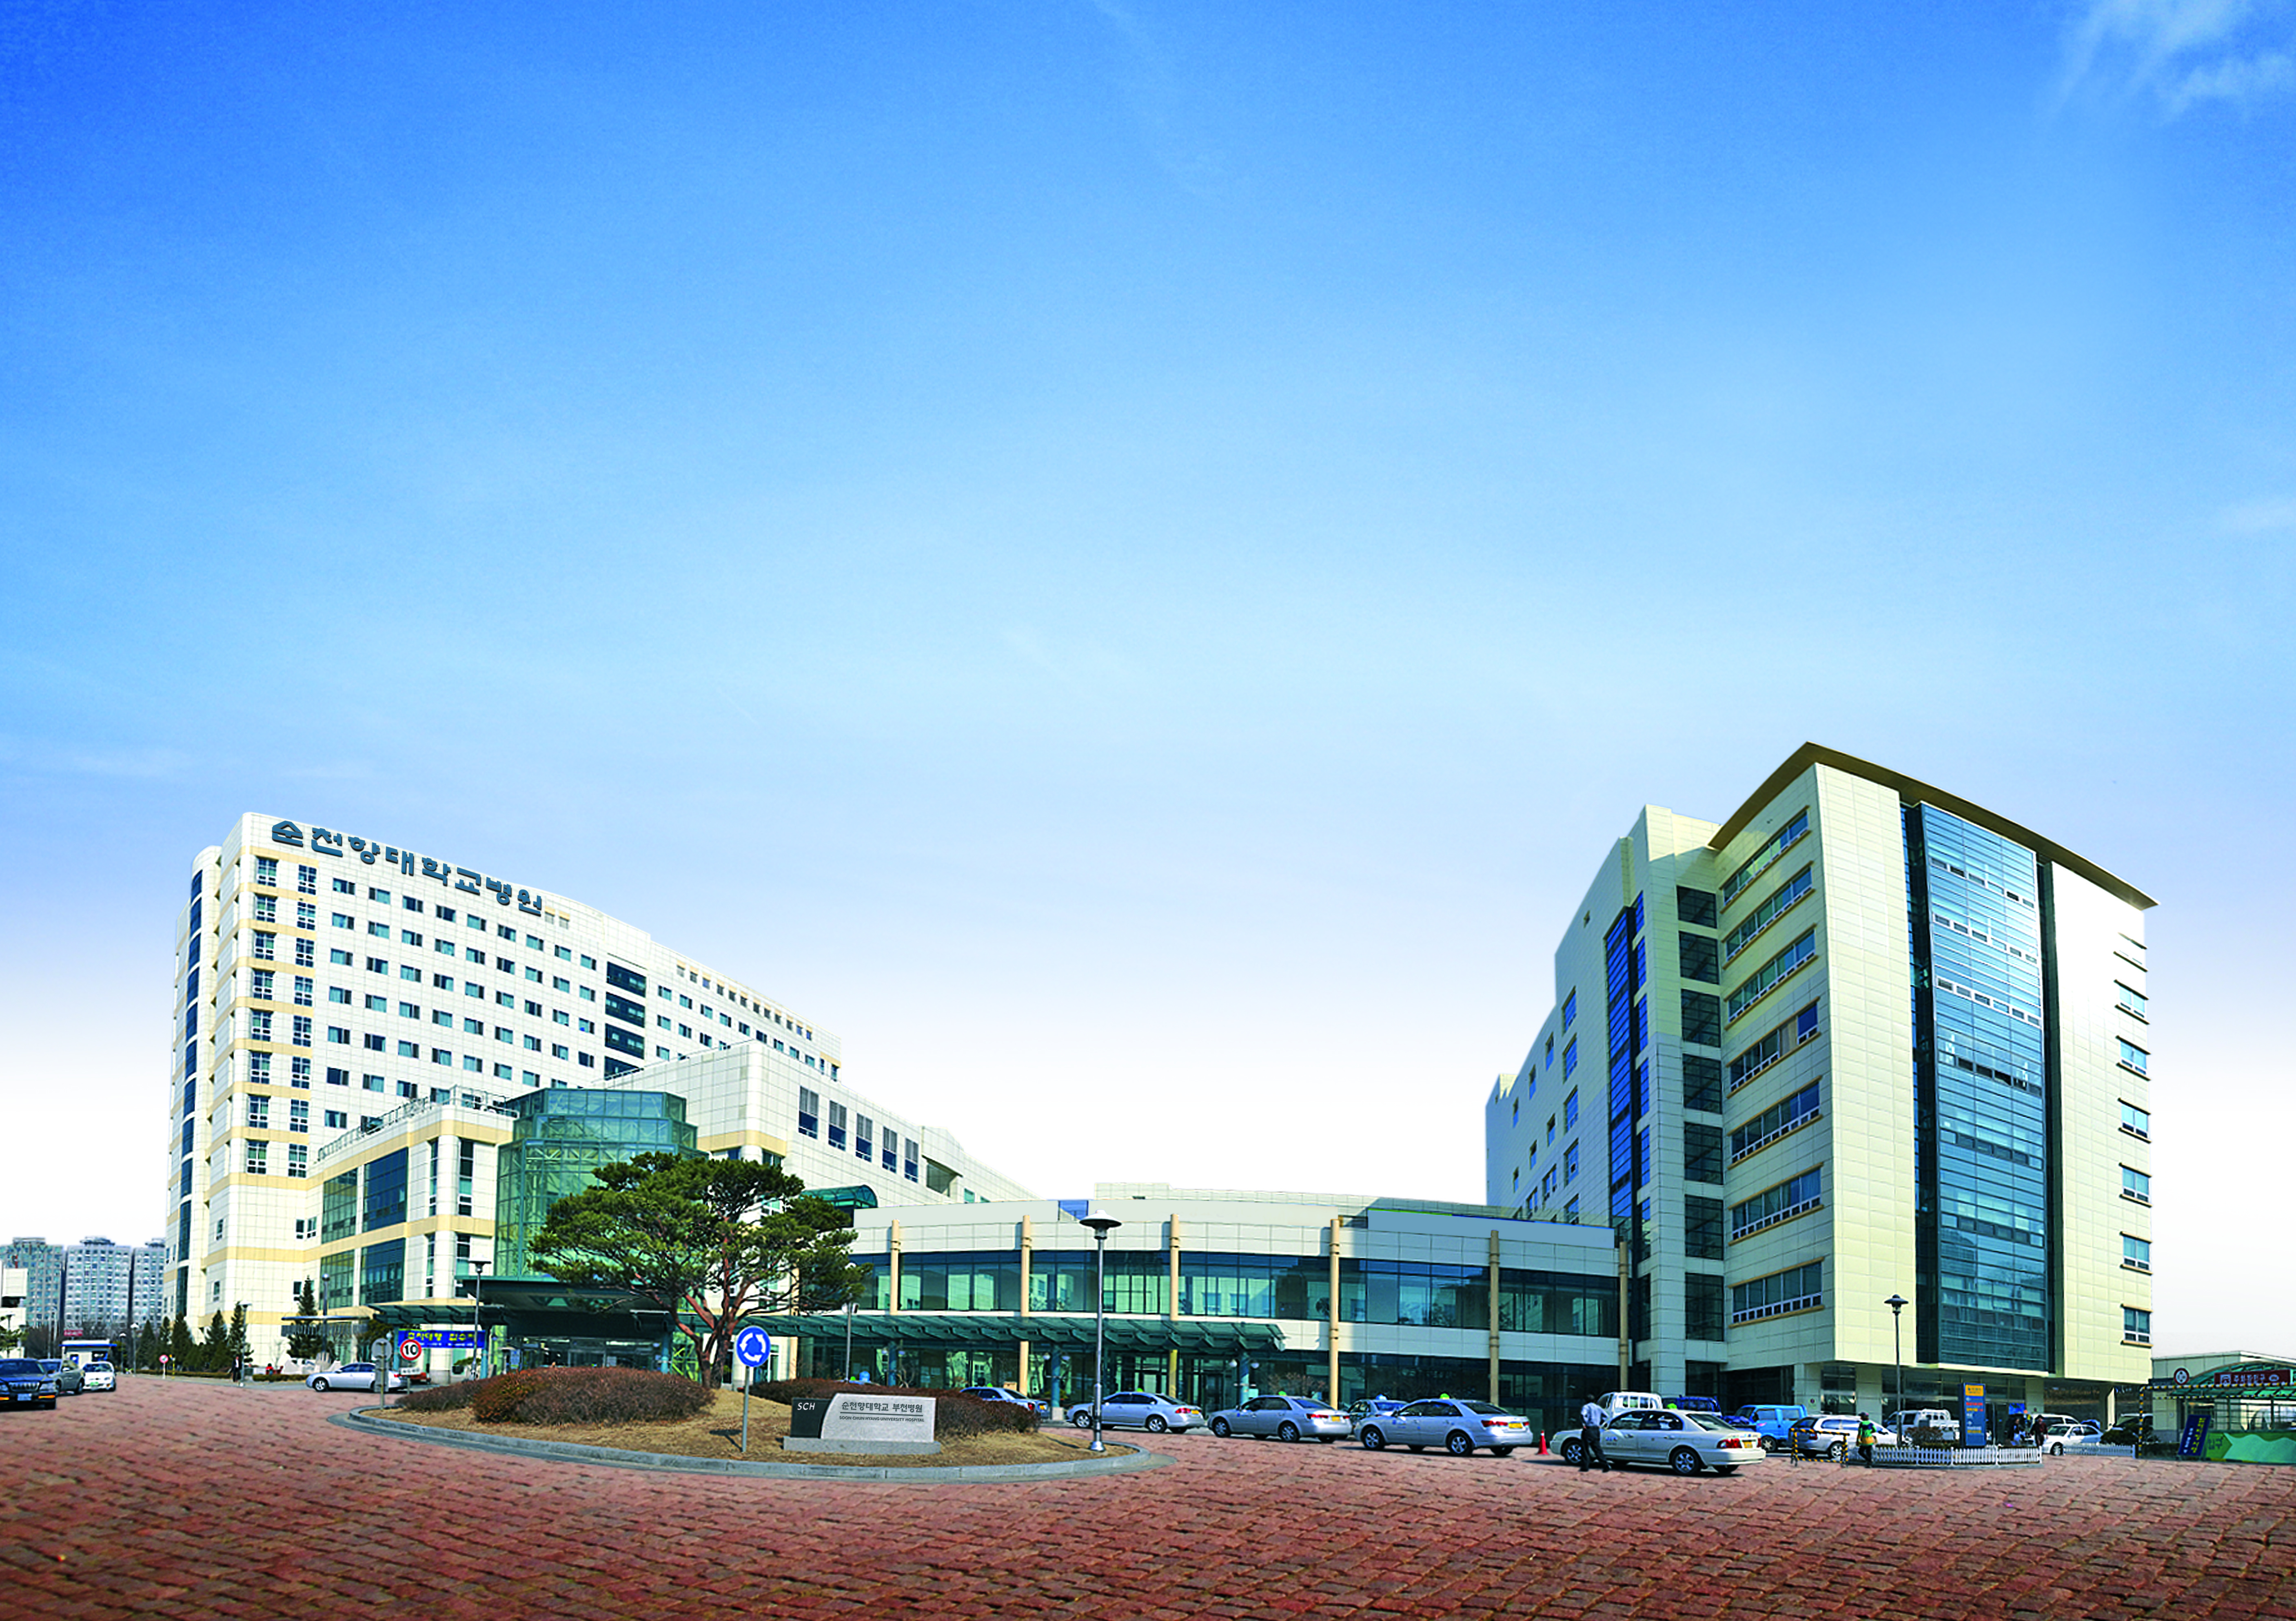
Thanks for your attentions

Slide 19
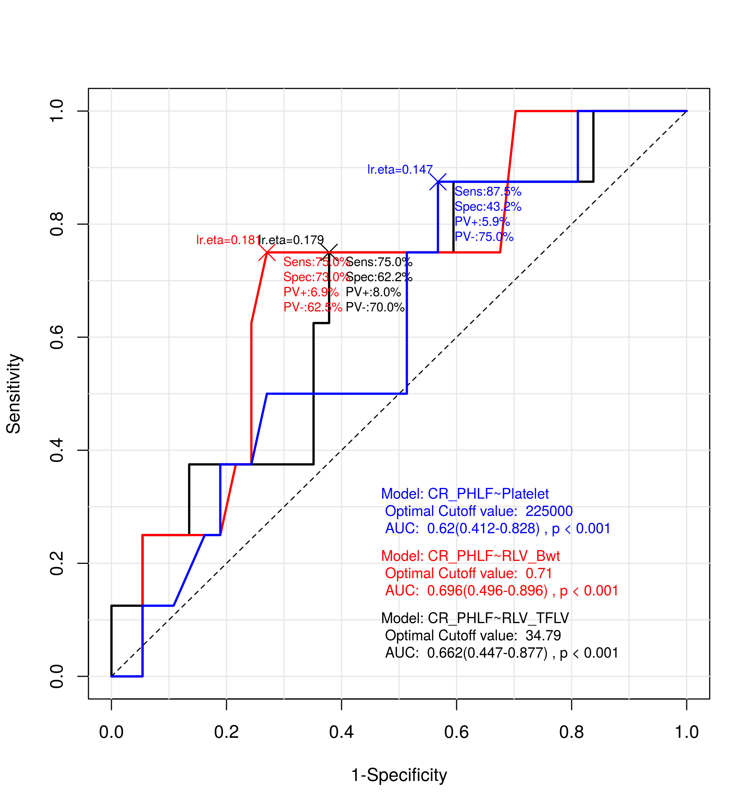
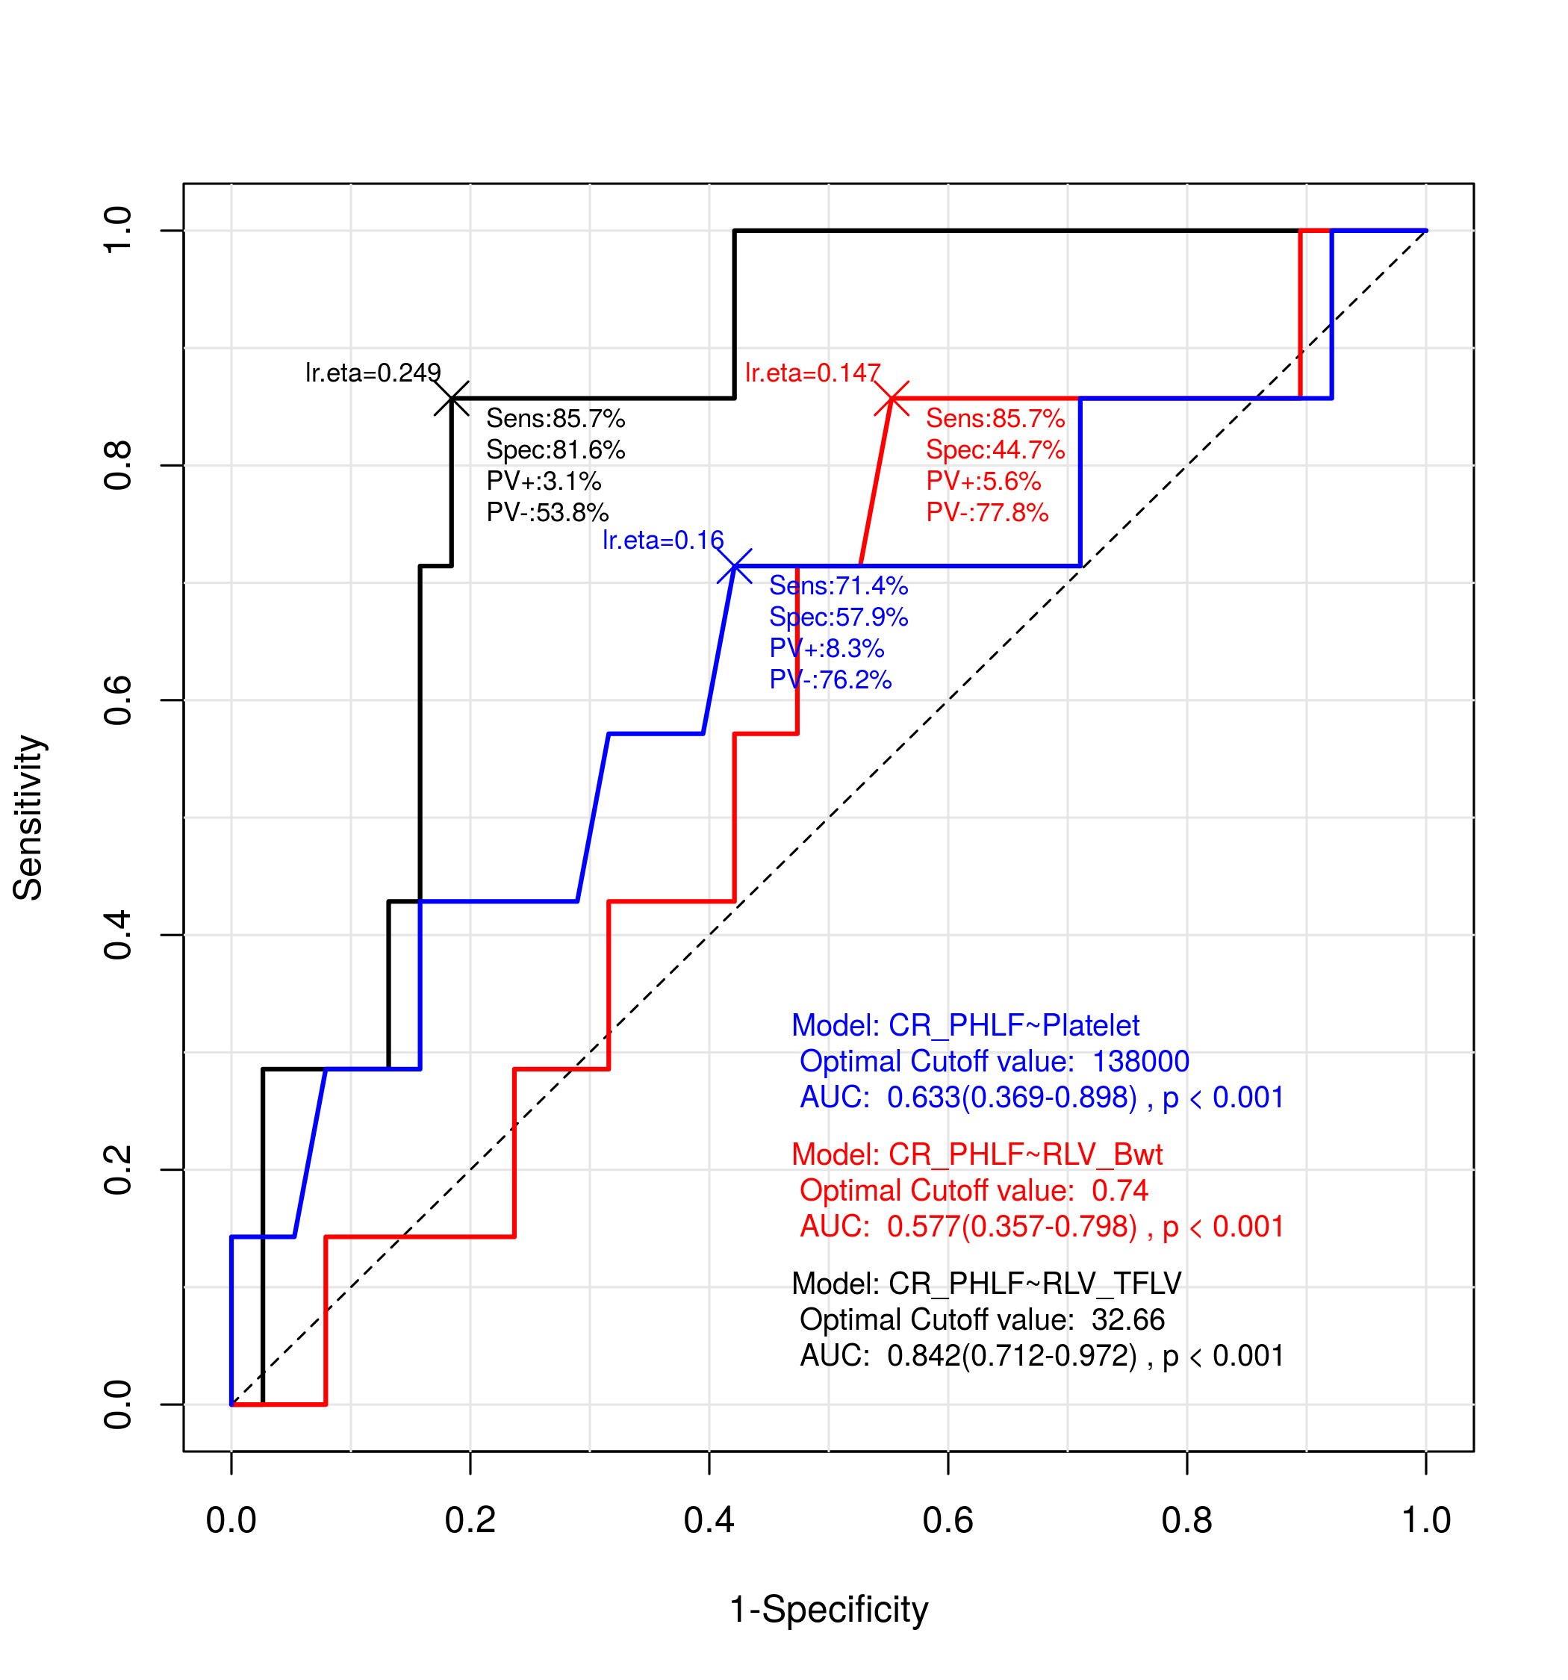
ROC curves and Cut-off values for Clinical relevant PHLF after Right hepatectomy (2)
In LSM < 11 kPa
In LSM ≥ 11 kPa
Notes:
As you know, fibroscan score 11 is well matched with grade 4 fibrosis or cirrhosis. Interestingly, when we divided CR PHLF group to fibroscan score 11 less or more subgroup, in the more than 11 kpa of LSM group, RLV /TFLV ratio is most appropriate, and If LSM is less than 11, RLV / body weight is best predictors of CR , It can be translated that if there is cirrhosis(like majority patients in this study), the safe future remnant liver volume should be decided according to total functional liver volume, not to body weight or SLV.

