Slide 1
Recurrence Patterns of Curative Resected Ampulla of Vater Cancer
: Significance of Lymph Node Dissection Around Superior Mesentery Artery
Hongbeom Kim, Jae Ri Kim, Wooil Kwon, Jin-Young Jang,
Sun-Whe Kim
Division of Hepatobiliarypancreas Surgery
Department of Surgery
Seoul National University College of Medicine

Slide 2
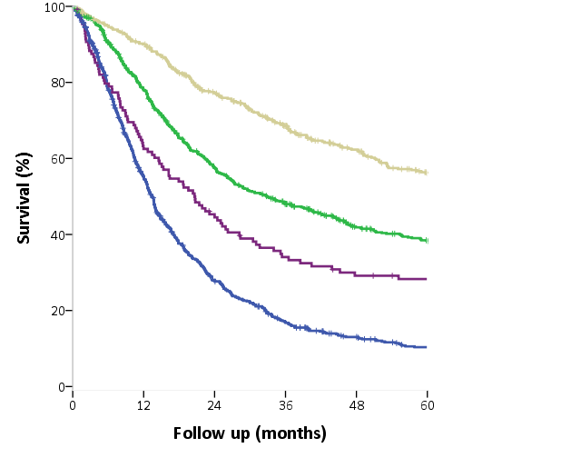
Background
Ampulla of Vater (AoV) cancer have better prognosis than other peri-ampullary cancers.
Prognosis of AoV cancer : different according to the stage
→ necessary to establish treatment guideline according to the stage
AoV cancer
Overall survival rate
Distal CBD cancer
Duodenal cancer
Pancreas head cancer
1983-2012 SNUH data
Unpublished
Month
Treatment strategy must be based on tumor biology and recurrence pattern
Notes:
이 슬라이드에서는 첫번째 문장과 생존그래프가 불필요하고 아래 내용만 있으면 될것 같다는 말씀이셨는데, 전보다 여백이 많이 생긴 것 같고 아래 것으로 한 페이지 채우려면 너무 썰렁하니 그냥 두는 것도 괜찮겠다. 너가 정해라.

Slide 3
Purpose
To figure out recurrence patterns according to the stage in AoV cancer
To suggest optimal treatment of AoV cancer
To identify significance of SMA node dissection based on recurrence pattern in AoV cancer
Notes:
이 페이지에서는 ca 말고 cancer 다 쓰라는 말씀으로 기억됨.

Slide 4
Methods
Jan. 2000 ~ Jun. 2012,
259 AoV cancer patients with R0 resection by
Pancreaticoduondenectomy
Extent of LN dissection around SMA and celiac axis:
up to Rt. side of SMA and celiac axis
Recurrence pattern and risk factors analysis
Recurrence sites identification: CT / MRI / PET
Notes:
사진 바꾸기

Slide 5
Demographics
Variables | N=259
Age* (yr) | 61.7 ± 10.1
Sex, M:F 138 : 121
Operation Whipple’s op PPPD TP** | 52 204 3 | (20.1%) (78.8%) (1.2%)
Histology W/D M/D P/D | 84 154 21 | (32.4%) (59.5%) (8.1%)
Adjuvant Tx. | 122 | (47.1%)
Variables | N=259
Stage Ia Ib IIa IIb III | 71 58 57 74 2 | (27.4%) (22.4%) (20.8%) (28.6%) (0.8%)
T classification T1 T2 T3 T4 | 80 81 96 2 | (30.9%) (31.3%) (37.1%) (0.8%)
LN metastasis | 76 | (29.3%)
*Mean ± SD
**Total pancreatectomy

Slide 6
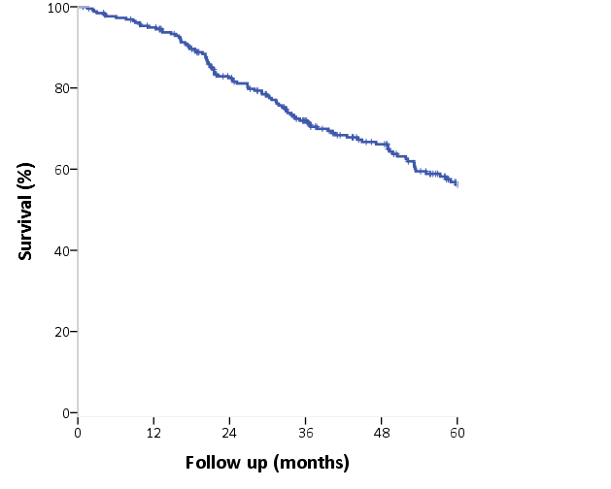
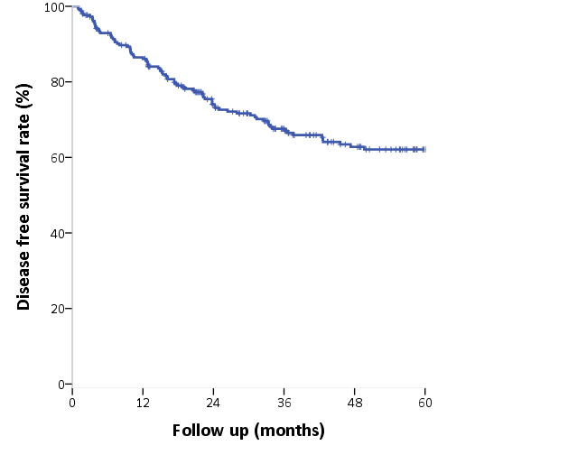
Survival and recurrence rate
Median F/U period : 40.7 months
Recurrence: 89 case (34.4%)
Median recur time: 15.3m
Recurrence free survival rate: 62.1%
Overall survival rate: 56.1%
Local only | Local + Distant | Distant only
19 (21.3%) | 14 (15.7%) | 56 (62.9%)

Slide 7
Risk factors of recurrence
Univariate analysis
Multivariate analysis
 | No Recur n=170 |  |  | Recur n=89 |  | P value | Hazard Ratio | 95% CI | P value
Sex M | 89 | (52.4%) |  | 49 | (55.1%) | 0.679
F | 81 | (47.6%) |  | 40 | (44.9%)
Age* (year) | 61.1 ± 10.1 |  |  | 62.8 ± 10.0 |  | 0.185
Histology W/D | 73 |  | (42.9%) | 11 | (12.4%) | <0.001 |  |  | .002
M/D | 90 |  | (52.9%) | 64 | (71.9%) |  | 3.061 | 1.436 – 6.527 | .004
P/D | 7 |  | (4.1%) | 14 | (15.7%) |  | 6.914 | 2.121 – 22.541 | .002
T T1 | 68 |  | (40.0%) | 12 | (13.5%) | <0.001 |  |  | .010
T2 | 55 |  | (32.4%) | 26 | (29.2%) |  | 1.619 | 0.709 – 3.699 | .253
T3/4 | 47 |  | (27.6%) | 51 | (57.3%) |  | 3.192 | 1.439 – 7.081 | .004
N N0 | 138 |  | (81.2%) | 45 | (50.6%) | <0.001
N1 | 32 |  | (18.8%) | 44 | (49.4%) |  | 2.578 | 1.394 – 4.767 | .010
*Mean ± SD
Notes:
Multivariate에서는 95% CI 어지간하면 써주자.
그리고 %는 행 중 % 말고 열 중 % 를 적어야 할 것 같은데..
예를 들면 No recur group에서 남자가 89명으로 52.4%고 여자가 51명으로 47.6%.
그 그룹의 전체에서 차지하는 비율에 차이가 있음을 검정하는 것이므로…
그리고 multivariate에서 N1이 HR 2.309인거 맞지??

Slide 8
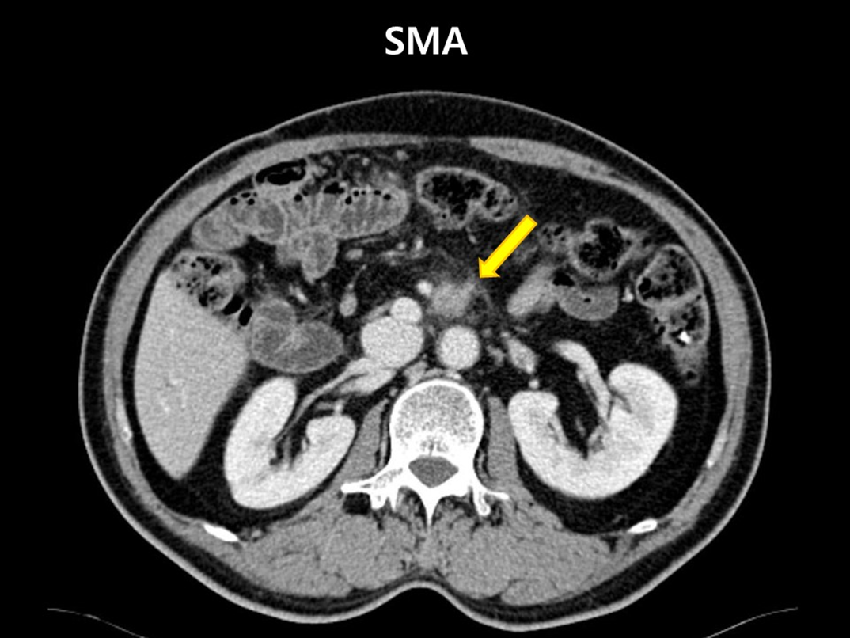
Recurrence site
Recurrence at 149 sites in 89 patients
Locoregional recur. N = 33 | n
LN SMA | 21
CHA | 5
Porto-caval | 2
Celiac | 1
PJ | 2
Pancreas | 1
HJ | 1
Distant recur. N = 116 | n
Liver | 52
Lung | 18
Peritoneal seeding | 15
Distant LN | 23
Bone | 4
Adrenal | 2
Brain | 2

Slide 9
Factors associated with recurrence patterns
Variable N=89 | Local only n=19 |  | Local + distant n=14 |  | Distant only n=56 |  | P value
Sex M | 7 | (36.8%) | 9 | (64.3%) | 33 | (58.9%) | 0.186
F | 12 | (63.2%) | 5 | (35.7%) | 23 | (41.1%)
Age* (year) | 66.1 ± 6.9 |  | 59.6 ± 9.5 |  | 62.5 ± 10.8 |  | 0.174
Histology W/D | 5 | (26.3%) | 2 | (14.3%) | 4 | (7.1%) | 0.192
M/D | 12 | (63.2%) | 11 | (78.6%) | 41 | (73.2%)
P/D | 2 | (10.5%) | 1 | (7.1%) | 11 | (19.6%)
T T1 | 7 | (58.3%) | 3 | (25.0%) | 2 | (16.7%) | 0.003
T2 | 6 | (23.1%) | 3 | (11.5%) | 17 | (65.4%)
T3/4 | 6 | (11.8%) | 8 | (15.7%) | 37 | (72.5%)
N N0 | 14 | (73.7%) | 9 | (64.3%) | 22 | (39.3%) | 0.019
N1 | 5 | (26.3%) | 5 | (35.7%) | 34 | (60.7%)
Adjuvant Tx. No | 10 | (52.6%) | 5 | (35.7%) | 16 | (28.6%) | 0.163
Yes | 9 | (47.4%) | 9 | (64.3%) | 40 | (71.4%)
*Mean ± SD
Notes:
이전과 마찬가지로 %를 각 그룹에 대한 것으로 바꿔줘..
통계량은 차이 없을 것이야…

Slide 10
Sites of locoregional and LN recurrence
Celiac
Portocaval
CHA
PJ stomy
T1
T2
T3
HJ
Pancreas, tail
N0
N1
DJ stomy
Aortocaval space
Along the SMA
Lt. para-arotic area
Rt. | Mid | Lt.
3 | 3 | 15

Slide 11
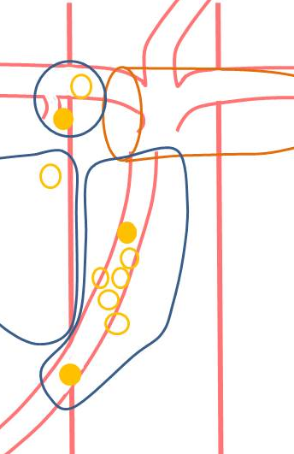
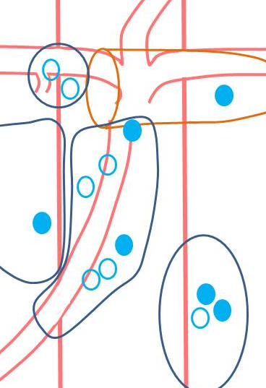
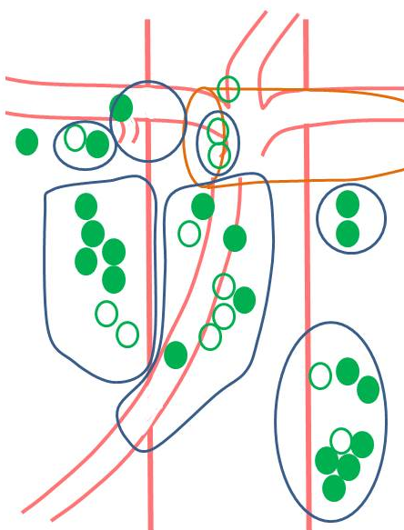
SMA recur. according to the T stage
T1
T2
T3,4
 | SMA recur (+) n=21 | non-SMA recur n=68 | p-value
T1 | 7 (58.3%) | 5 (41.7%) | 0.007
T2 | 6 (23.1%) | 20 (76.9%)
T3/4 | 8 (15.7%) | 43 (84.3%)
Notes:
아마도 T stage가 높아짐에 따라 non-SMA recur의 빈도가 증가한다는 이야기를 하려고 사용한 통계 같은데, 그렇다면 %를 다르게 써야 할 것 같다. 그리고 Total recur 열은 없어도 될 듯

Slide 12
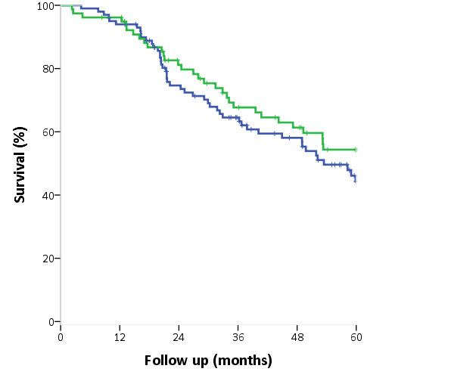
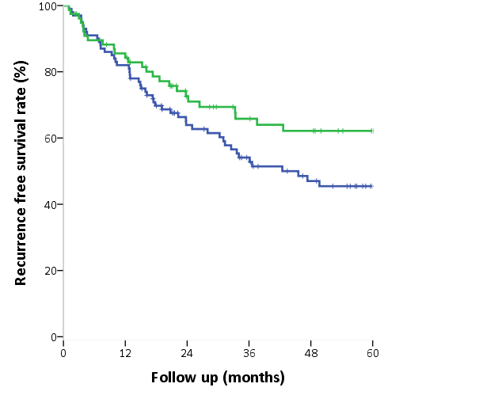
Effect of adjuvant therapy, chemo Tx.
T2,3,4 N=178
Chemo Tx. (+)
(n=78)
Chemo Tx. (+)
(n=78)
Chemo Tx. (-)
(n=100)
Chemo Tx. (-)
(n=100)
P=0.072
P=0.240
Month
Month
Recurrence free survival rate
Overall survival rate

Slide 13
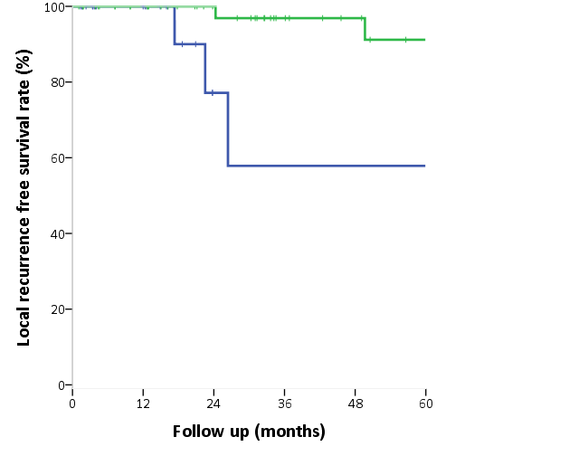
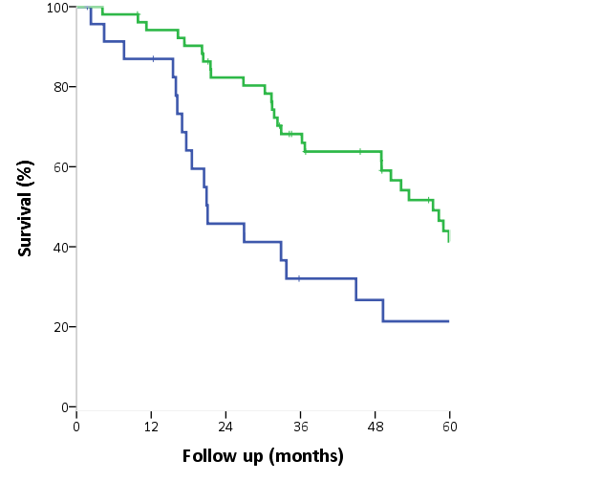
Effect of adjuvant therapy, Radio Tx.
LN meta. (+) N=76
Radio Tx. (+)
(n=52)
Radio Tx. (+)
(n=52)
Radio Tx. (-)
(n=24)
P=0.005
Radio Tx. (-)
(n=24)
P=0.007
Month
Month
Local recurrence free survival rate
Overall survival rate

Slide 14
Summary
5-YSR of curative AoV cancer. : 56.1%
Recurrence rate: 34.4% (local: 21.1%, distant: 78.8%)
Risk factor of recurrence
Higher T classification
LN metastasis
Differentiation (worse differentiation)
Most common recurrence site : Liver
Most common LN recurrence site : SMA LN (8.1%)
Current chemotherapy has limited impact on outcome
→ Better chemotherapy agent or regimen needs to be uncovered
Radiotherapy improves DFS and OS in LN (+) patients
Notes:
Distant recurrence rate가 어떻게 68.8%인지? 70/259가 맞을 것이고 recur 중 distant meta를 알고 싶다면 70/89 아닌가 모르겠다.

Slide 15
Conclusion
Recurrence pattern is different according to the T stage
Early stage
Advanced stage
Local recurrence, esp. SMA area
Systemic recurrence
Elaborate LN dissection around SMA region is important
Aggressive adjuvant treatment should be exerted postoperatively

Slide 16
Thank you !

