Slide 1

Prognosis and Problems after Liver Transplantation for Alcoholic Liver Disease
Dong-Hwan Jung
Department of Surgery, Division of Hepatobiliary Surgery and Liver Transplantation , University of Ulsan College of Medicine and
Asan Medical Center, Seoul, Korea

Slide 2

Alcohol abuse is the most common cause of end-stage liver disease in the United States, but many transplant centers are unwilling to accept alcoholic patients because of their supposed potential for recidivism, poor compliance with the required immunosuppression regimen and resulting failure of the allograft.
Hepatology. 1990 February ; 11(2): 159–164
Notes:
Alcohol abuse is the most common cause of end-stage liver disease in the United States, but many transplant centers are unwilling to accept alcoholic patients because of their supposed potential for recidivism, poor compliance with the required immunosuppression regimen and resulting failure of the allograft.

Slide 3
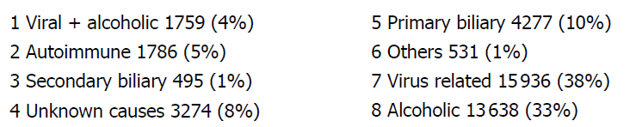
ALD is 2nd Common Indication for Liver Transplantation
European Liver Transplant Registry (2008)

Slide 4
ALD is 2nd Common Indication for Liver Transplantation
UNOS (2009)

Slide 5
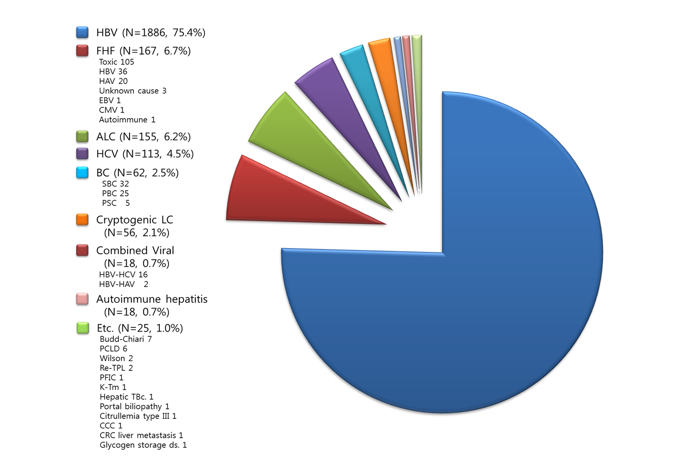
Original Disease of Adult LDLT at AMC
Results
(Feb 1997~Aug 2013)
2784 Adult LDLTs
HCC (+)
in 1227 pts. (44.1%)
TMC : HBV-LC (75.4%)

Slide 6
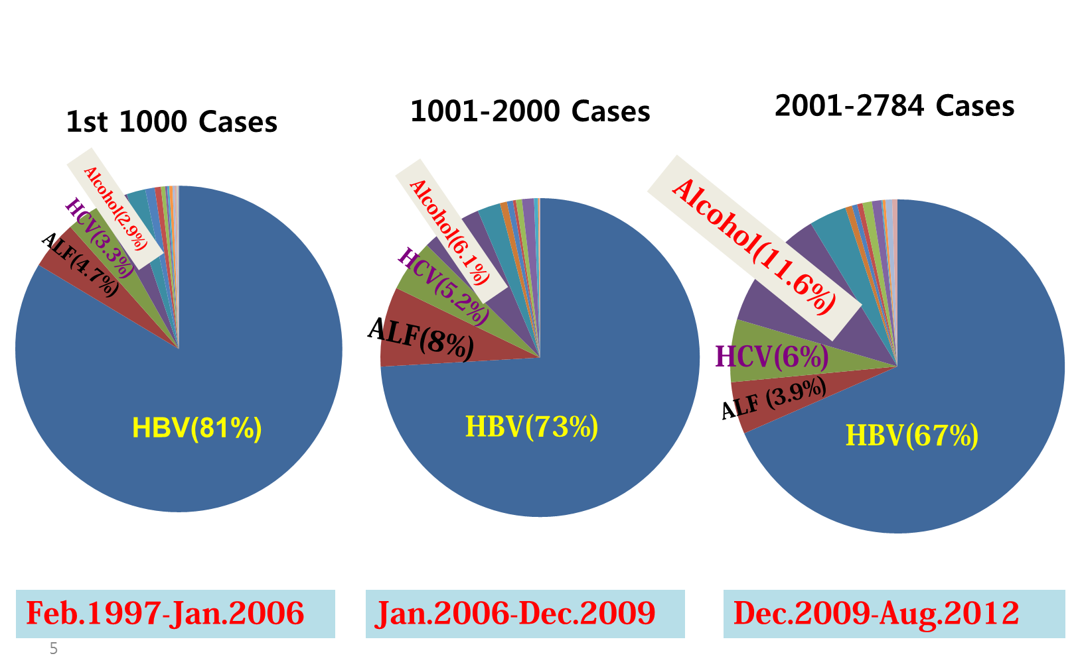
Change of Trend in Original Disease
for Adult LDLT at AMC

Slide 7

Alcohol-related Liver Disease requiring LT
Mortality s Tx ~50%
High short-term mortality (unresponsive to steroid Tx)
Unresectable/
Within Criteria
ALD + Viral
Annual mortality > 10%
Liver Transplantation

Slide 8
Prognosis after LT for ALD
Problems after LT for ALD
- Cardiovascular events after LT for ALD
- De novo malignancies after LT for ALD
- LT for Severe alcoholic hepatitis
- Relapse after LT for ALD
Experience of LT for ALD at AMC

Slide 9
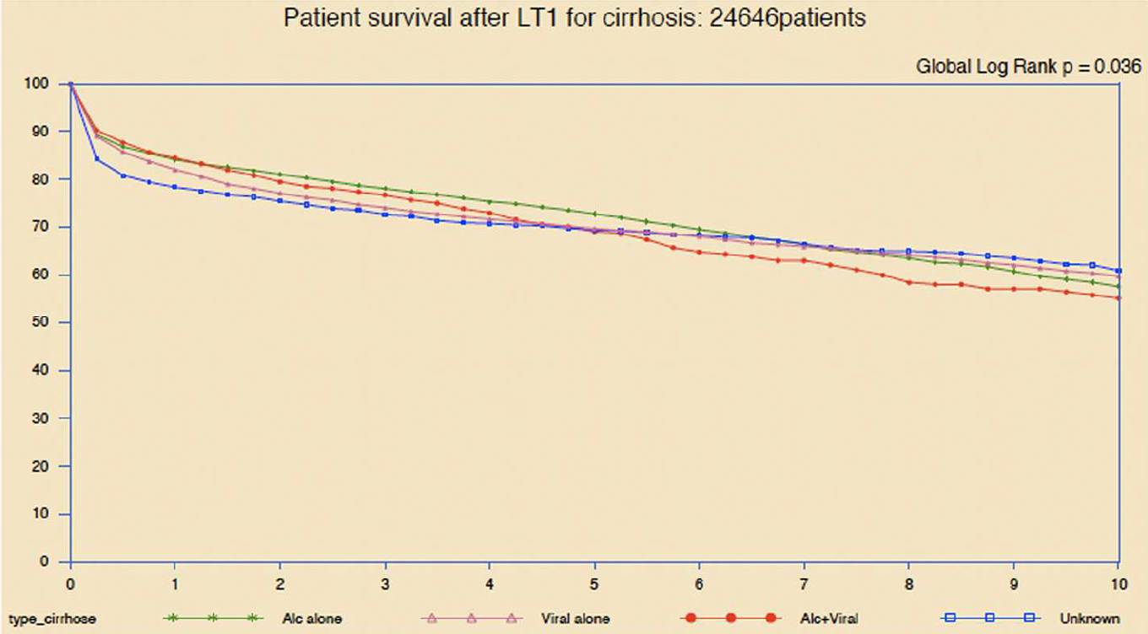
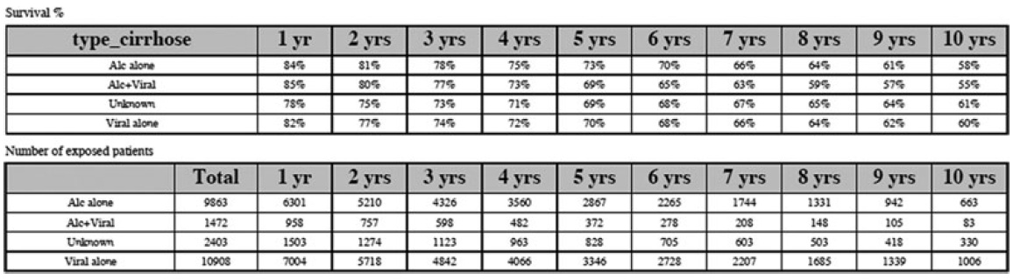
Prognosis after LT for ALD
Liver Transplantation for Alcoholic Liver Disease in Europe: A Study from the ELTR
1,3,5, and 10 yrs Pt. Survival
84%, 78%, 73%, 58%, ALD
82%, 74%, 70%, 60%, VIR (p=0.04)
78%, 73%, 69%, 61%, CRYPT (p = 0.05)
American Journal of Transplantation 2010; 10: 138–148
Notes:
Survival rates after LT in ALD patients were significantly higher than in VIR and CRYP. When ALD patients were analysed according to HCV or HBV infection, patient survival from first transplantation in ALD –HCV patients was significantly lower than observed in ALD-HBV patients.

Slide 10
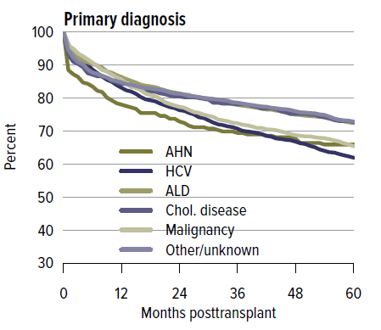
Prognosis after LT for ALD
OPTN/SRTR 2013
Annual Data Report
Kim_et_al-2015-American_Journal_of_Transplantation
Notes:
In the US data from SRTS showed that outcome for patients transplanted for ALD, is at least as good as that for most other diagnoses, and better than that for HCV.

Slide 11
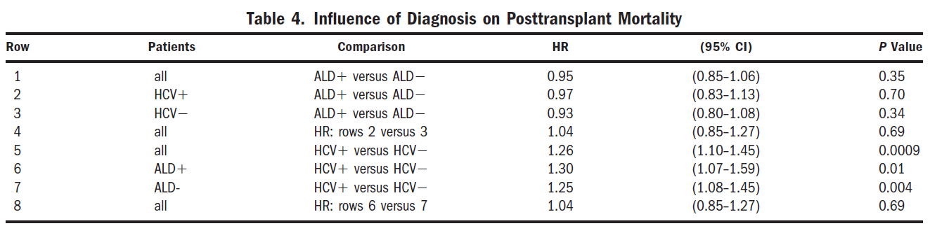
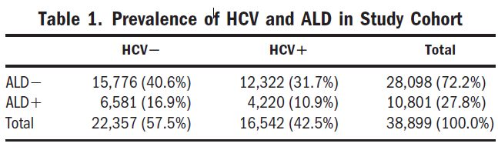
Prognosis after LT for ALD
the effect of alcoholic liver disease
(ALD) and hepatitis C virus (HCV) infection on waiting list mortality, post transplant mortality, and the survival benefit of DDLT using US data from the SRTR on 38,899 adults placed on the transplant waiting list between September 2001 and December 2006.
HCV status has a significant negative impact on the survival benefit of liver transplantation. In contrast, the presence of ALD does not influence liver transplant survival benefit.
HEPATOLOGY 2009; 50:400-406
Notes:
The presence of ALD did not influence mortality after transplantation (HR 0.95), whereas posttransplant mortality was significantly greater in HCV-infected patients than in non-HCV subjects (HR 1.26). Note that median posttransplant follow-up time was 1.76 years. The coincidence of ALD did not significantly contribute to mortality in either HCV or HCV subjects. In contrast, HCV infection increased posttransplant mortality in both ALD (HR 1.30) and ALD subjects (HR 1.25), with the interaction between HCV and ALD on posttransplantation mortality being nonsignificant. HCV status has a significant negative impact on the survival benefit of liver transplantation. In contrast, the presence of ALD does not influence liver transplant survival benefit.

Slide 12
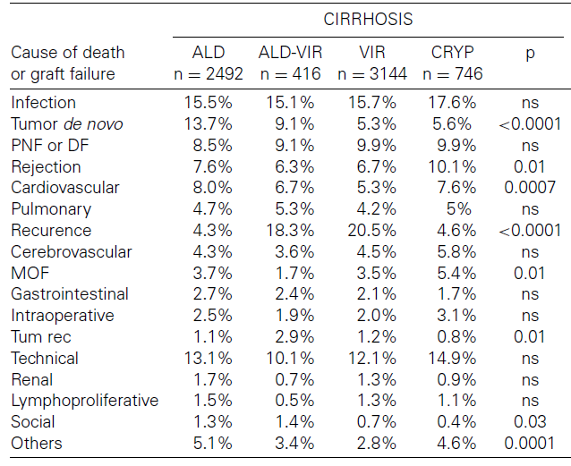
Prognosis after LT for ALD
Liver Transplantation for Alcoholic Liver Disease in Europe: A Study from the ELTR
Cause of Death
after LT for ALD
American Journal of Transplantation 2010; 10: 138–148
Notes:
The incidence of cardiovascular events and de novo malignancy is higher in patients transplanted for ALD compared with patients transplanted for other causes of liver disease (8%vs 5.3%).

Slide 13
Cardiovascular Events after LT for ALD
An increased relative risk of ischemic cardiac events (3.07, CI 1.98– 4.53) and cardiovascular deaths (2.56, CI 1.52–4.05) has been reported in LT recipients when compared to age and sex match general population. Transplantation 2002;73:901–906.
A large multicentered prospectively obtained transplant database study showed the leading nonhepatic causes of deaths are malignancy (29.5%), infection/sepsis (25.1%), and cardiovascular disease (19.3%).

Slide 14
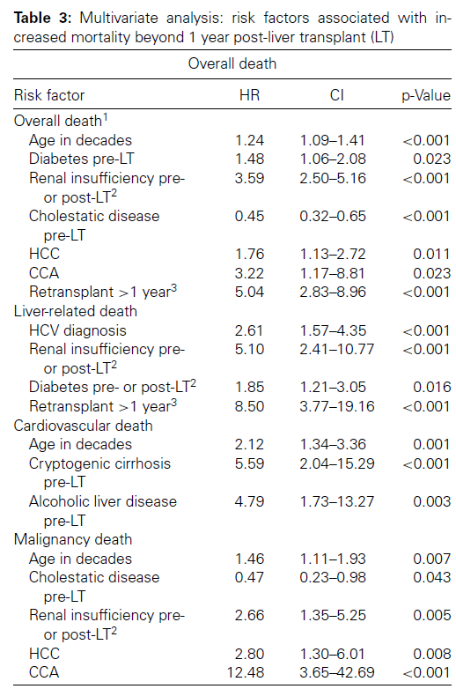
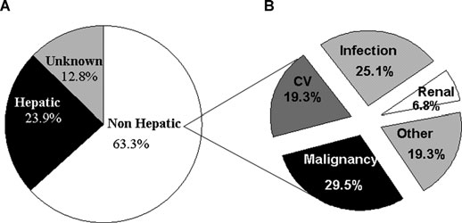
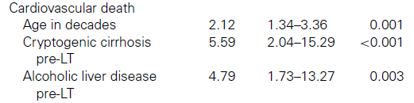
Cardiovascular Events after LT for ALD
The National Institute of Diabetes and Digestive and Kidney Diseases (NIDDK) LT Database collection occurred from April 1990 to June 1994, with follow-up data obtained by January 2003 (median follow-up of 10 years) at three clinical centers
American Journal of Transplantation 2010; 10: 1420–1427
Notes:
The National Institute of Diabetes and Digestive and Kidney Diseases (NIDDK) LT Database collection occurred from April 1990 to June 1994, with follow-up data obtained by January 2003 (median follow-up of 10 years) at three clinical centers. Nonhepatic causes of death included: 61 (29.5%) malignancy, 52 (25.1%) infection, 40 (19.3%) cardiovascular, 14 (6.8%) renal, 6 (2.9%) neurologic, 5 (2.4%) gastrointestinal, 5 (2.4%) respiratory and 19 other (multiorgan failure of unclear cause, trauma, suicide or other infrequent events).

Slide 15
De Novo Malignancies after LT for ALD
The incidence of rejection, infection, and re-LT was also similar to other recipients.
ALD patients are more prone to develop de-novo malignancy
: long term effect of alcohol, tobacco combined with IS
Notes:
The incidence of rejection, infection, re-LT and cardiac event after LT for ALD was also similar to other recipients. ALD patients are more prone to develop de-novo malignancy due to long term effect of alcohol, tobacco combined with IS.

Slide 16
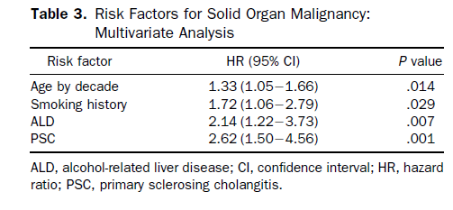
De Novo Malignancies after LT for ALD
NIDDK Diseases’ liver transplantation database of 798 adults who received transplants from April 1990 to June 1994 and long-term follow-up data through January 2003.
GASTROENTEROLOGY 2009;137:2010–2017
Notes:
According to NIDDK Diseases’ liver transplantation database of 798 adults who received transplants, PSC patient showed increased hematologic and solid organ malignancy. ALT patient showed increased incidence of solid organ malignancy. ALD patient showed 2.14 HR.

Slide 17
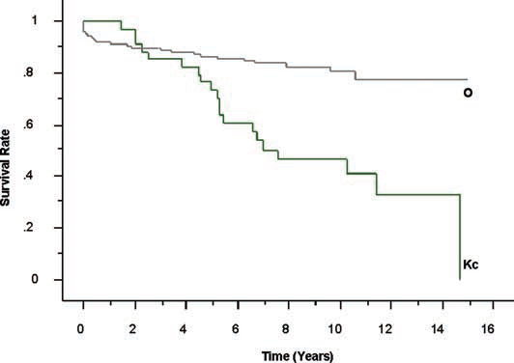
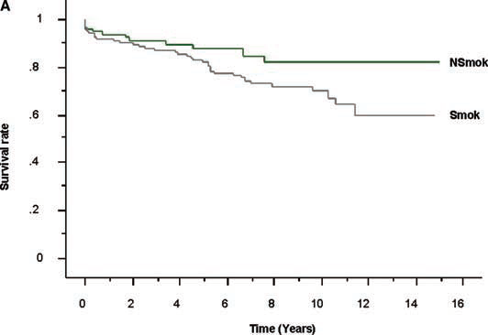
De Novo Malignancies after LT for ALD
From October 1990 to October 2005, 305 consecutive patients with alcoholic cirrhosis underwent LT in one center
Survival curves according to occurrence of de novo malignancy
Survival curves according to history of smoking
Excluding PTLDs and cutaneous malignancies, 35 patients developed de novo carcinoma after LT, after a median delay of 62 months. The most common primary site was upper aero-digestive (N = 31).
Am J Gastroenterol 2007;102:1032–1041
Notes:
From October 1990 to October 2005, 305 consecutive patients with alcoholic cirrhosis underwent LT in one center. De novo malignancy patient showed decreased survival rate. Smokers showed decreased survival rate. Excluding PTLDs and cutaneous malignancies, 35 patients developed de novo carcinoma after LT, after a median delay of 62 months. The most common primary site was upper aero-digestive (N = 31).

Slide 18
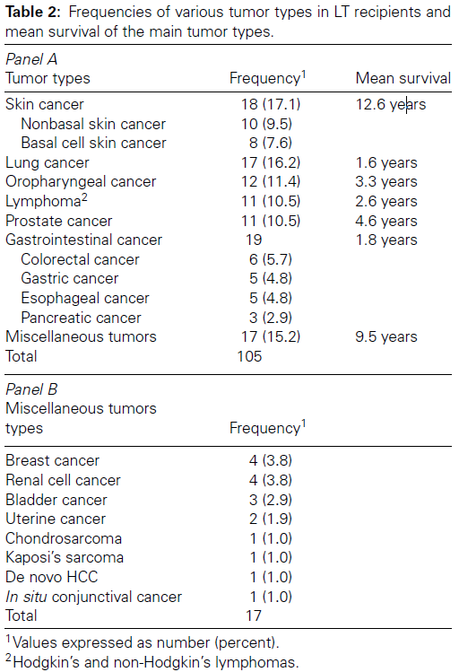
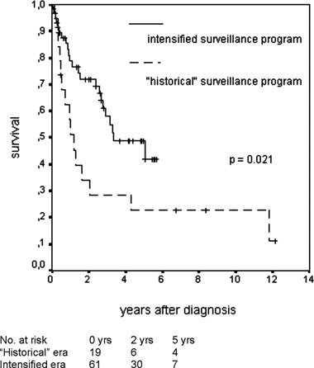
De Novo Malignancies after LT for ALD
779 consecutive LT recipients, 96 (12.3%) developed 105 malignancies
to examine whether an extensive surveillance protocol will promote early diagnosis and improved survival in patients with de novo cancer following LT
American Journal of Transplantation 2009; 9: 2355–2361
Notes:
The aim of this study was to examine whether an extensive surveillance protocol will promote early diagnosis and improved survival in patients with de novo cancer following LT. This study included 779 consecutive LT recipients, 96 (12.3%) developed 105 malignancies. The cumulative risk for development of de novo neoplasia increased with the time after LT. This is Survival of LT recipients with a de novo non-skin cancer diagnosed during our ‘historical’ surveillance program and those diagnosed during the intensified screening program. Only patients with skin cancers and solid tumors, diagnosed at early stages, showed an excellent outcome. After introducing an intensified surveillance protocol, the detection rate of de novo cancers increased from 4.9% to 13% and more de novo malignancies were diagnosed in earlier stages.

Slide 19
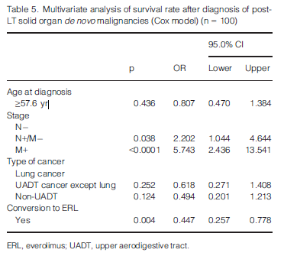
De Novo Malignancies after LT for ALD
83 patients (presenting 100 tumors, including 75% of upper aerodigestive tract cancers), among the 398 patients who underwent LT for ALD in one center
Conversion to ERL
improves the prognosis of de novo malignancies after LT for ALD. Prospective studies are needed to confirm this benefit.
Clin Transplant 2014: 28: 1339–1348
Notes:
This study included 83 patients (presenting 100 tumors, including 75% of upper aerodigestive tract cancers), among the 398 patients who underwent LT for ALD in one center. Conversion to ERL improves the prognosis of de novo malignancies after LT for ALD. Prospective studies are needed to confirm this benefit.

Slide 20
CV Events and De Novo Malig. after LT for ALD
The incidence of cardiovascular events is higher in patients transplanted for ALD compared with patients transplanted for other causes of liver disease (8%vs 5.3%).
Several studies have suggested that the risk of de novo malignancy is increased 1.5- to 2-fold in LT recipients for ALD compared with patients transplanted for other indications.
Patients with ALD are at particularly increased risk of upper gastrointestinal, oropharyngeal-laryngeal and lung cancers.
Applying a strict surveillance protocol to all LT recipients might be associated with improved detection rates of cancer and patient survival.
It might be necessary improve posttransplant health through promotion of smoking cessation in alcoholic liver transplant recipients.
There is a current trend to tailor immunosuppression in patients with ALD by minimizing the exposure to CNIs while promoting the use of mammalian target of rapamycin inhibitors.

Slide 21
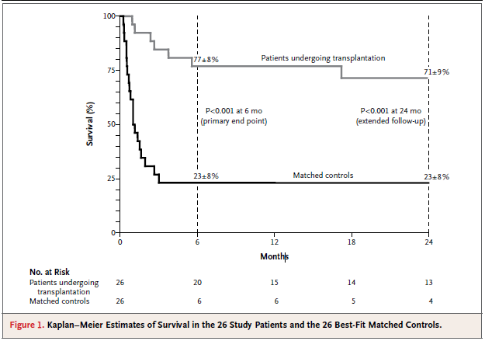
LT for Alcoholic Hepatitis
Early Liver Transplantation for Severe Alcoholic Hepatitis
In a prospective, multicenter trial, investigators in France and Belgium
Candidates for early LT :
-nonresponse to medical therapy
-severe alcoholic hepatitis as the first liver-decompensating event
-presence of close supportive family members
-absence of severe coexisting or psychiatric disorders
-agreement by patients (with support from family members) to adhere to lifelong total alcohol abstinence.
Early LT performed for severe AH not responding to glucocorticoids is feasible and improves survival with low rates of alcohol relapse in highly selected candidates.
N Engl J Med 2011;365:1790-1800.
Notes:
This is a landmark trial of early liver transplantation for alcoholic hepatitis in highly selected patients which demonstrated a clear survival benefit and favorable posttransplant outcomes. In a prospective, multicenter trial, investigators in France and Belgium, early LT for severe alcoholic hepatitis showed improved survival rates compared with matched controls.

Slide 22
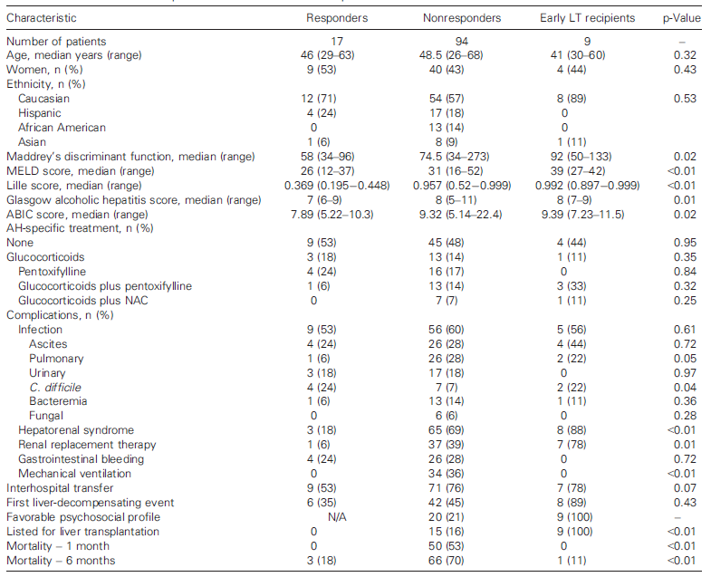
LT for Alcoholic Hepatitis
Early Liver Transplantation for Severe Alcoholic Hepatitis in the US
—A Single-Center Experience
American Journal of Transplantation 2016; 16: 841–849
Notes:
This is a single center experience of early LT for severe alcoholic hepatitis in the US. Survival was compared between those receiving early LT and matched patients who did not. Using a process similar to the European trial, 94 patients with severe AH not responding to medical therapy were evaluated for early LT. Overall, 9 (9.6%) candidates with favorable psychosocial profiles underwent early LT, comprising 3% of all adult LT during the study period.

Slide 23
LT for Alcoholic Hepatitis
Eight recipients are alive at a median of 735 days with 1 alcohol relapse.
Early LT for severe AH can achieve excellent clinical outcomes with low impact on the donor pool and low rates of alcohol relapse in highly selected patients in the US.
American Journal of Transplantation 2016; 16: 841–849
Notes:
The 6-month survival rate was higher among those receiving early LT compared with matched controls (89% vs. 11%, p<0.001). Eight recipients are alive at a median of 735 days with 1 alcohol relapse. Early LT for severe AH can achieve excellent clinical outcomes with low impact on the donor pool and low rates of alcohol relapse in highly selected patients in the United States.

Slide 24
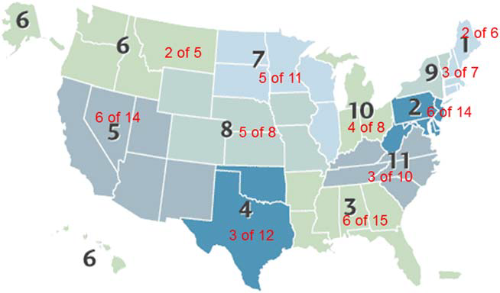
LT for Alcoholic Hepatitis
Survey of LT centers in the US with an aim to examine practice patterns on the use of LT for severe AH
Of 45 LTs for AH, the survival rates at these time points were 93% (39/42), 93% (37/40), and 87% (27/31), respectively.
In the same survey, centers reported alcohol recidivism in 8/45 (18%) of patients. No comment was made as to impact of recurrent drinking on graft function.
45 centers completed the survey (response rate of approximately 45%).
Only 12 of 45 centers (27%) reported listing AH patients for LT, and 11 centers reported performing 1 to 15 LTs for AH patients.
LIVER TRANSPLANTATION 21:1449–1452, 2015
Notes:
In a survey of 45 transplant centers, 11 had transplanted patients for acute alcoholic hepatitis over the last 5 years, constituting 45/ 3290 (1.37%) of total transplants at these centers. Patient survival was excellent among the 45 patients who were transplanted: 39/42 (93%) were alive at 6 months post liver transplantation, 37/40 (93%) at 1 year, and 27/31 (87%) at 5 years. In the same survey, centers reported alcohol recidivism in 8/45 (18%) of patients. No comment was made as to impact of recurrent drinking on graft function.

Slide 25
LT for Alcoholic Hepatitis
A landmark trial of early liver transplantation in highly selected patients demonstrated a clear survival benefit and favorable posttransplant outcomes.
Glucocorticoids remain the best initial medical therapy for severe acute alcoholic hepatitis, but liver transplantation can be an acceptable and effective therapy for those who fail to respond to steroids.
Recidivism is anticipated in these patients who likely continue to consume large volumes of alcohol. LT for alcoholic hepatitis is still a highly controversial issue from the public point of view, and needs to be resolved.
Notes:
A landmark trial of early liver transplantation in highly selected patients demonstrated a clear survival benefit and favorable posttransplant outcomes. Glucocorticoids remain the best initial medical therapy for severe acute alcoholic hepatitis, but liver transplantation can be an acceptable and effective therapy for those who fail to respond to steroids. Recidivism is anticipated in these patients who likely continue to consume large volumes of alcohol. LT for alcoholic hepatitis is still a highly controversial issue from the public point of view, and needs to be resolved.

Slide 26
Relapse after LT for ALD
Alcohol consumption after LT covers a spectrum from occasional consumption (“slips”) to regular and harmful drinking (“relapses”).
The rate of alcohol consumption after LT is highly variable with a percentage ranging from 10% to 95%, probably due to the different way to define and classify alcohol consumption.
The incidence of alcohol use after LT is difficult to assess with accuracy, especially when self-reporting is used as the means of identification.
Notes:
Alcohol consumption after LT covers a spectrum from occasional consumption (“slips”) to regular and harmful drinking (“relapses”). The rate of alcohol consumption after LT is highly variable with a percentage ranging from 10% to 95%, probably due to the different way to define and classify alcohol consumption. The incidence of alcohol use after LT is difficult to assess with accuracy, especially when self-reporting is used as the means of identification.

Slide 27
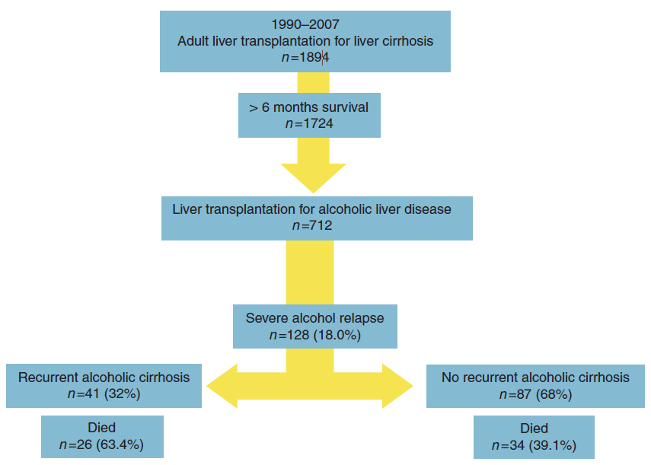
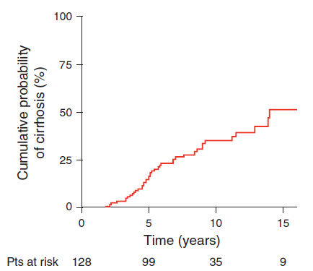
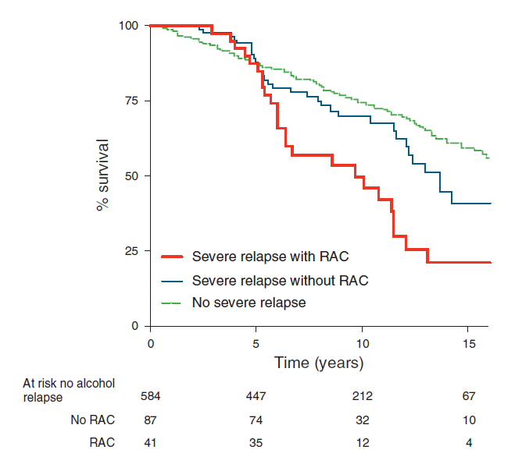
Relapse after LT for ALD
All patients transplanted for ALD between 1990 and 2007 in three French centers
6%
RAC was significantly associated with younger age and a shorter period of pre-LT abstinence.
Am J Gastroenterol 2015; 110:1160–1166
Notes:
In a recent study of patients transplanted for alcoholic cirrhosis in French centers between 1990 and 2007, 712 patients who survived beyond 6 months post liver transplantation were followed for a median of 9 years. Of these, 128/712 (18%) experienced severe alcoholic relapse at a median of 25 months following liver transplantation. Among them, 41/128 (32%) were diagnosed with recurrent alcoholic cirrhosis at a median of 5.1 years after liver transplantation and 4.0 years after relapse. Recurrent alcoholic cirrhosis was significantly associated with younger age at liver transplantation as well as shorter preliver transplantation sobriety and significantly reduced 10-year and 15-year post liver transplantation survival.

Slide 28
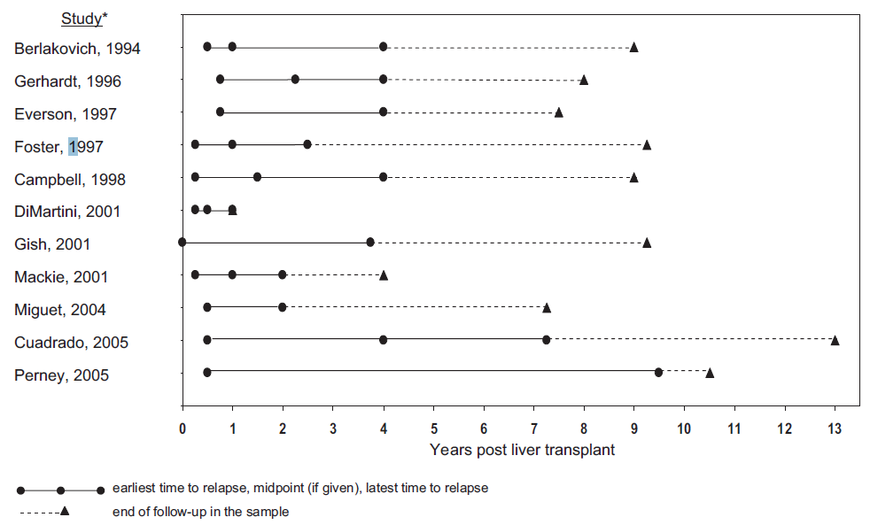
Time to alcohol relapse (any use) after liver transplantation
Liver Transpl 14:159-172, 2008
Notes:
Risk for alcohol relapse (any use) begins early posttransplantation and may continue for many years. To decrease relapse, systematic multidisciplinary professional support is necessary as soon as possible after LT for ALD.

Slide 29
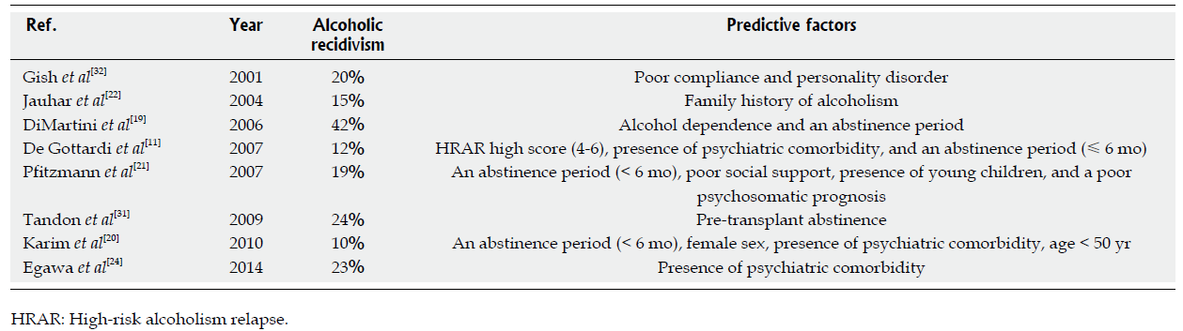
Predictive Factors for Relapse
Predictive factors for alcoholic recidivism
Psychiatric comorbidity, Abstinence period, Poor social support, Family Hx. of alcoholism
World J Hepatol 2014; 6(11): 812-817
Notes:
There were so many factors to predict alcoholic recidivism after LT. Although not conclusive, psychiatric comorbidity, abstinence period, poor social support, and family Hx. of alcoholism are potential predictive factors for post-transplantation recidivism.

Slide 30
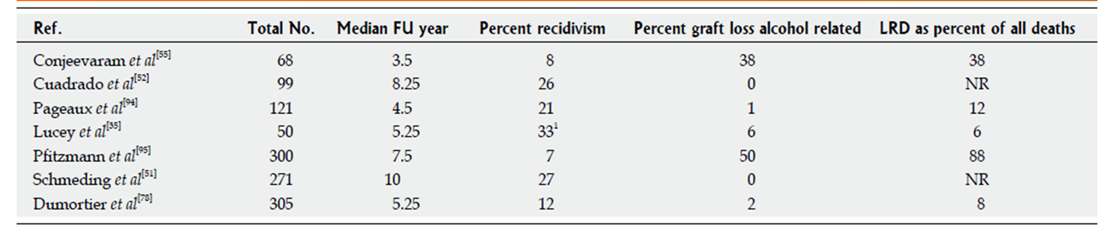
Relapse after LT for ALD
Relapse to harmful drinking affects long-term patient survival
- Abstinent non-ALC Pts. Vs Pts. with relapse
: similar initially but become worse after 5-10 years
(45%-68% vs 75%-86%)
Graft loss from recurrent disease related to ALC use is rare : less than 5% at 5 years for alcohol compared with 25% for HCV
Notes:
Abstinent non-alcoholic patient versus patient with relapse had initially similar survival rate but became worse after 5-10 years in relapse patients. Graft loss from recurrent disease related to alcohol use in rare that was less that 5% at 5 years for alcohol relapse. Relapse to harmful drinking affects long-term survival.

Slide 31
Relapse after LT for ALD
Definition of terms is important within the field of addiction medicine.
Although death as a consequence of recurrence of ALD was reported, it was not the main cause of inferior survival rates.
The consequences of alcohol use post-LT may not be apparent for some years. However, by 10 years, a clear survival detriment is evident in consumers of alcohol.
Notes:
Definition of terms is important within the field of addiction medicine. Although death as a consequence of recurrence of ALD was reported, it was not the main cause of inferior survival rates. The consequences of alcohol use post-LT may not be apparent for some years. However, by 10 years, a clear survival detriment is evident in consumers of alcohol.

Slide 32

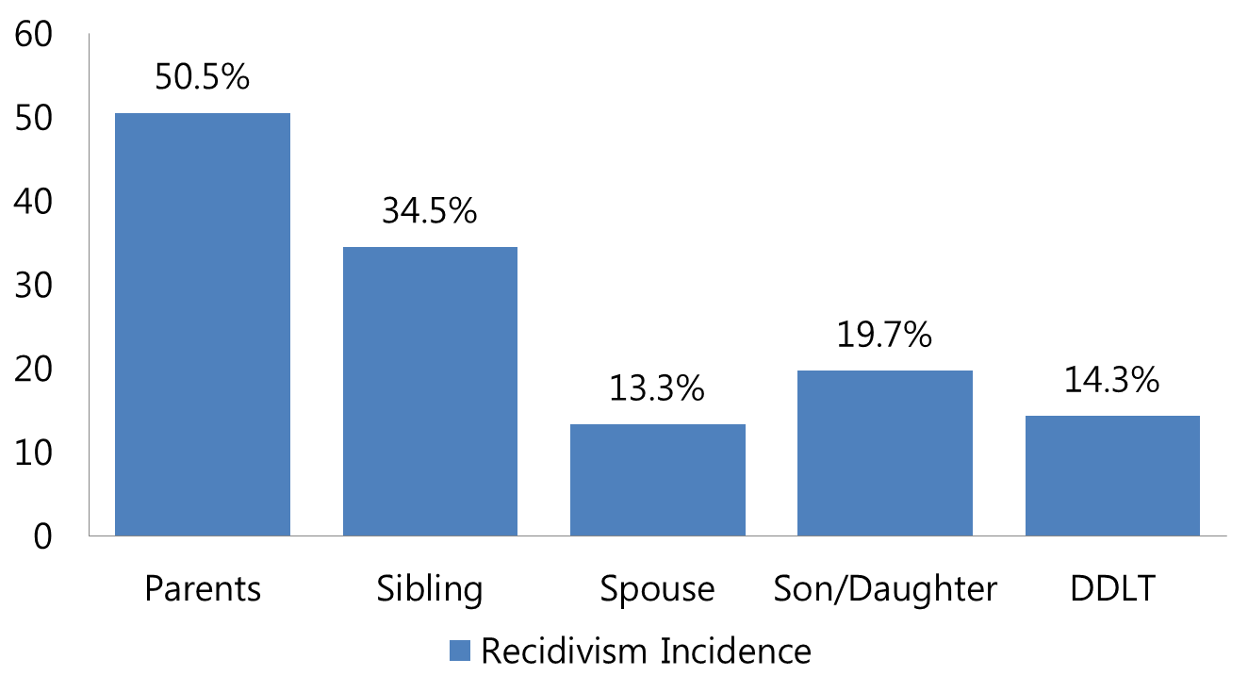
In LDLT, healthy relatives donate their organs to the patients. The conditions for alcohol relapse may be different after LDLT versus DDLT.
Preoperative alcohol consumption was not a risk factor.
In conclusion, rather than selecting patients on the basis of preoperative alcohol use, we should provide sociomedical support to improve adherence after LT for ALC in Japan.

Slide 33
Survival Outcome of LT for ALD in LDLT
Notes:
Recidivism group showed decreased survival rate compared with abstinence group esp. later period. The incidence of fatty changes was greater in the recidivism group (45.0%) versus the abstinent group (13.2%). In contrast, the incidence of rejection was greater in the abstinent group versus the recidivism group.

Slide 34
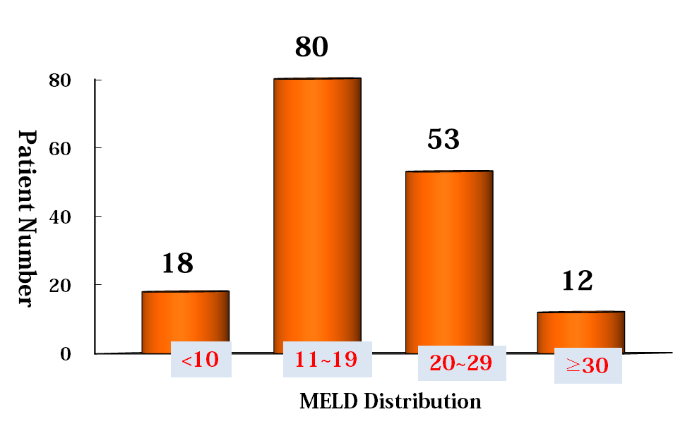
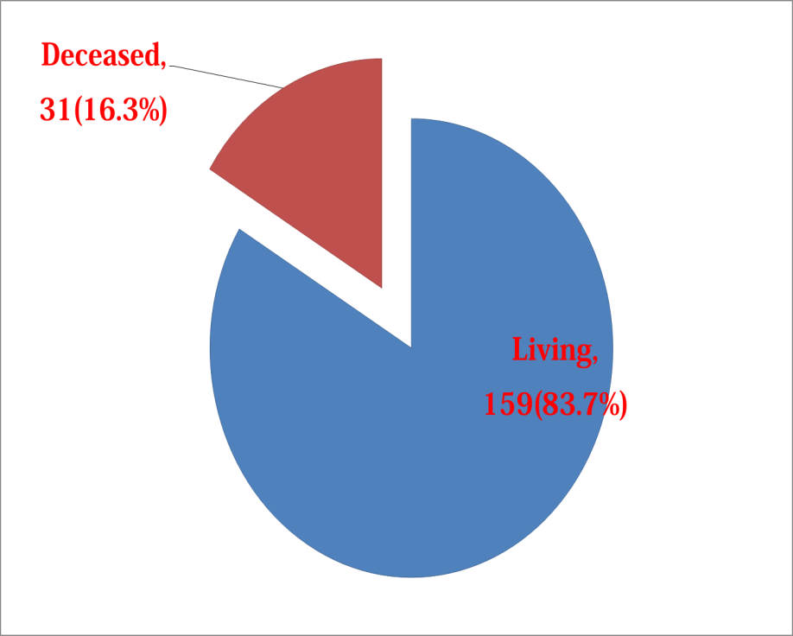
Experience of LT for ALD at AMC
Among 210 LTs for ALD patients from Jan 2005 to Dec 2012, 190 cases were analyzed. (excluding IHM)
Recipient
Pre-LT Condition
Mean Age : 51.7 ± 8.2 yrs. (31~69)
Gender Ratio (M/F): 169 (88.9%)/21
Mean MELD Score 21.0 ± 9.8
Donor Type
HCC (+) N=32 (16.8%)

Slide 35
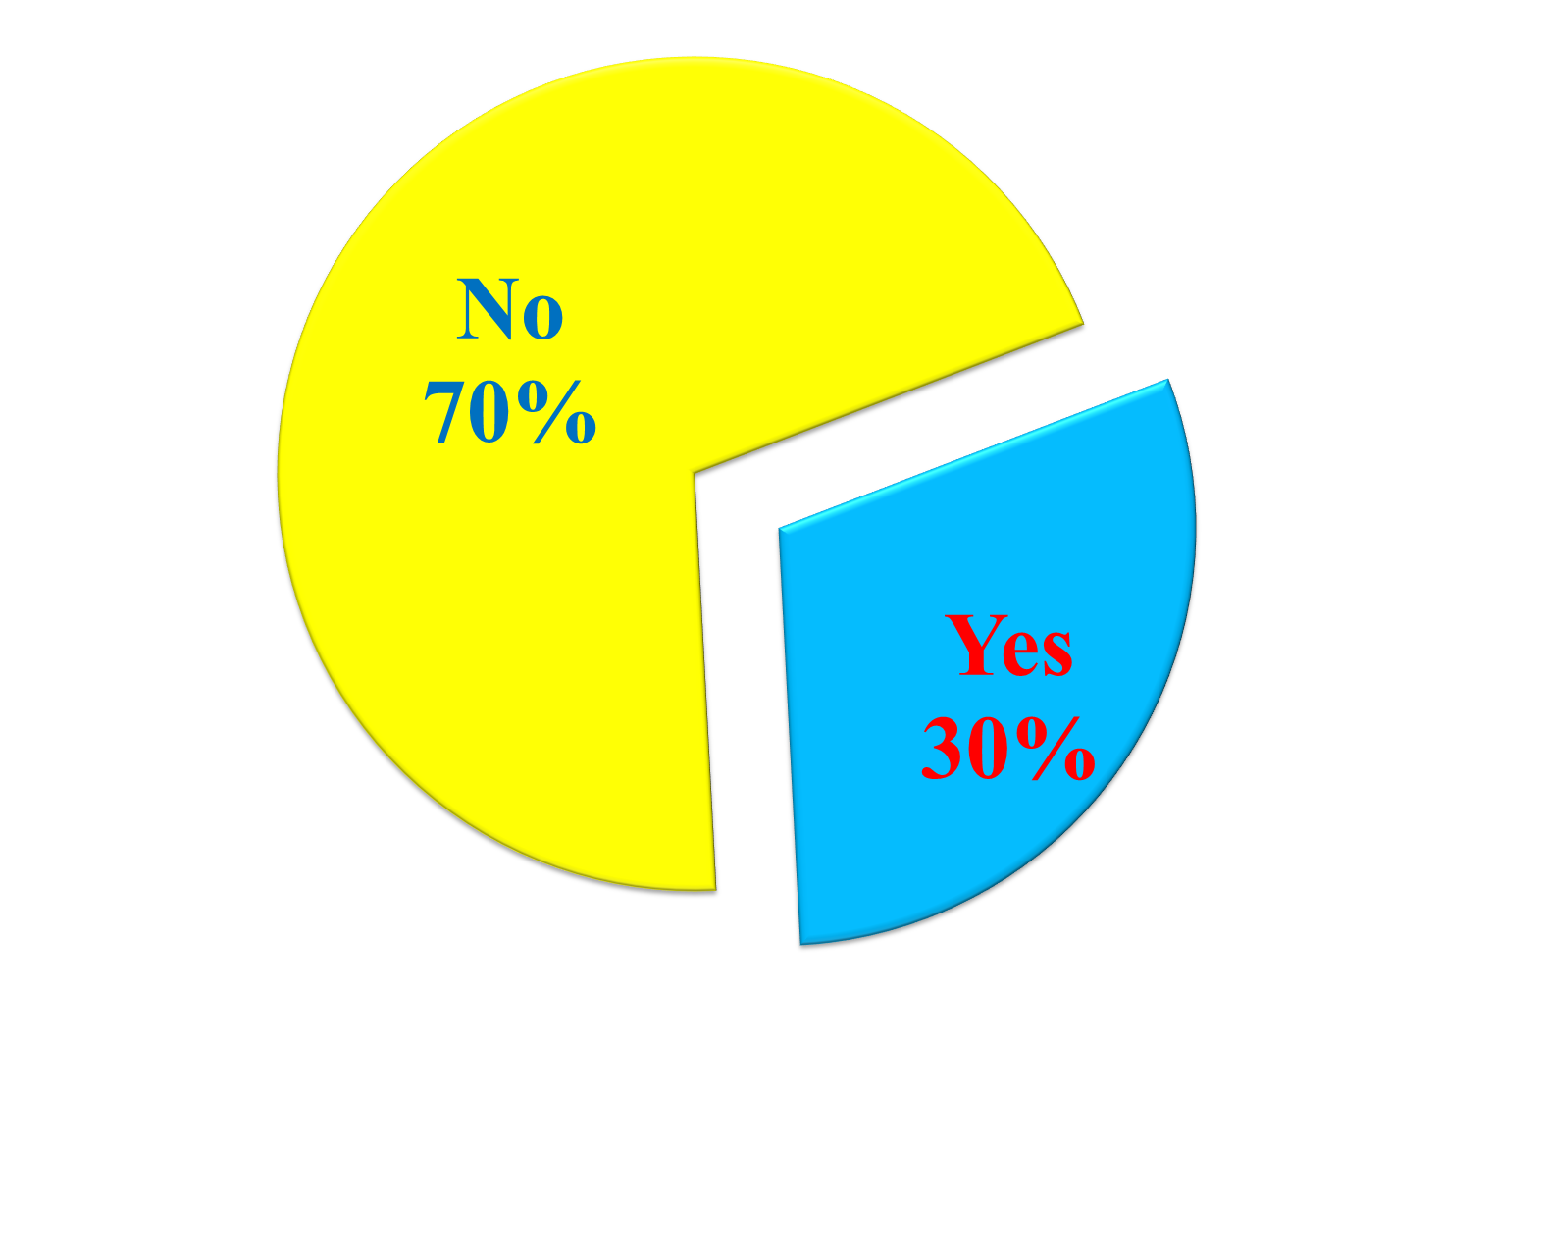
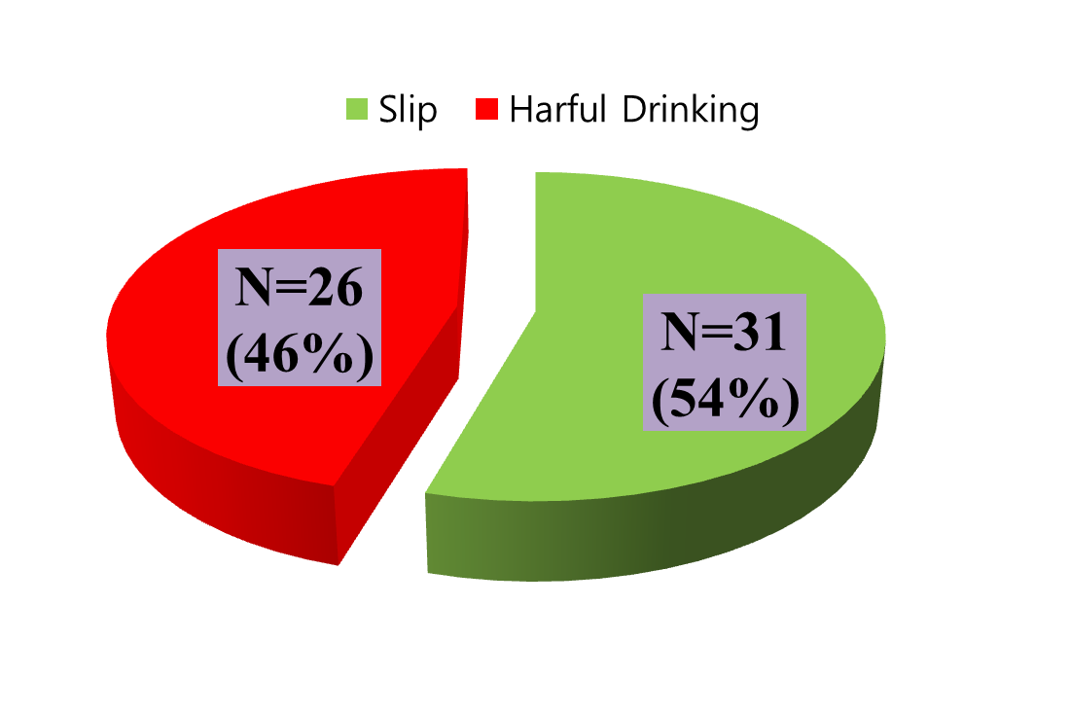
Experience of LT for ALD at AMC
Recidivism
Mean Follow-up Period: 47.6 ± 8.2 months (4.3~114.2)
Questionnaire Survey: Direct survey at OPD/Tele research
From patient/Collateral
Harmful Drinking
1. Relapse within 6 months after LT
2. ≥ 4 times/week
3. ≥ 72gm/d (male) or 48gm/d (female)
Mean Interval: 22.1 ± 16.4 months (1.0~65.0)

Slide 36
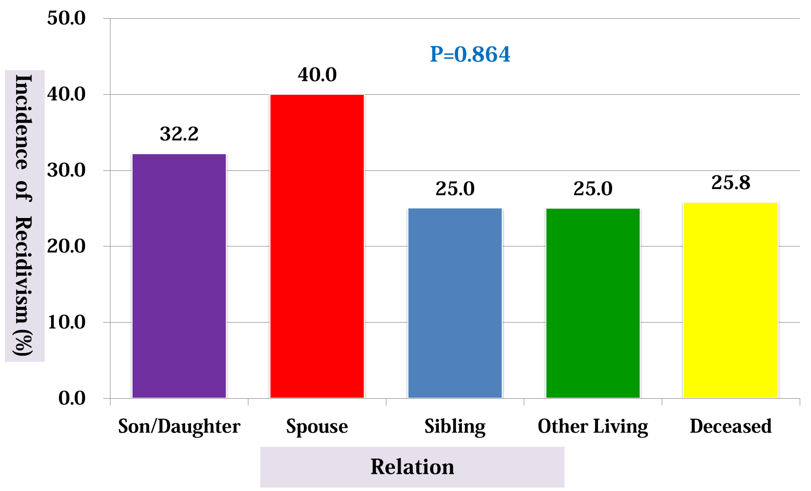
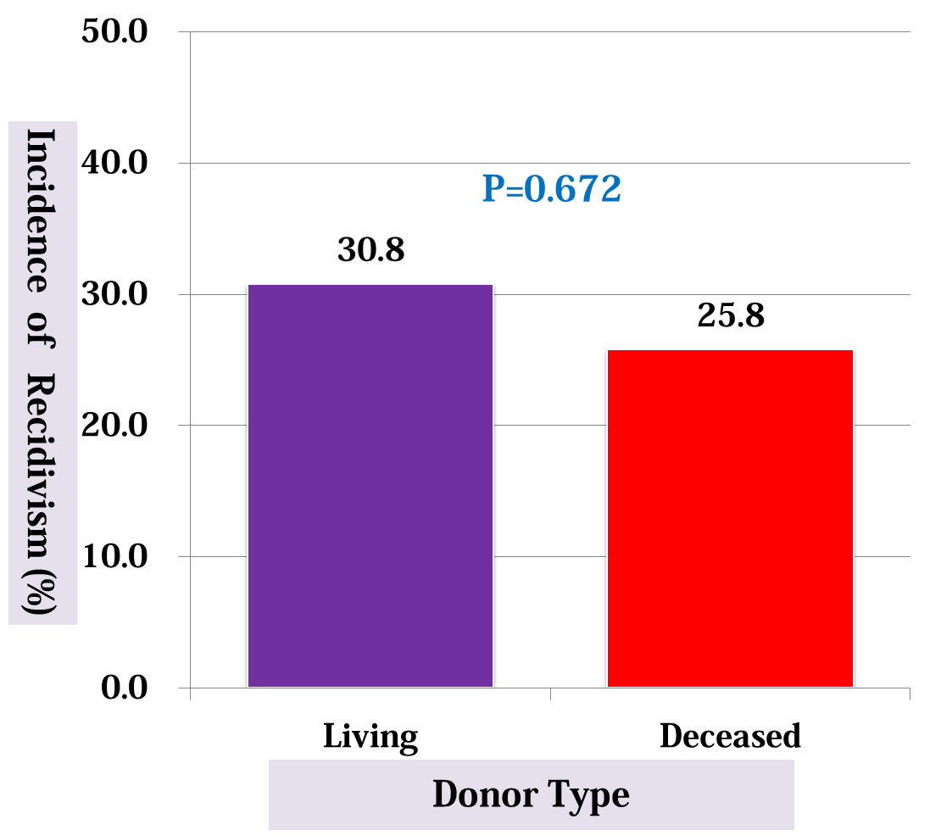
Experience of LT for ALD at AMC
Risk Factor Analysis for Recidivism

Slide 37
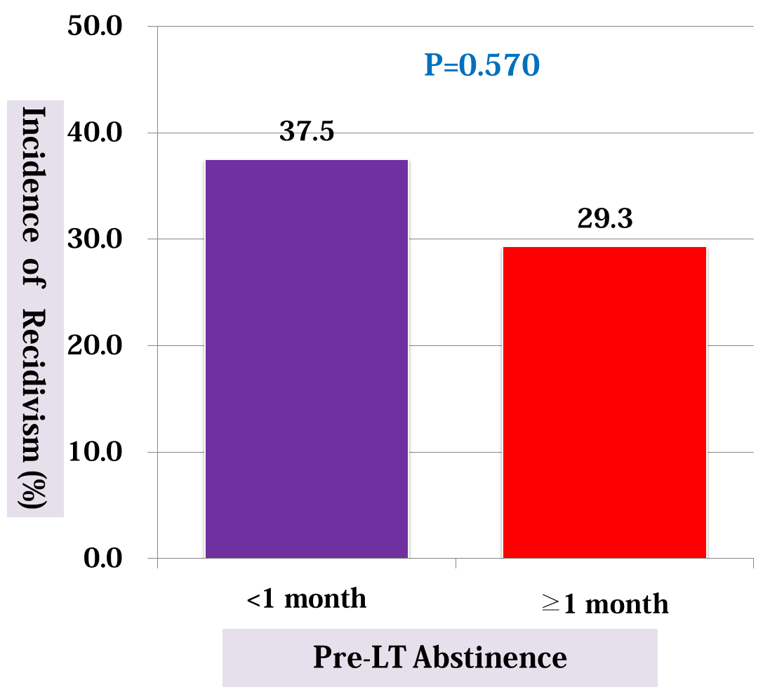
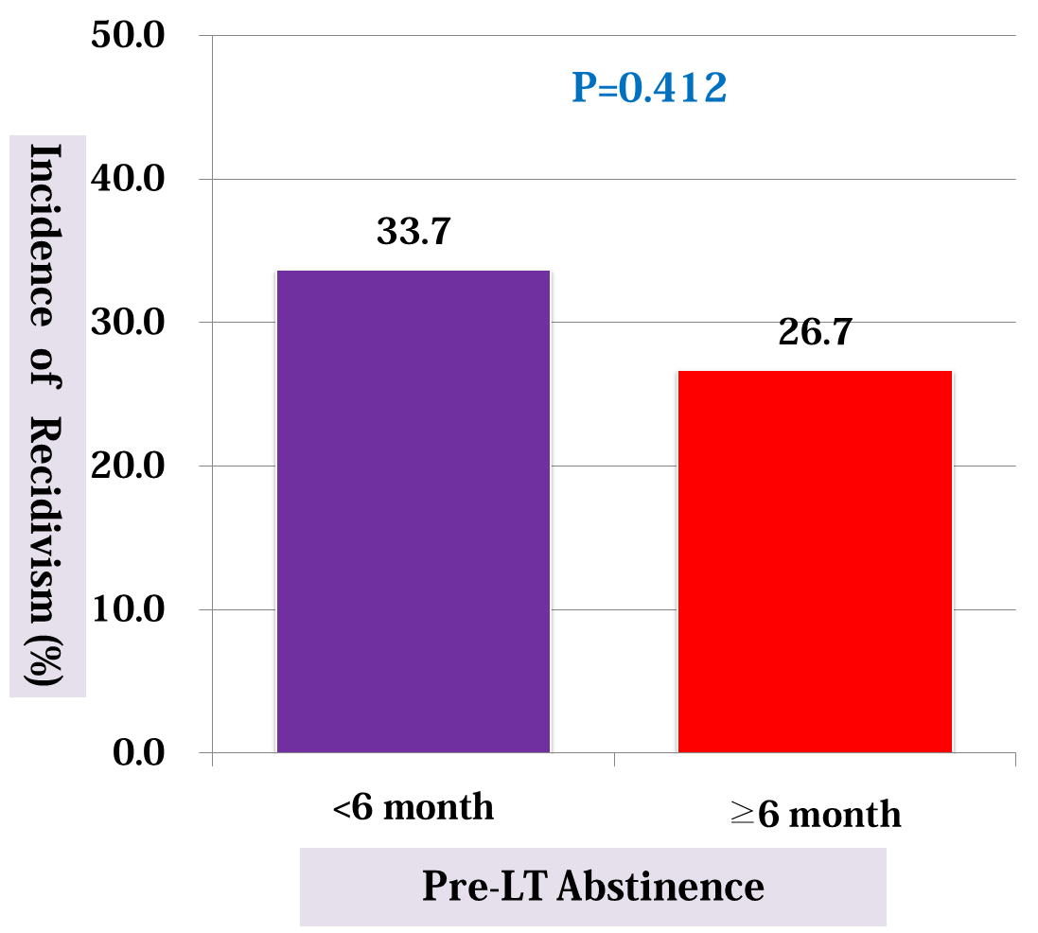
Experience of LT for ALD at AMC
Risk Factor Analysis for Recidivism

Slide 38
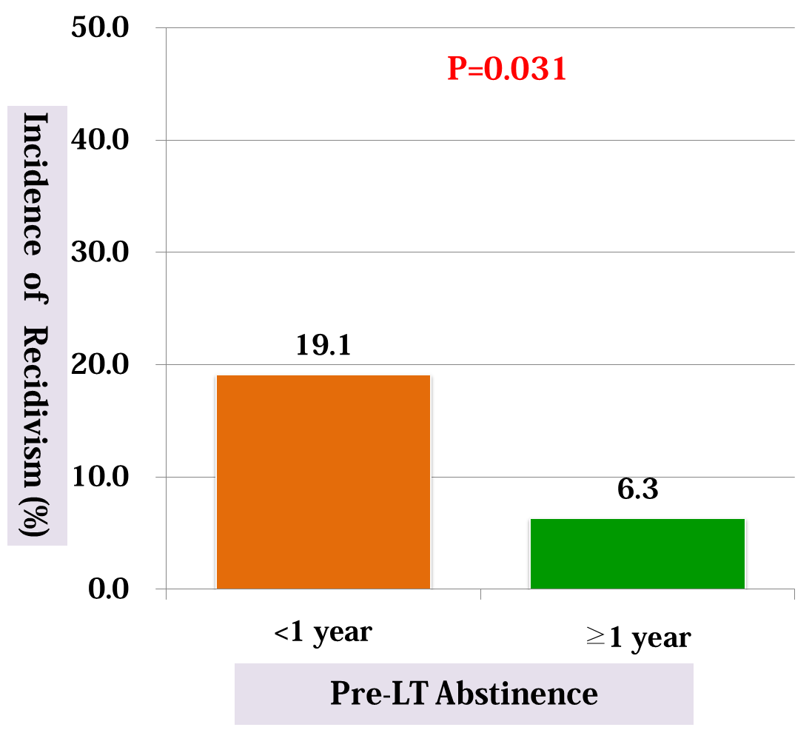
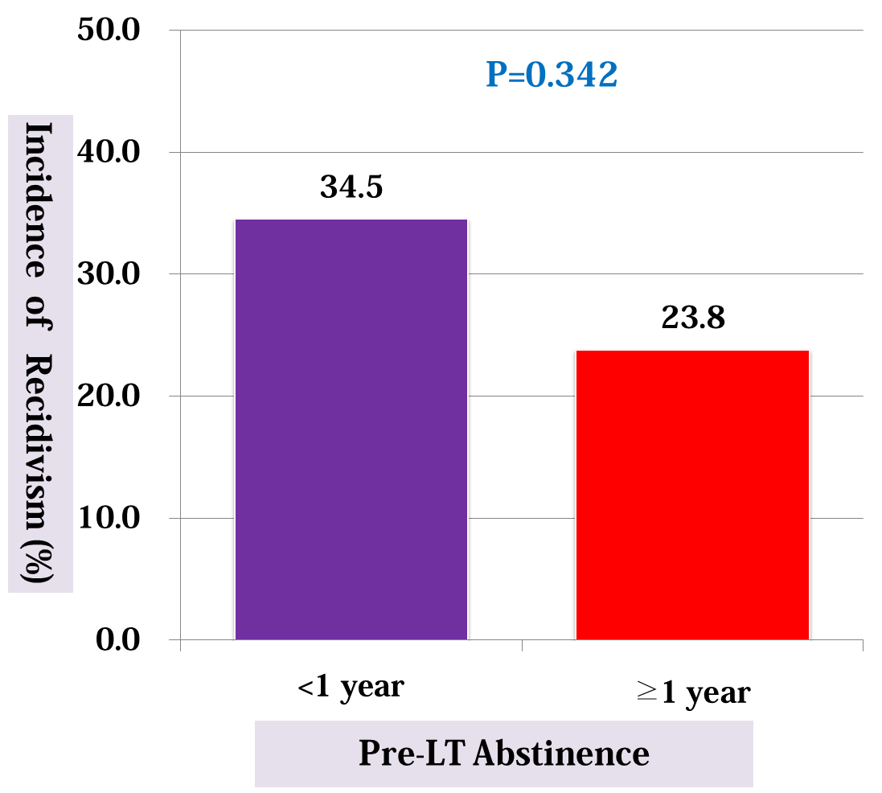
Experience of LT for ALD at AMC
Risk Factor Analysis for Recidivism
Incidence of Harmful Drinking

Slide 39
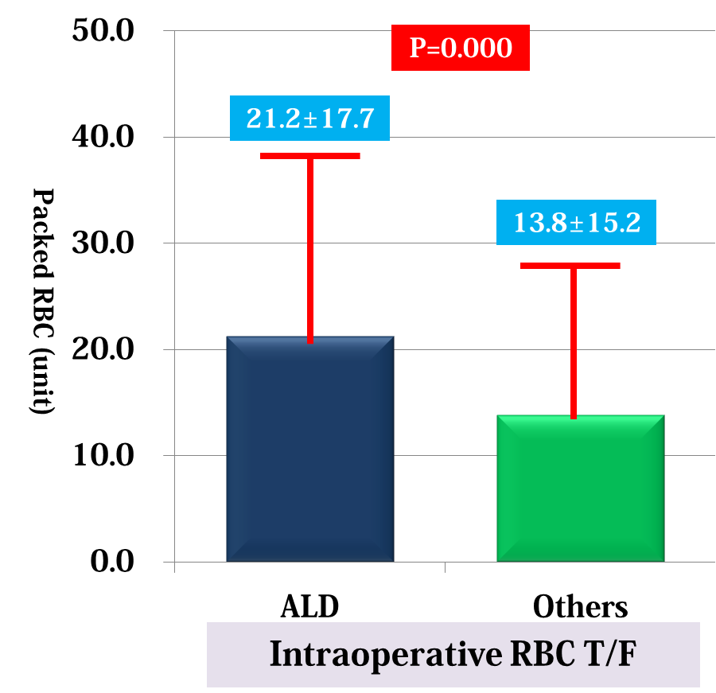
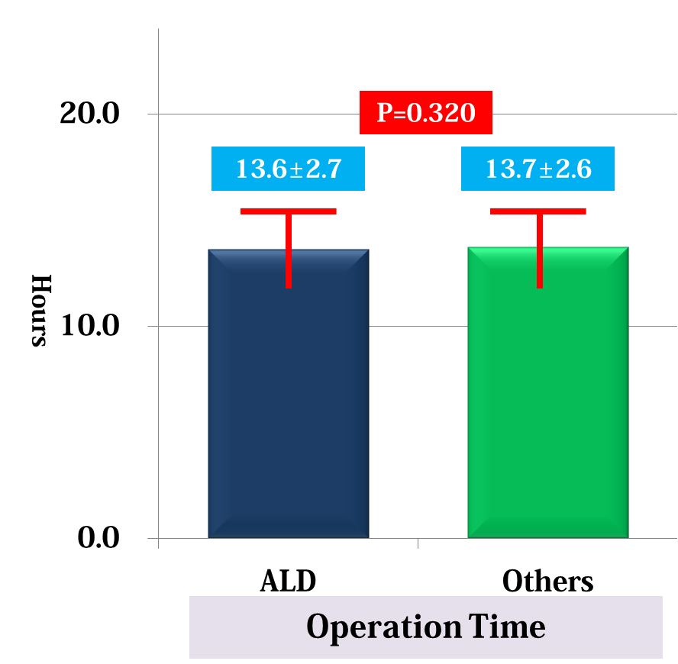
Operative Issues in LT for ALD

Slide 40
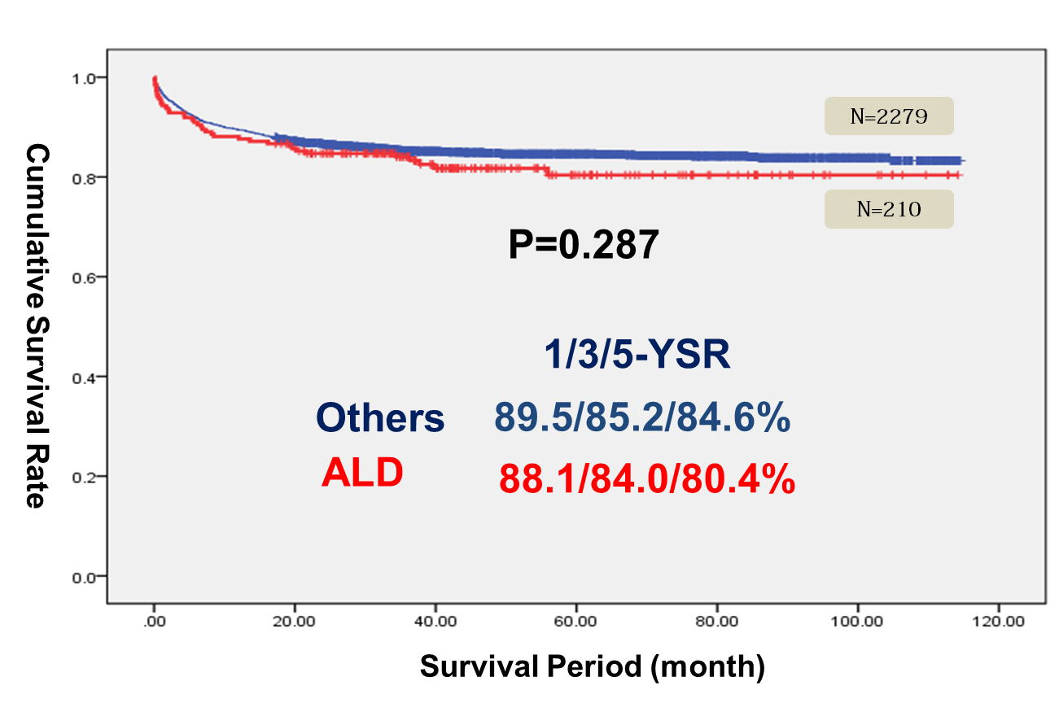

Survival Outcome of LT for ALD at AMC
Patient Survival Rate
Graft Survival Rate

Slide 41
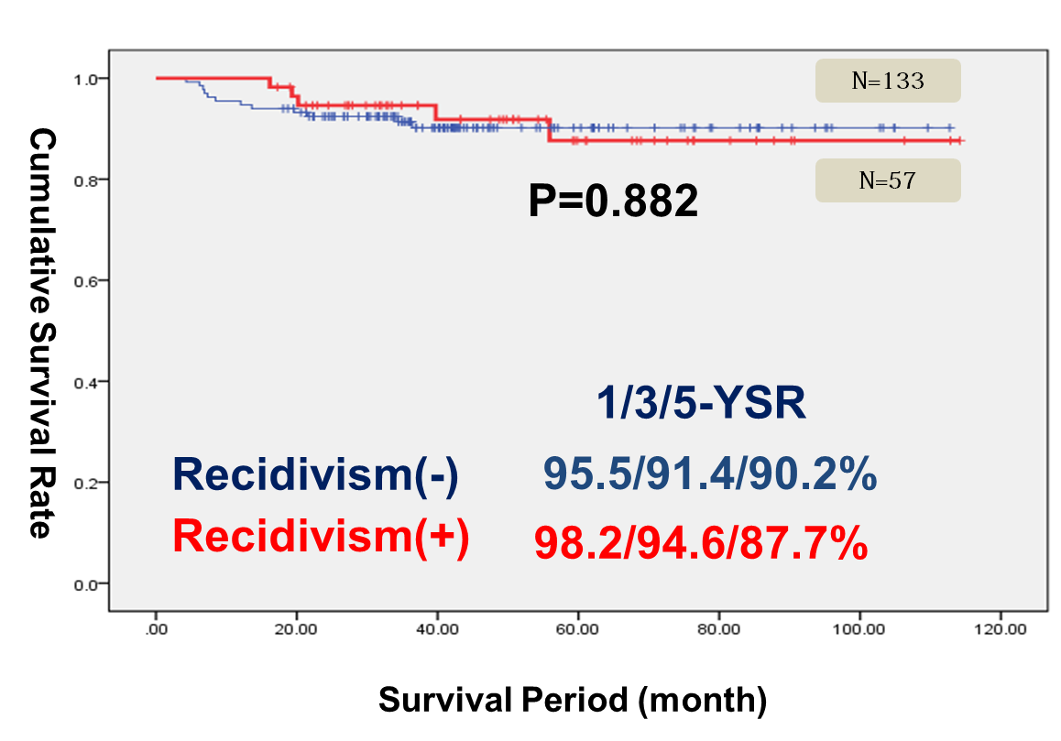
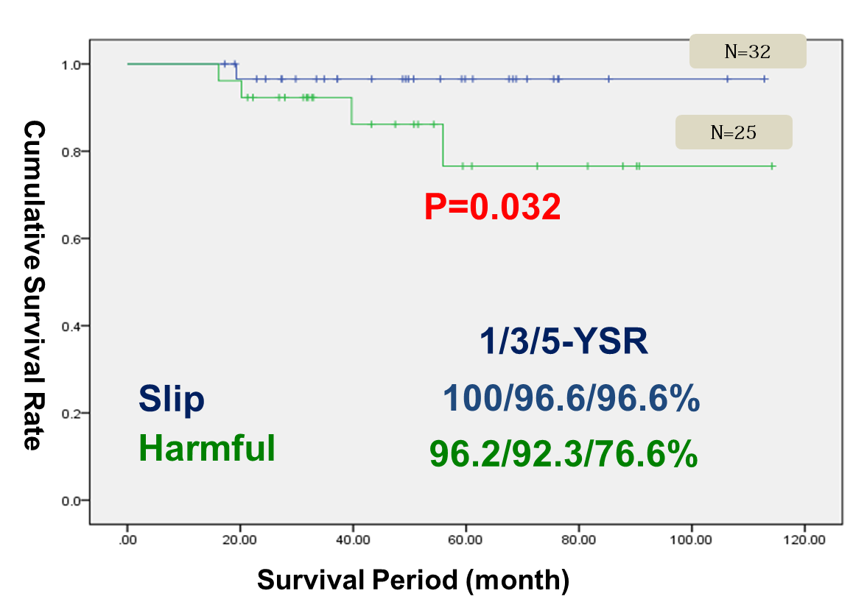
Survival According to Relapse of Alcohol Abuse

Slide 42
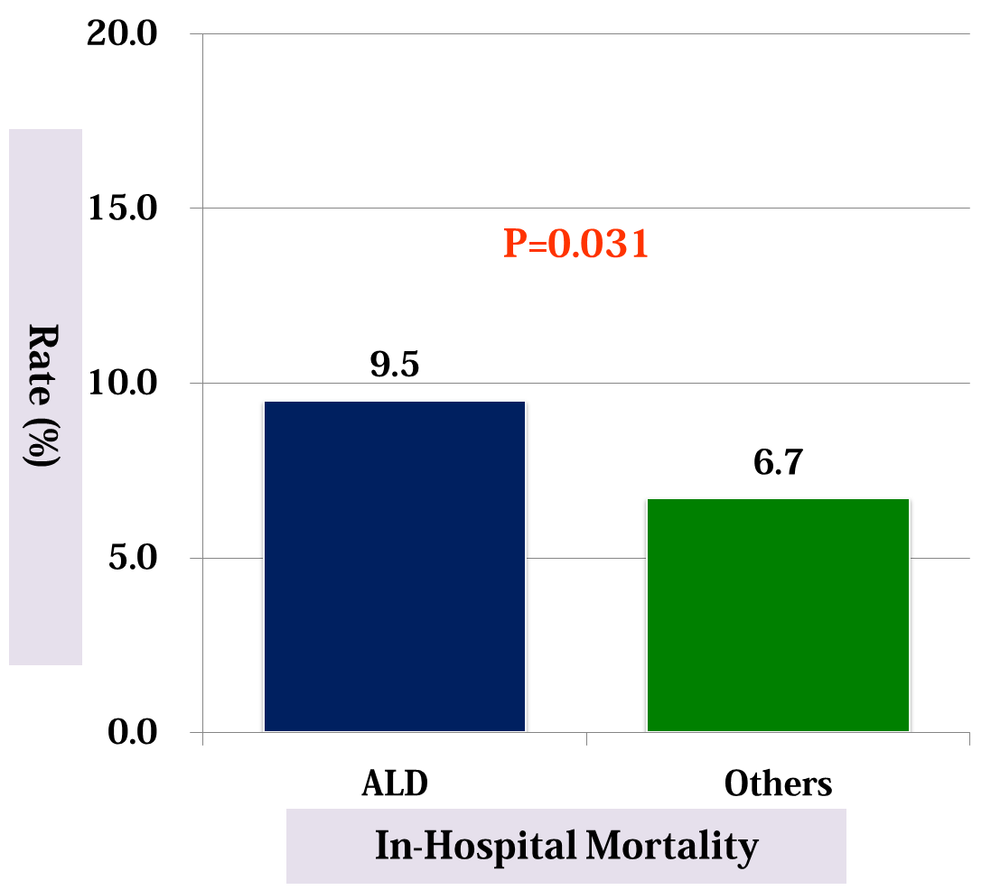
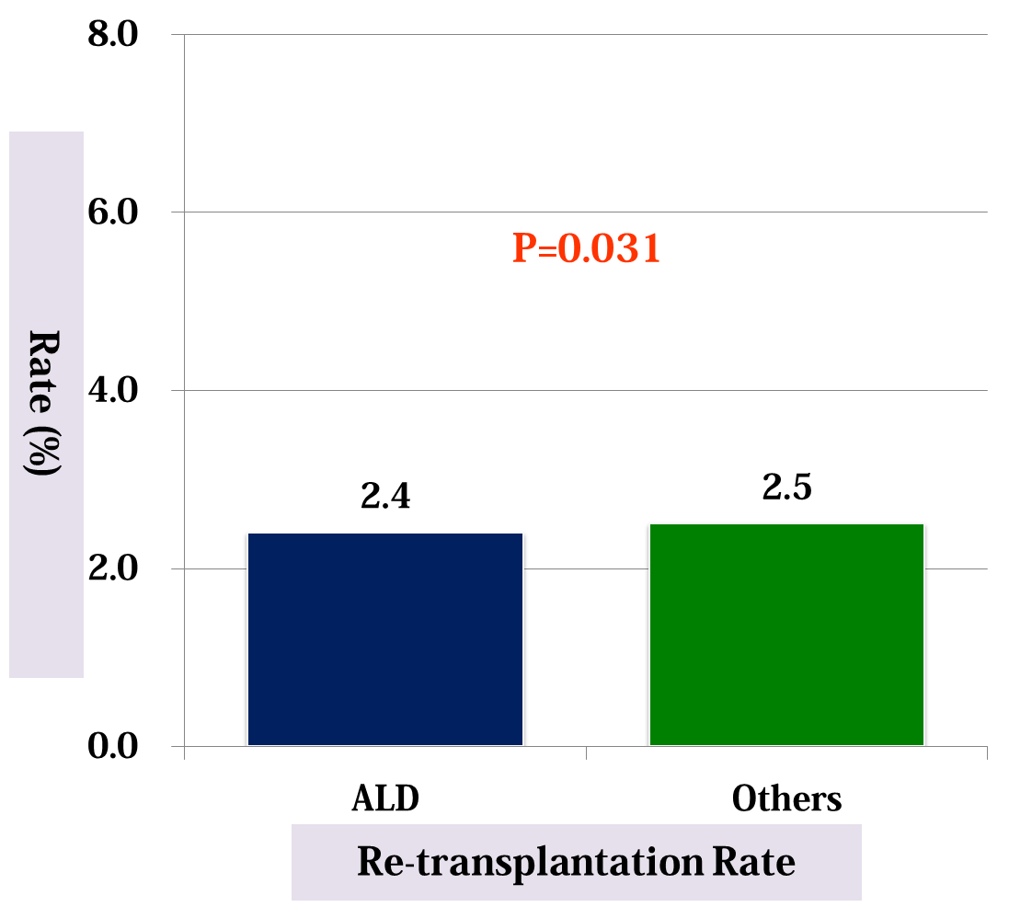
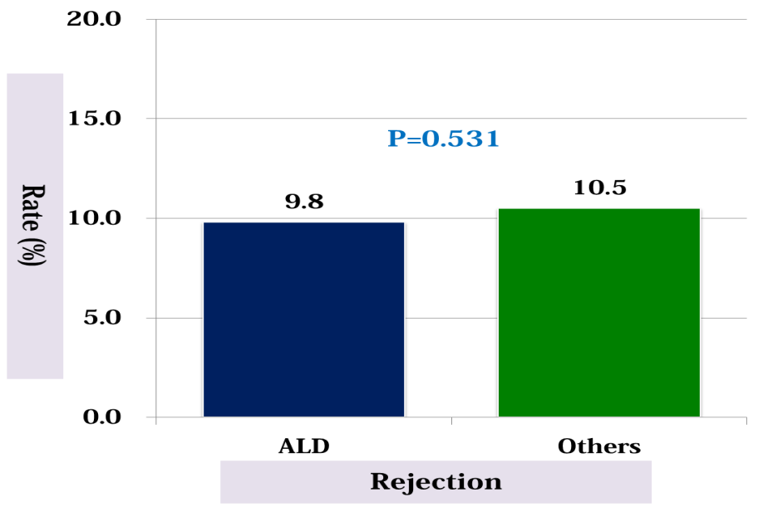
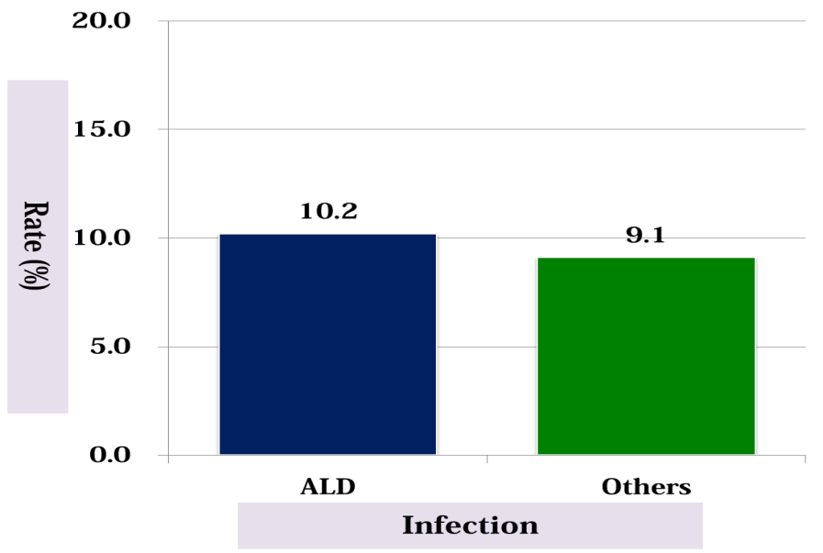
Survival Outcome of LT for ALD at AMC
P=0.091
P=0.361
P=0.531
P=0.478
Noncompliance-related ACR or CR in 6 patients (4 in relapsed Pts)
Alc-related graft loss or near-loss in 5 patients (4 in relapsed patients)
2 De novo malignancies (AGC/Pancreas CA)

Slide 43
Summary and Conclusion
Patients with ALD undergoing liver transplantation have a similar survival benefit to recipients of a liver transplant who do not have ALD.
De novo tumors, cardiovascular events, and social causes are the main causes of death in patients transplanted for ALD.
Liver transplantation for refractory severe acute alcoholic hepatitis is a life-saving intervention and should be judiciously employed in highly selected individuals who are at low risk of recidivism.
Alcohol relapse may lead to liver damage and increased mortality, albeit usually after many years of renewed drinking.

Slide 44
Summary and Conclusion
ALD is one of important indication for LT in Korea. (may be 3rd and about 10% of all cause)
The recidivism after LDLT is not fully affected by pre-LT alcohol consumption pattern, but, affected by more complicated psychosocial factors. To decrease relapse, systematic multidisciplinary professional support is necessary.
Although the use of LT for ALD is increasing, alcohol relapse after LT is not yet widely recognized in Korean society. Therefore, we need further study to establish the guideline of LT for ALD.

Slide 45

Thanks !!

